Slide 1
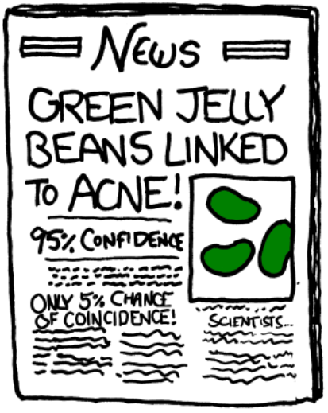
Harper Adams R Users Group
(HARUp)
Ed Harris
2019.11.20
R programming
(Plus some other HARUp! business)

Slide 2
What do we want to accomplish today?
www.operorgenetic.com/wp
Click “HARUp!” tab

Slide 3
What do we want to accomplish today?
- Intro to R programming resources activity
- Future topics / stats / etc.
- Website and logo
- Future of HARUp! (topics, attendees, etc.)

Slide 4
Intro to R programming resources activity
R programming primer group comparison activity
Guru 99,
Venables An Introduction to R,
Burns R Inferno,
Ed’s Tutorial,
Swirl,
optional: Datacamp

Slide 5
Future topics / stats / etc.
Working through a book together in R?
A "stats course"
Some special topics
What do you think / what do you want to do?

Slide 6
Website and logo
http://operorgenetic.com/wp/?page_id=519 Ed's
https://harug.netlify.com/ Joe's

Slide 7
Future of HARUp! (topics, attendees, etc.)
Email Ed or say it now!
Need some volunteers, at least one per week?
Stats challenge, item of interest, critical help, something cool,
Etc.

Slide 8
HA
Up!

