Slide 1
Harper Adams R Users Group
(HARUG!)
2019.12.11
1:10p - 3pm
Room WG4
Ed HARUG! :: http://operorgenetic.com/wp/?page_id=519
Joe HARUG! :: https://harug.netlify.com/
HARUG! Slack site :: https://harper-adams-rug.slack.com/

Slide 2
Today
-Talk: R MotivatorTM (Joe Roberts)
-Quick stats: simple ANOVA in R
-Tool tip: Jamovi
-Seasonal: R code advent calendar!

Slide 3
-Talk: R MotivatorTM (Joe Roberts)

Slide 4
-Quick stats: simple ANOVA in R
https://bookdown.org/ndphillips/YaRrr/
Good, (if irreverent) basic R and intro stats book
Free and open source
We will do sections 14.1- 14.3

Slide 5
-Quick stats: simple ANOVA in R
What is ANOVA?

Slide 6
-Quick stats: simple ANOVA in R
Steps for data analysis
01 Explore your data
02 Graph your data (matching experimental design)
03 Test assumptions
04 Evaluate hypotheses (primary, …secondary)
05 Perform and communicate results

Slide 7
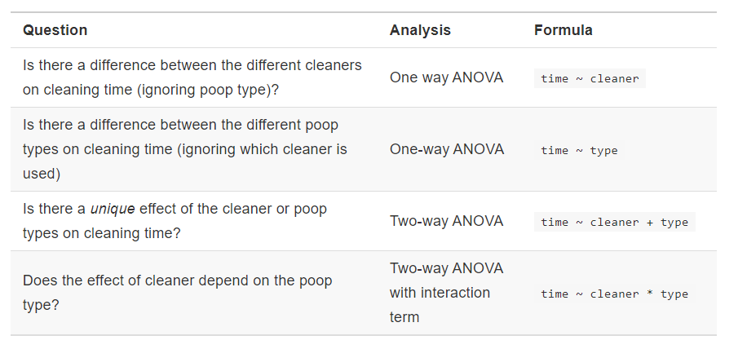
Possible questions
(statistical formula special mention)

Slide 8
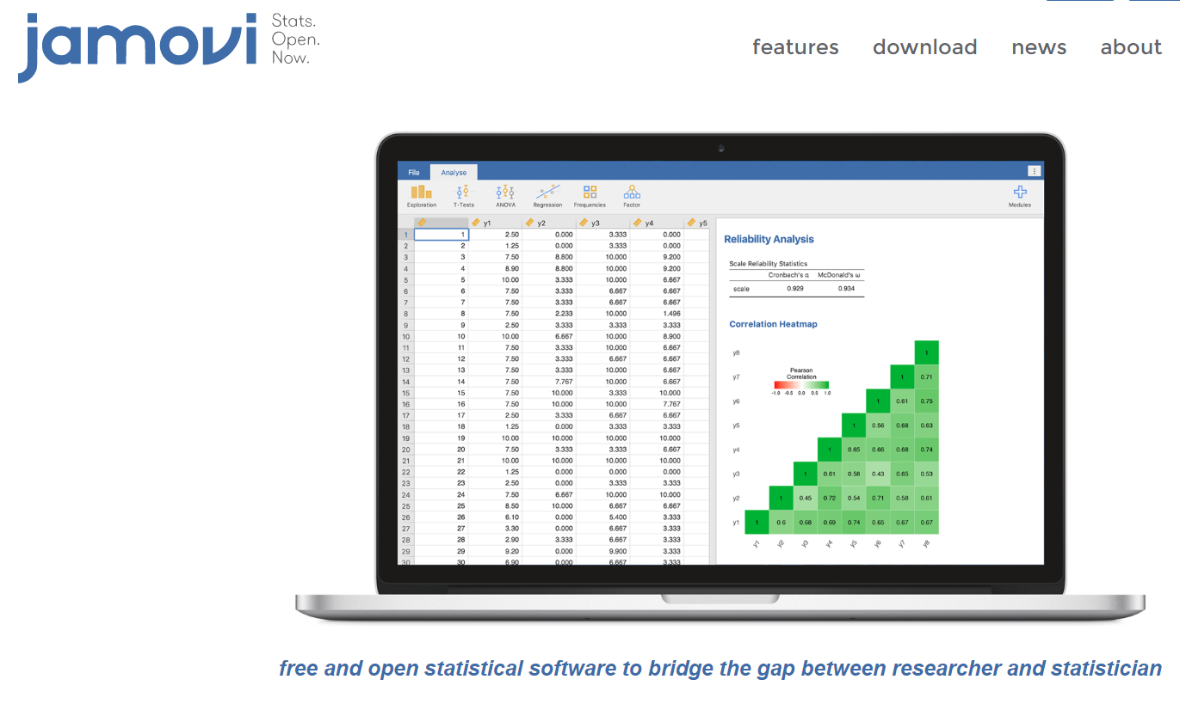
-Tool tip: Jamovi.org

Slide 9
-Tool tip: Jamovi.org
Built on R engine (under the hood)
-easier to learn than, e.g. SPSS, Genstat
-free, open source, reproducible workflow
-free, platform specific textbook and videos
https://www.jamovi.org/user-manual.html
https://blog.jamovi.org/2018/10/25/learning-statistics-with-jamovi.html
https://www.youtube.com/watch?v=mZomeS0tLxY
-has all advantages of the R universe; none of the disadvantages of SPSS, Genstat, etc.
-I will exclusively teach with this to BSc and MSc; researchers could start here too
Vulcan brain transplant
So simple a child could do it

Slide 10
-Seasonal: R code advent calendar!
Learn R a little at a time
https://kiirstio.wixsite.com/kowen/post/the-25-days-of-christmas-an-r-advent-calendar

Slide 11
-Seasonal: R code advent calendar!
For something a little more challenging, try this in R
https://adventofcode.com/

Slide 12
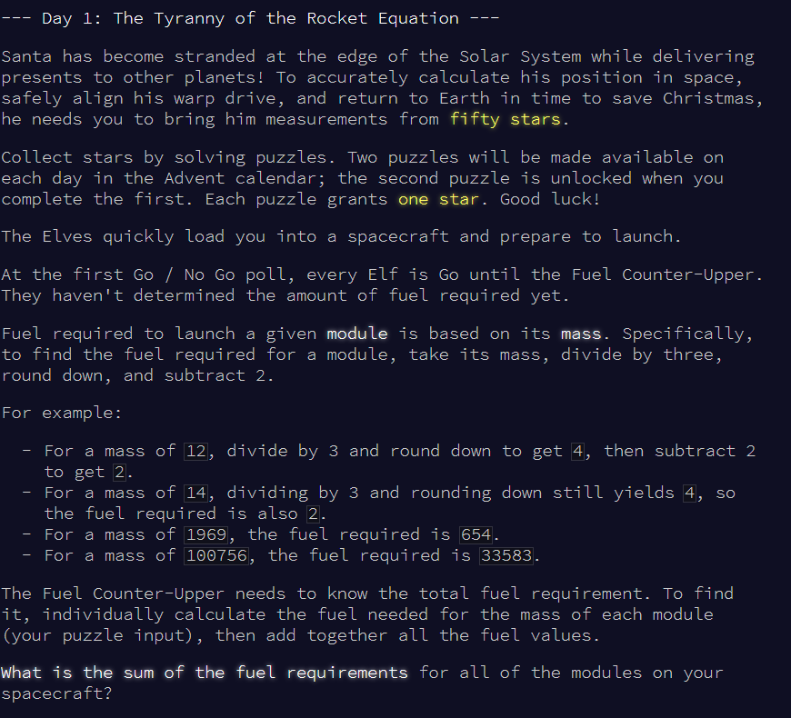
-Seasonal: R code advent calendar! Day 1

Slide 13
2020.01.15
1:10p - 3pm
Room M47
Next time:
Presentation: (Joe Blackshaw-Crosby)
Adventures with ggplot2 in R
Quick stats: {agricolae} exp design
Tool tip: ?
Ed HARUG! :: http://operorgenetic.com/wp/?page_id=519
Joe HARUG! :: https://harug.netlify.com/
HARUG! Slack site :: https://harper-adams-rug.slack.com/

