Slide 1
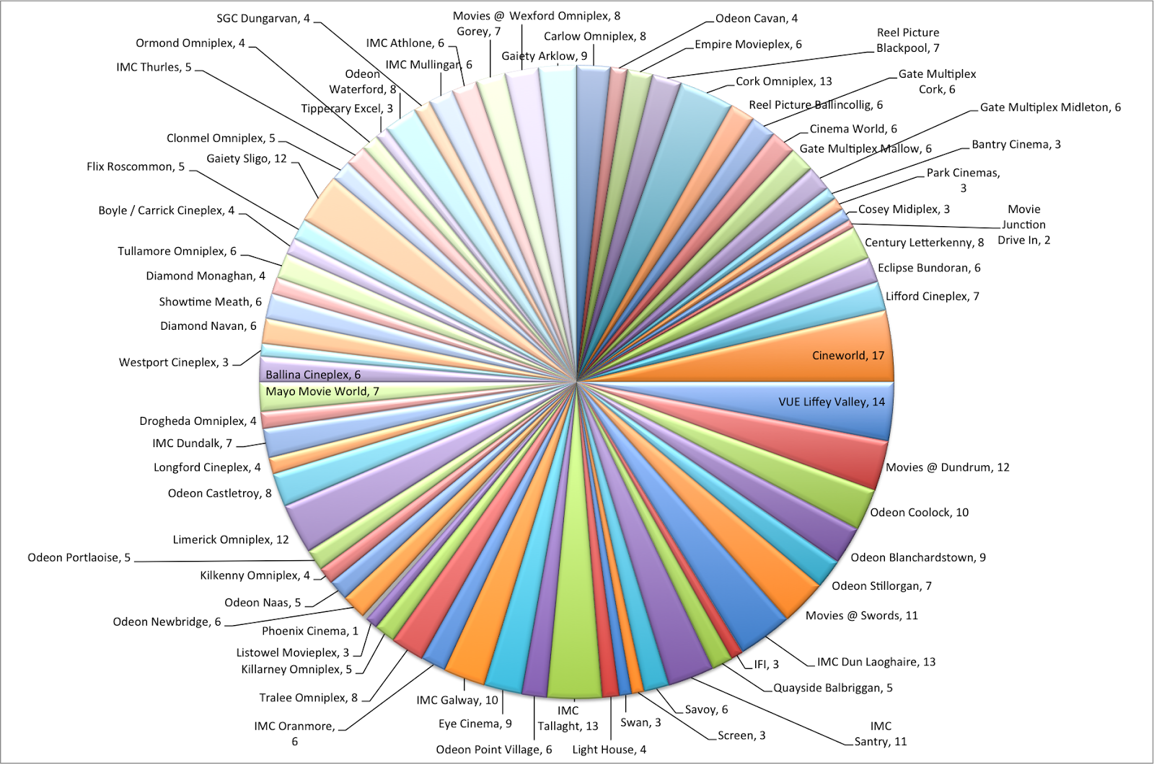
Harper Adams R Users Group (HARUG)
Ed Harris
2020.02.05
Graphing activity

Slide 2
What do we want to accomplish today?
www.operorgenetic.com/wp > “HARUG!” tab
Slack link (also in emails)

Slide 3
What do we want to accomplish today?
Graph activity
Tidy Tuesday
Book reading group: Interest? Decide first meeting.

Slide 4
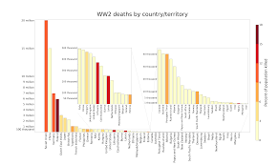
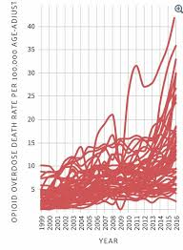
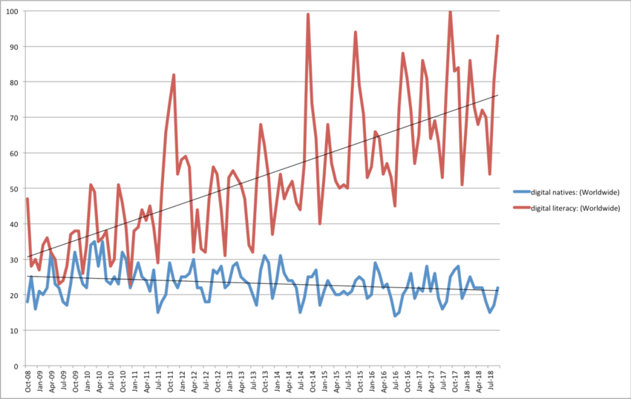
What make a good / bad graph?
https://www.reddit.com/r/shittydataisbeautiful/
https://www.reddit.com/r/dataisugly/
https://www.reddit.com/r/dataisbeautiful/comments/3y2zbh/the_most_misleading_charts_of_2015_fixed/

Slide 5
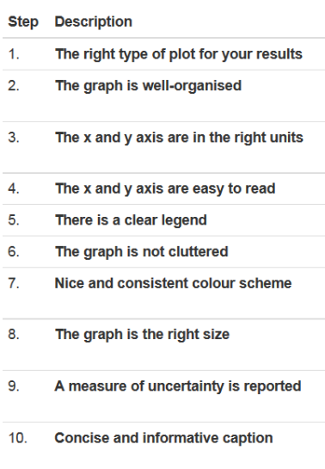
What make a good / bad graph?
https://ourcodingclub.github.io/2017/01/29/datavis.html
- use of colour if it "adds value"
- does graph represent any statistical results?
- variation is shown explicitly (if raw data are not present -
e.g. error bars)

Slide 6
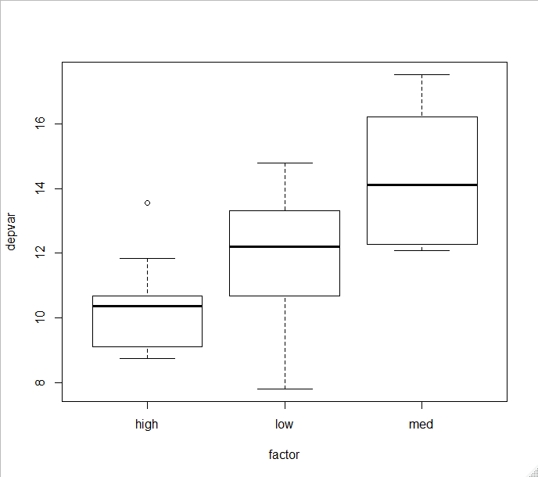
Can this graph be better?

Slide 7
Make it better with anovaDat and boxplot()?

Slide 8
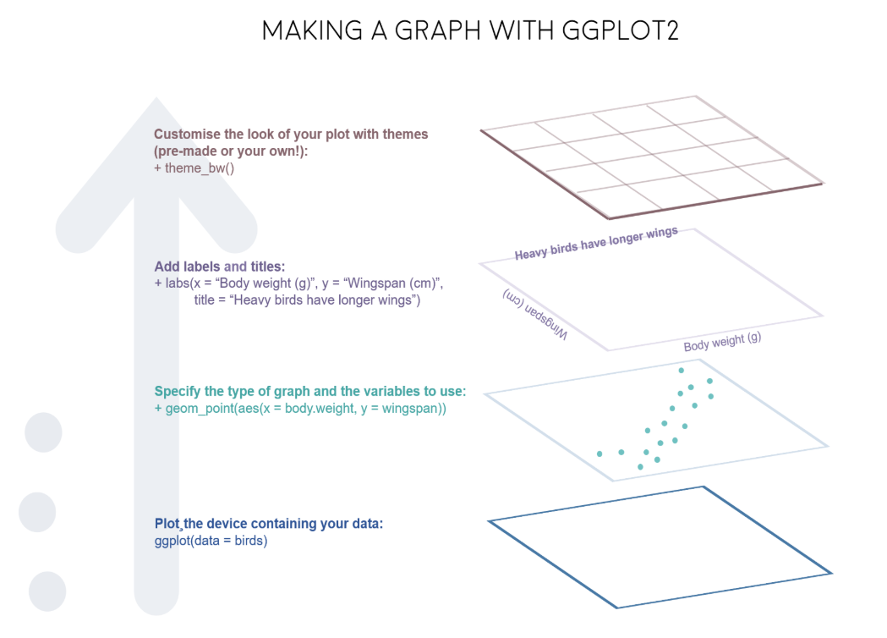
Graph features in R
"Layering" design of graphs in R (both base and ggplot2)
- Concept of layers
abline() adds straight lines
points() adds points
arrows() adds lines with arrow or "whisker" tips
axis() draws axis
text(), legend(), plot(), boxplot(),
barplot(), etc.

Slide 9
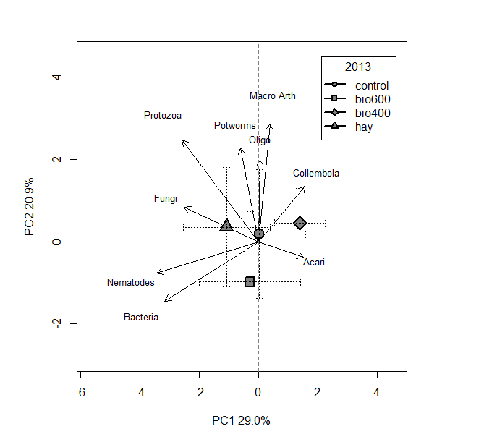
Graph challenge: recreate this plot
(as closely as you can)

Slide 10
Tidy Tuesday
TidyTuesday.R(.txt)
https://github.com/rfordatascience/tidytuesday

Slide 11
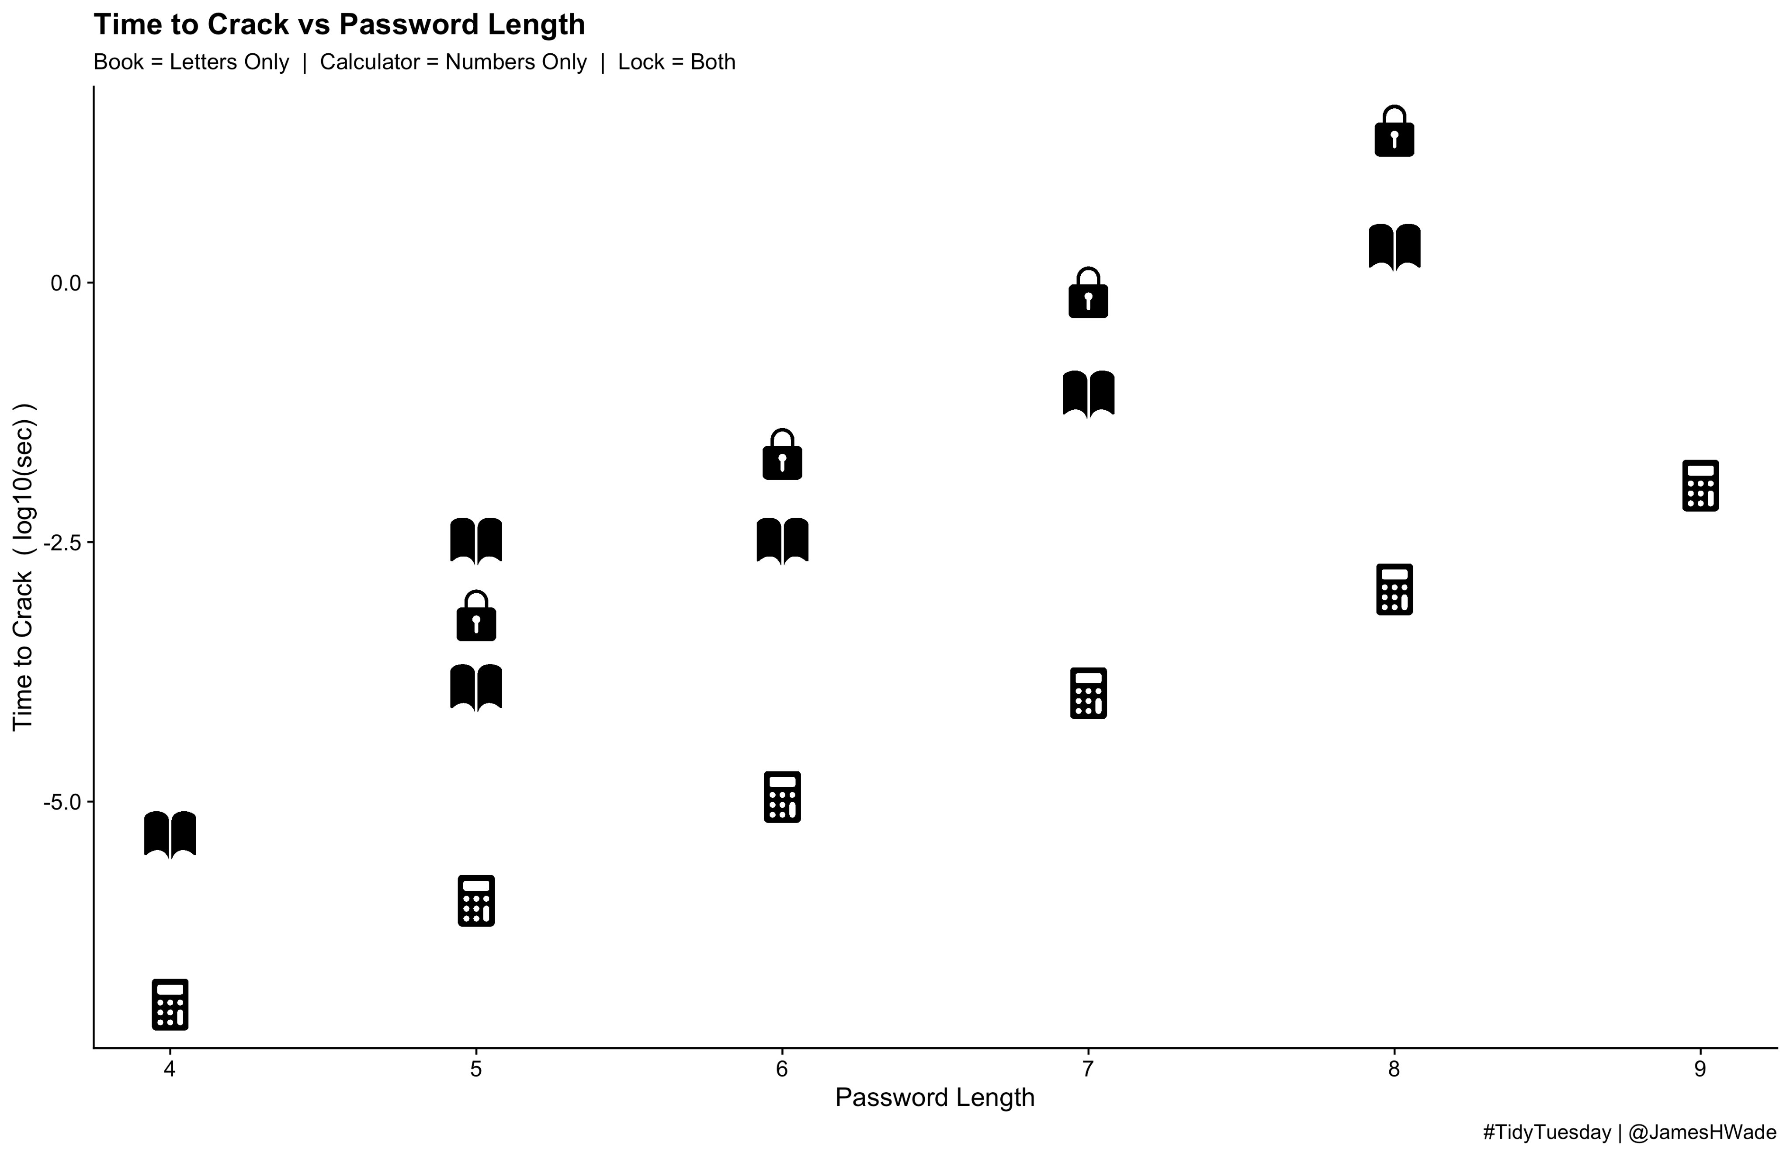
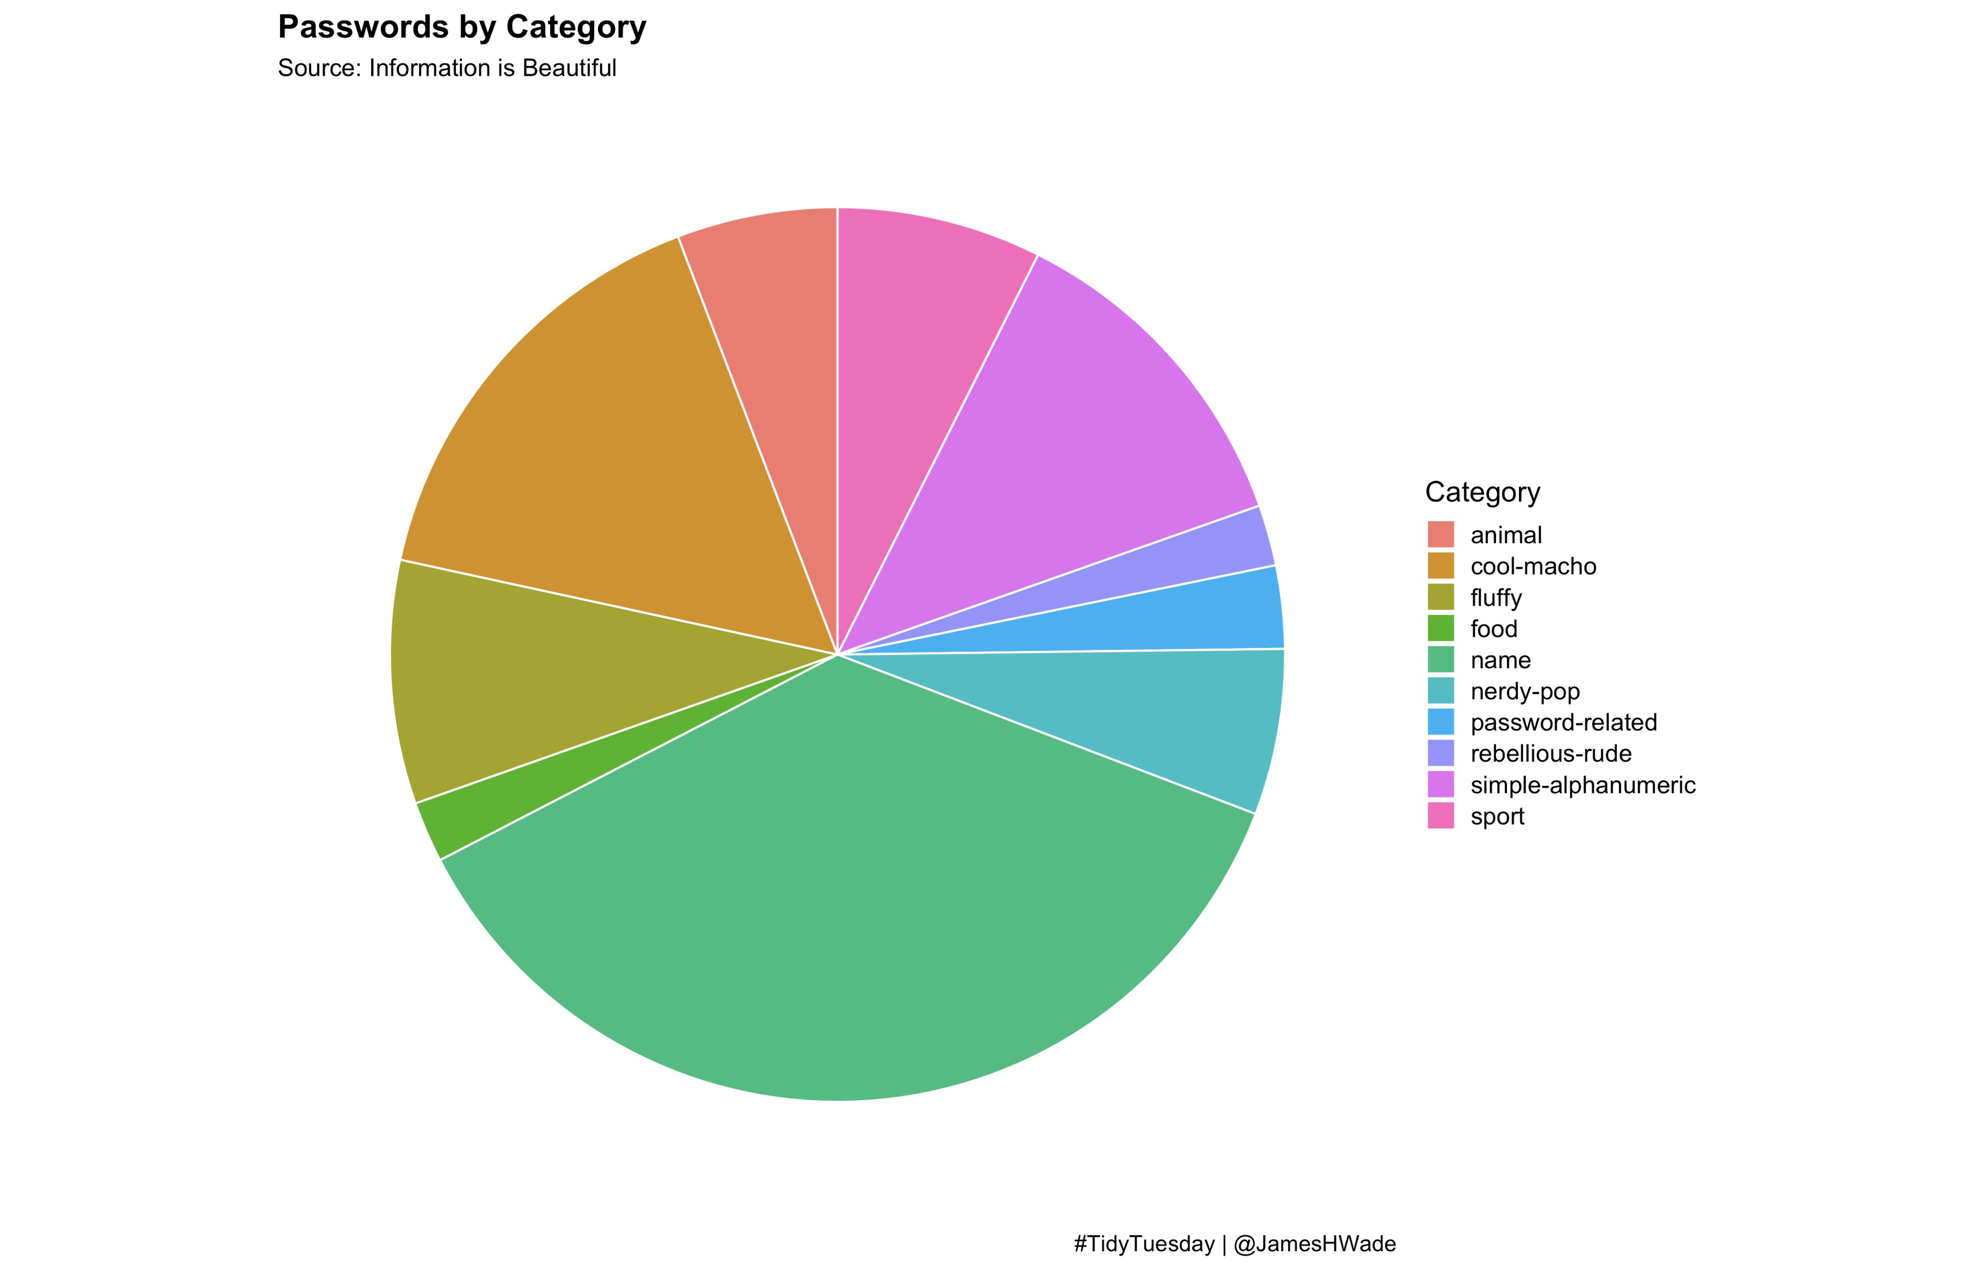
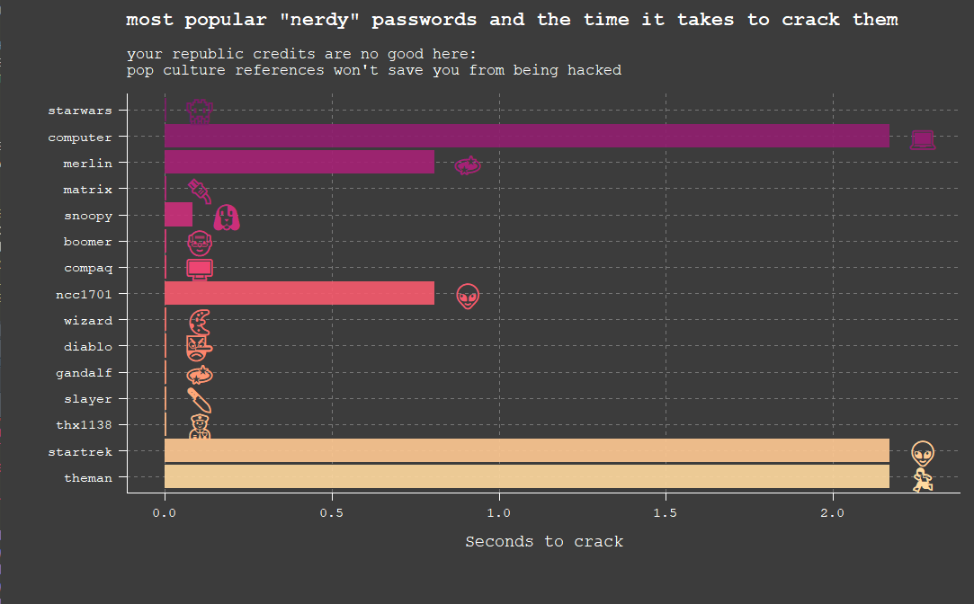
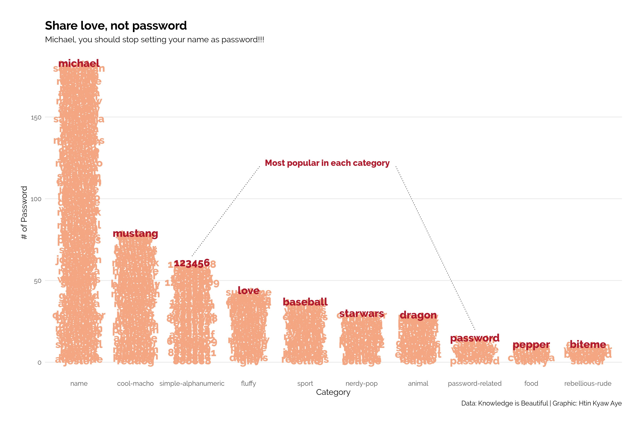
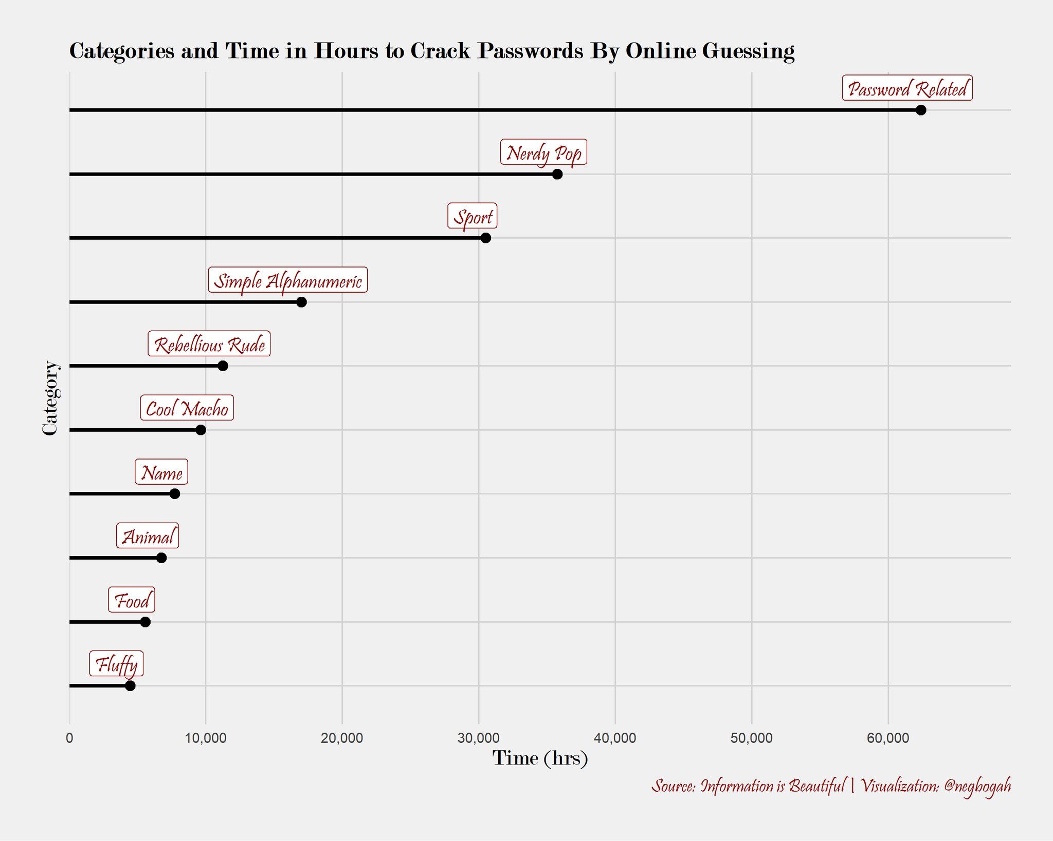
Tidy Tuesday
#TidyTuesday on Twitter

Slide 12
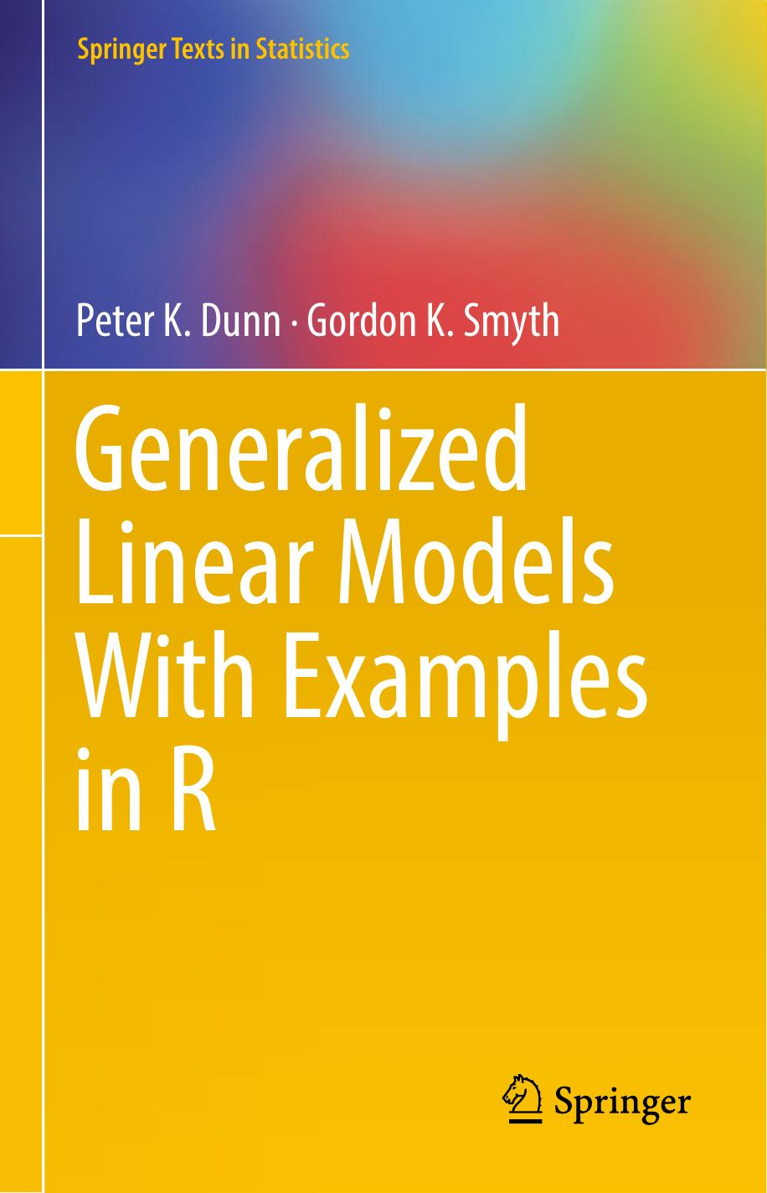
Stats book reading: GLM in R
Dunn, P.K., Smyth, G.K., 2018.
Generalized Linear Models With Examples in R. Springer.
Chapter 01 is on website - up to you to obtain your
own copy after ch01.
Propose Thursdays 3:30-5pm, starting Feb 13th. Discuss.

Slide 13
HA
Up!

