Slide 1
Can we count the number of potato stems in a field at full canopy?

Slide 2
Timing and type of aerial imagery for stem number quantification
Question
Which vegetation indices can help quantify stem number variability?

Slide 3
Methods
Identification of potential vegetation indices from literature
Excess Green
Excess Blue
Redness
Excess Red
Excess Green minus Excess Red
Colour Index for Vegetation Extraction

Slide 4
Green-Blue & Red-Blue Differences

Slide 5
Comparing indices
Two custom indices were developed based on Blue differences
Cumulative Blue Differences Index (CBDI)
Blue Difference Normalized Index (BDNI)
All indices were compared for their performance in canopy feature classification

Slide 6
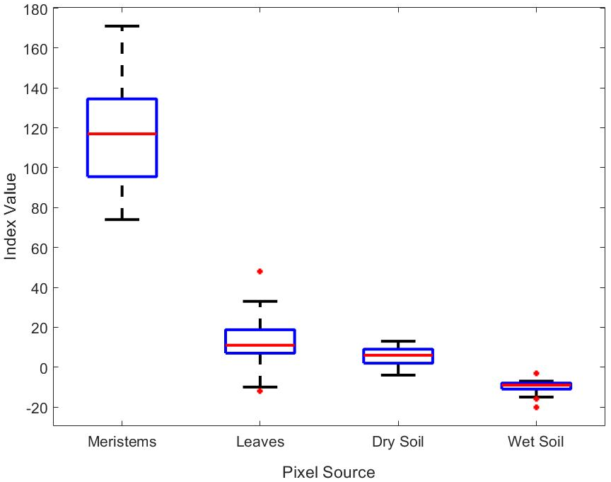
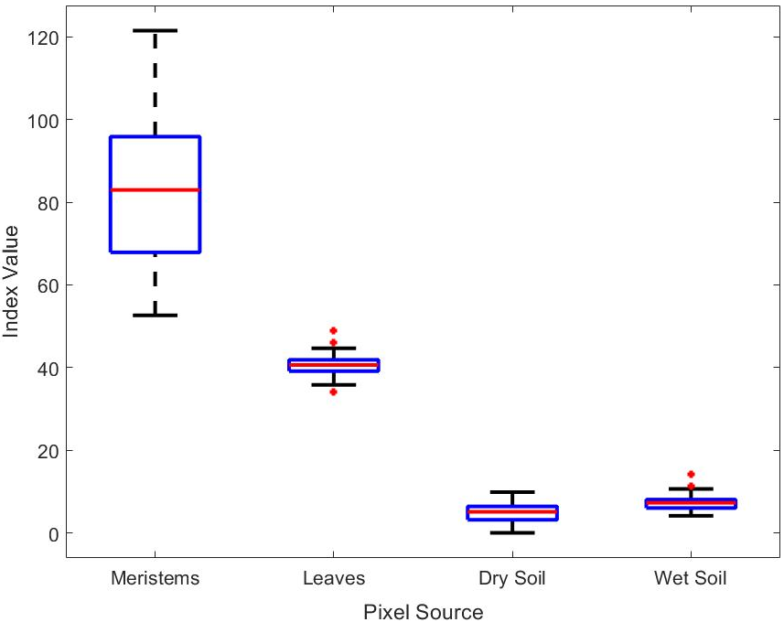
CBDI BDNI

Slide 7
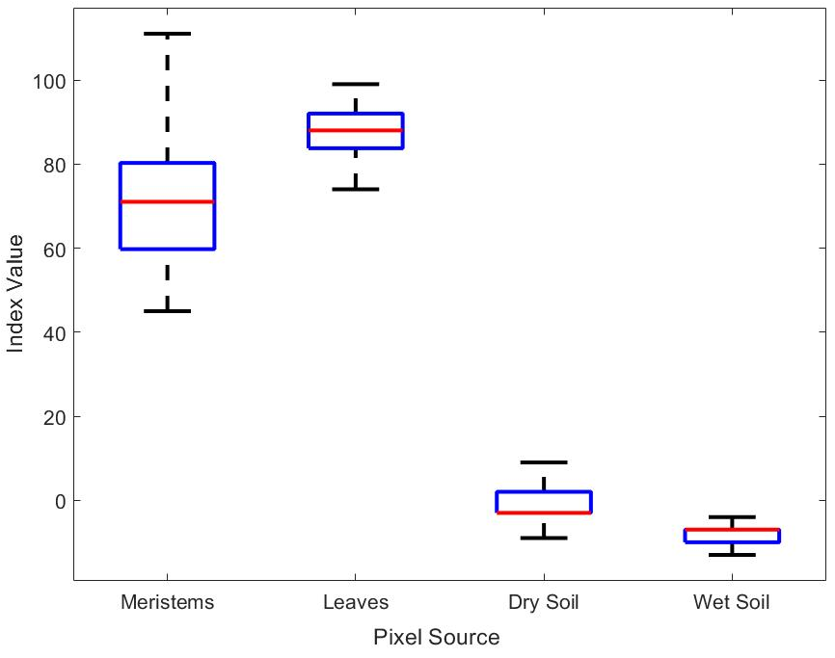
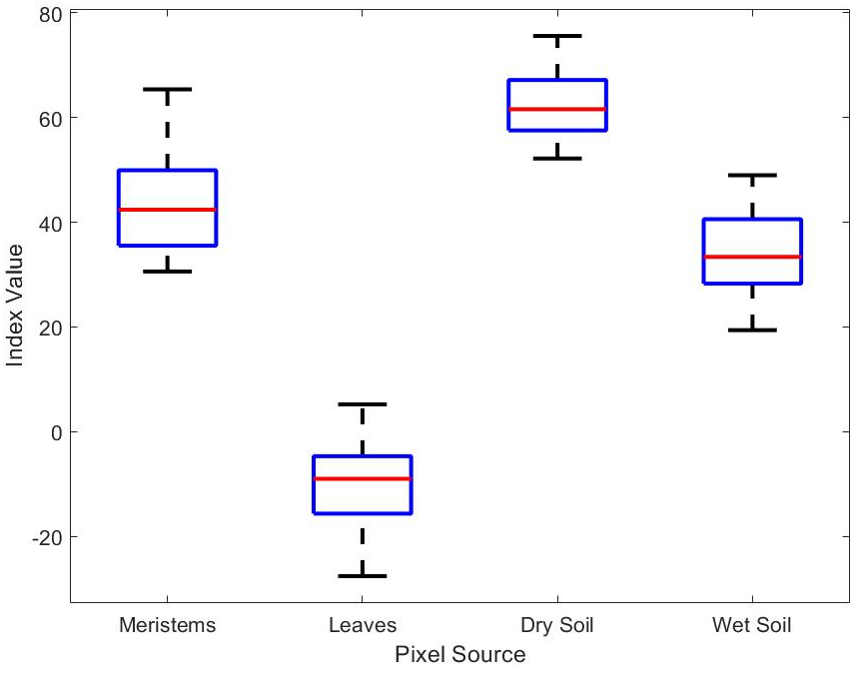
Excess Green Excess Red

Slide 8
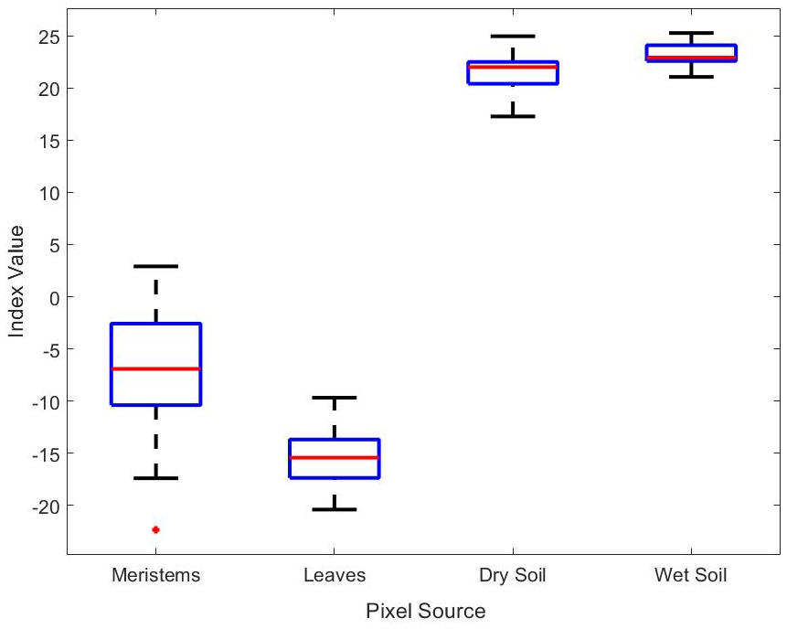
Excess Blue CIVE

Slide 9
Mean Separation
Feature | CBDI | ExG | Redness | ExR | ExB | ExG-ExR | CIVE | BDNI
Meristem | 115.59ª | 70.22^{b} | -0.032^{b} | 42.98^{b} | -32.13^{d} | 27.24^{b} | -6.67^{c} | 82.06ª
Mature Leaf | 12.27^{b} | 87.78ª | -0.197^{c} | -9.73^{d} | 19.79^{c} | 97.50ª | -15.56^{d} | 40.32^{b}
Dry Soil | 5.24^{c} | -1.63^{d} | 0.009ª | 62.65ª | 39.07^{b} | -64.28^{d} | 21.78^{b} | 7.42^{c}
Wet Soil | -10^{d} | -8.31^{c} | 0.013ª | 33.61^{c} | 56.99ª | 41.91^{c} | 23.25ª | 4.85^{c}
Minimum | -20.00 | -13.00 | -0.26 | -27.60 | -63.60 | -83.60 | -22.35 | 0.00
Maximum | 171.00 | 111.00 | 0.03 | 75.60 | 70.00 | 121.40 | 25.25 | 121.51
Meristems to leaf separation** | 0.14 | -0.29 | 0.27 | 0.25 | 0.01 | 0.01 | -0.27 | 0.03

Slide 10
Timing and type of aerial imagery for stem number quantification
Question 2.
To what extent can these indices be practically implemented?
Value of the derived vegetation indices for yield dig area selection

Slide 11
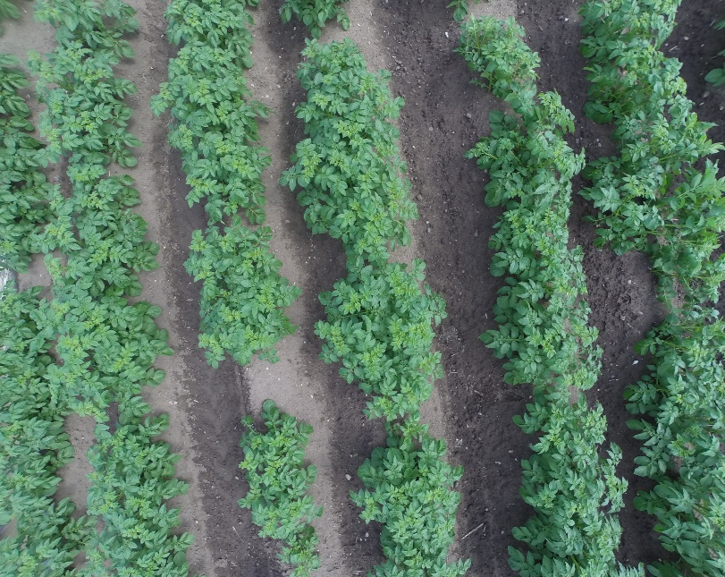
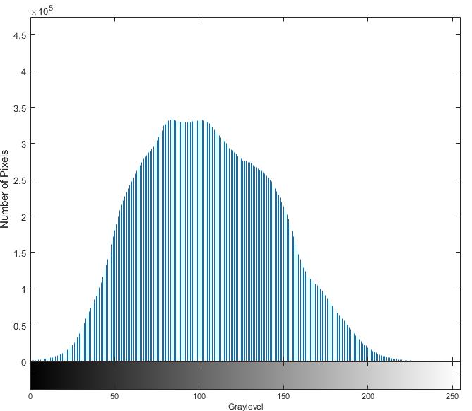
Normal histogram shows no obvious separation between image features
Soil
Histogram produced after application of vegetation index shows valleys representing different image features
leaves
stems

Slide 12
CBDI and BDNI were used to create an algorithm for segmenting canopy images into stems and non-stems then enumerate the stems
The algorithm was tested on a 48 variety trial
36 out of 48 varieties were used after
Removing edge plots where pixels were distorted during image collection
Removing failed stands

Slide 13
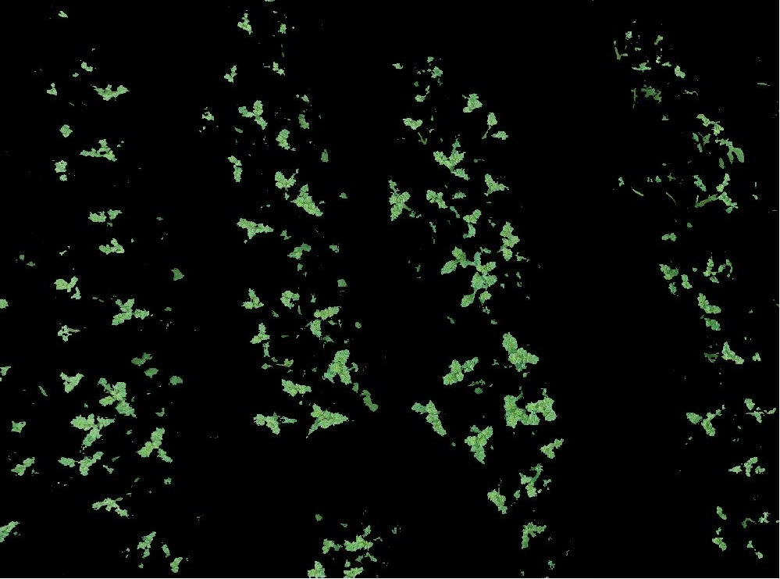
Raw Results after Thresholding

Slide 14
Stem Counting Algorithm Results
Breeder | Mean Number of Above Ground Stems | Number of Above Ground Stems per Plant | Mean Number of Meristems | Number of Meristems per plant | CBDI Prediction | BDNI Prediction
Agrico | 146.6 | 3.67 | 95.6 | 2.39 | 97.6 | 86.2
Branston | 110 | 2.75 | 78.5 | 1.96 | 80.5 | 70.5
Greenvale | 177 | 4.43 | 124 | 3.1 | 117 | 105
Higgind Group | 174 | 4.35 | 116 | 2.9 | 125 | 113
HZPC | 159.18 | 3.98 | 102 | 2.55 | 100.18 | 83.36
IPM | 150 | 3.75 | 93 | 2.33 | 90 | 86
McCains | 118 | 2.95 | 75 | 1.88 | 40 | 19
Meijer | 191 | 4.78 | 102.5 | 2.56 | 107 | 65
Unknown | 155.2 | 3.88 | 101.6 | 2.54 | 101 | 92.8
Grand Mean | 154.52 | 3.84 | 99.24 | 2.47 | 98 | 82.97
nRMSE_{Stems} |  | 0.4 |  |  | 0.42 | 0.52
nRMSE_{Meristems} |  |  |  |  | 0.11 | 0.23

Slide 15
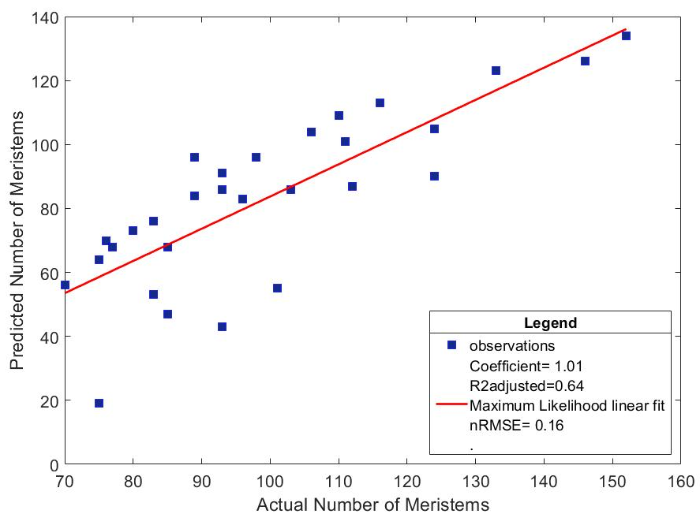
Prediction vs Actual Plots - Meristems
CBDI BDNI

Slide 16
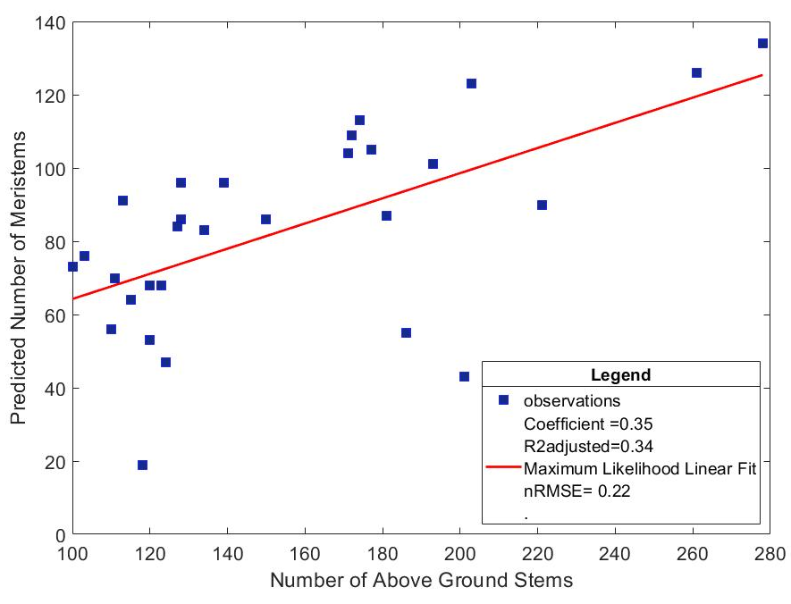
Predicted vs Actual Plots – Above Ground Stems
CBDI BDNI

Slide 17
Predicted vs Actual Plots – Meristems to Above Ground Stems

Slide 18
Improvement of image processing algorithm
We combined vegetation indices with a decorrelation algorithm based on principal component analysis to improve the separation between stems and leaves.
The main purpose of this further processing is to produce a better quality filter for image labelling and subsequent training of a deep learning network
Original image Grayscale Veg Index applied PCA processing applied

Slide 19
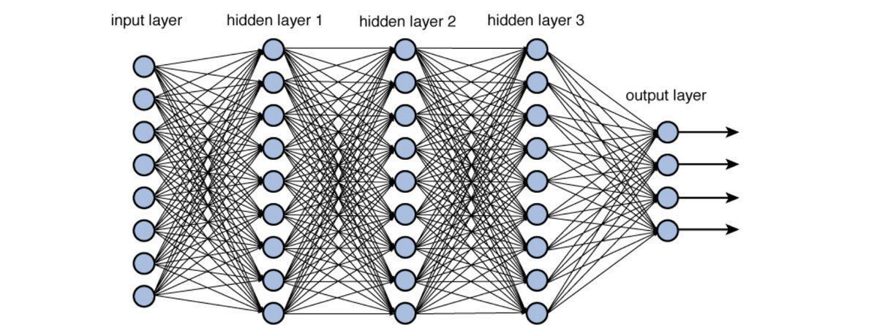
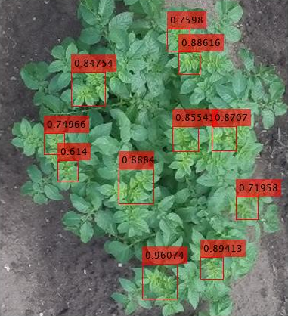
Deep Learning Approach
Faster RCNN with VGG16

Slide 20
Deep Learning Results
Deep Learning ➔
88 stems
Actual = 87 stems
Image Analysis ➔
94 stems

Slide 21
Conclusions
The BDNI and CBDI provide adequate distinction between stems and non-stems needed to determine stem numbers
The potential practical use of the indices has been demonstrated
The Indices can be used to automatically label data and train accurate deep learning models

Slide 22
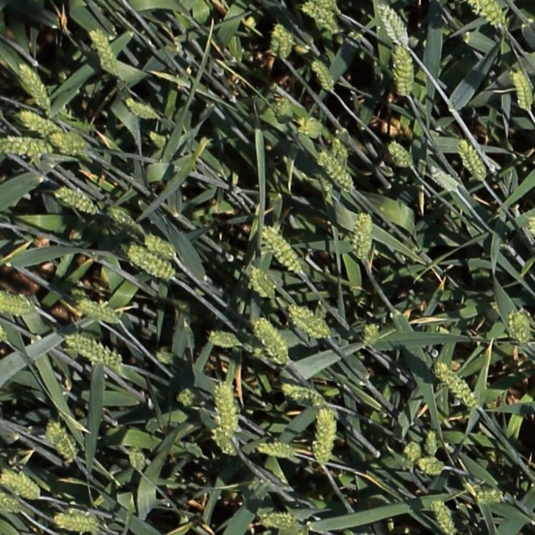
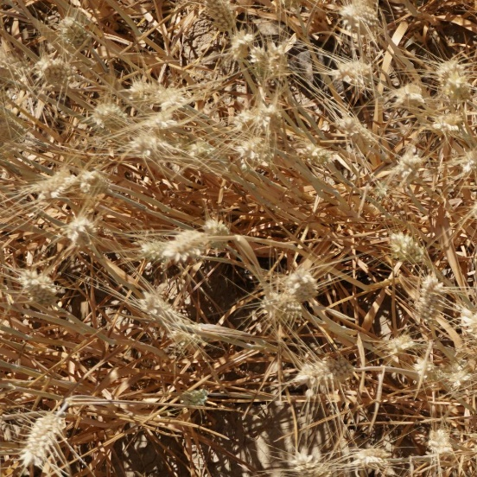
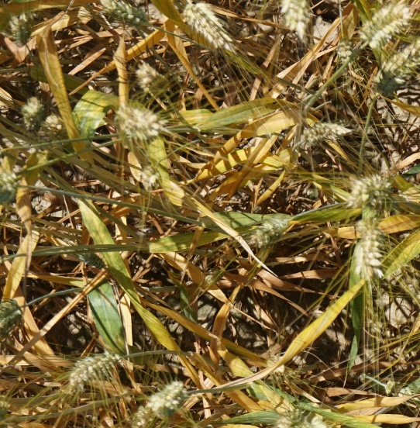
Kaggle Challenge
Machine Learning: Needs feature extraction. What common feature do the wheat ears have?
Shape Analysis: Ear orientation is erratic
Deep Learning: No successful generalized model achieved – YET

Slide 23
Current Approaches
RUNTIME REQUIREMENTS
CPU Notebook <= 9 hours run-time
GPU Notebook <= 6 hours run-time
Battle of the GPUs

Slide 24
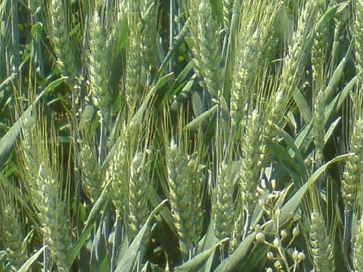
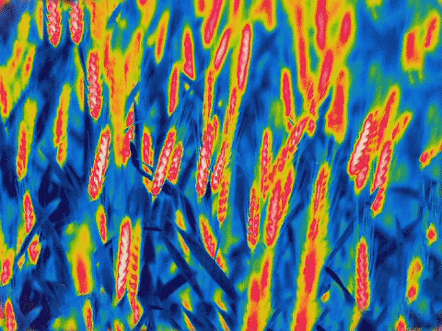
Most Promising Published Work

Slide 25
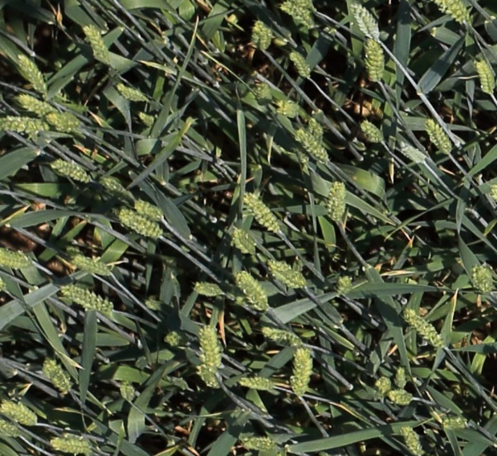
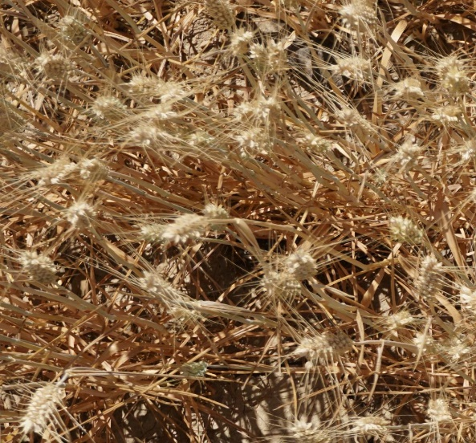
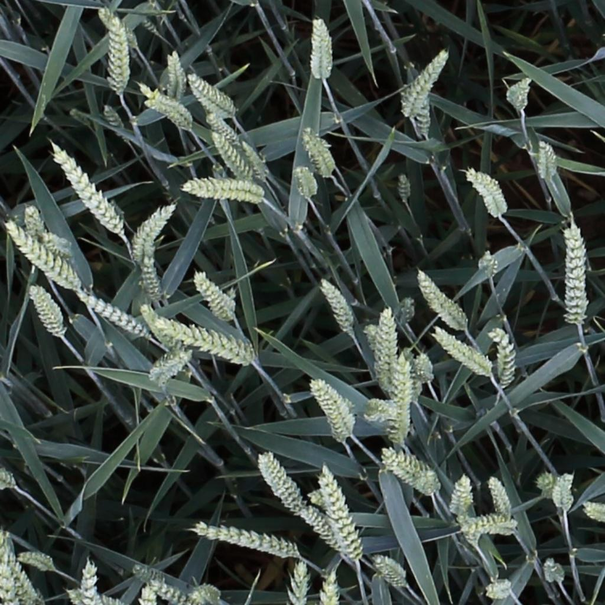
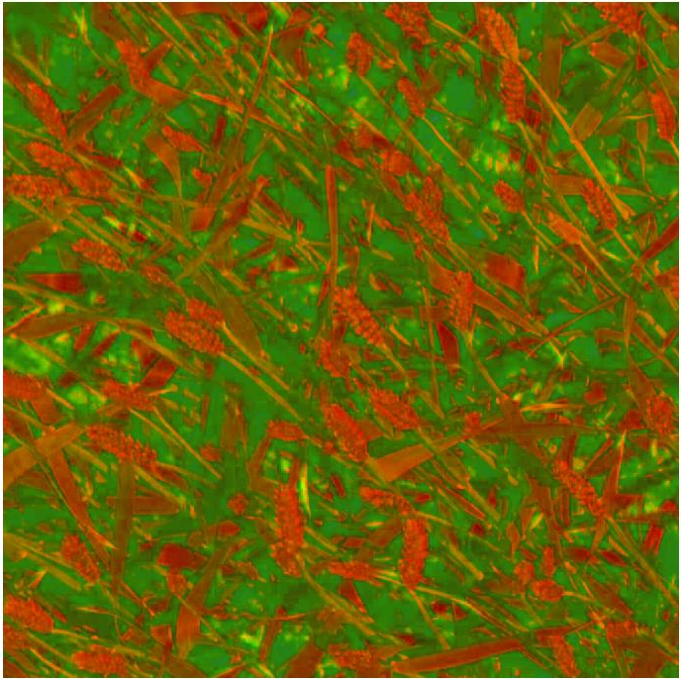
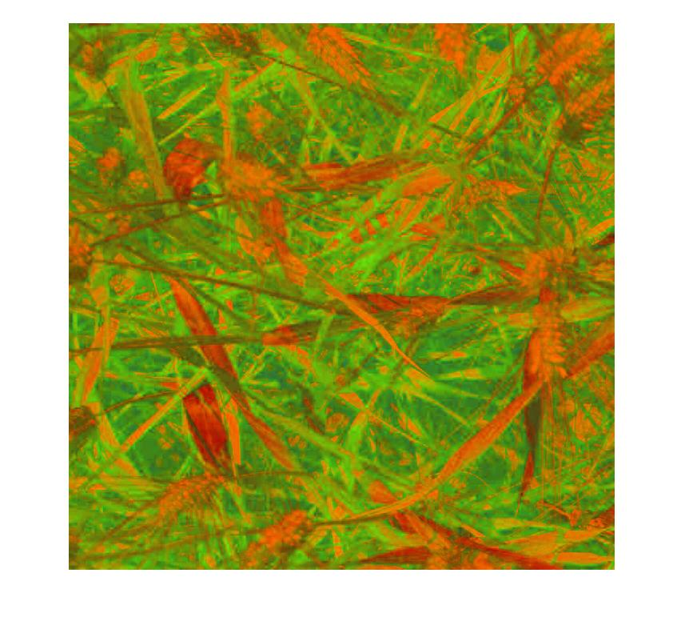
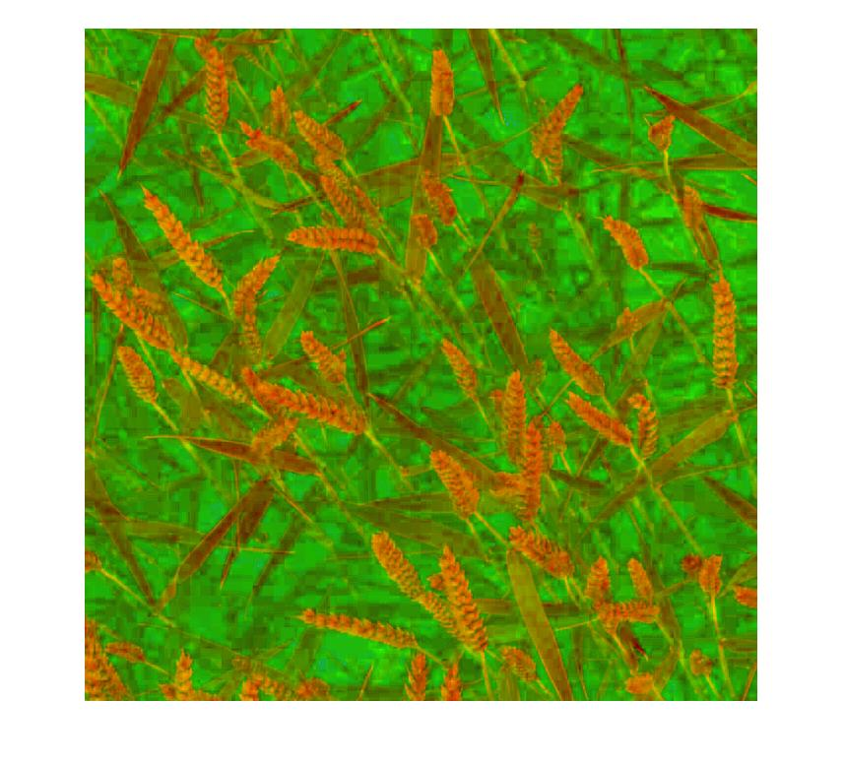
Can we do image analysis in R to mimic thermal imagery and do something similar to Grbovic et al?

