Slide 1
Zuur Ch 05 mixed effects (at last)
HARUG! QRantine edition Ed Harris

Slide 2
Chapter 05
-Outline of mixed effects idea, “nested” data -Formal intro to mixed effects, correlation structure -ML, REML… (hard stuff) -Model selection and validation -Examples

Slide 3
5.1 Introduction
RIKZ data Each sample measured spp Richness, NAP (sample height above mean tide), and a measure of Exposure 9 beaches, 5 samples in each beach

Slide 4
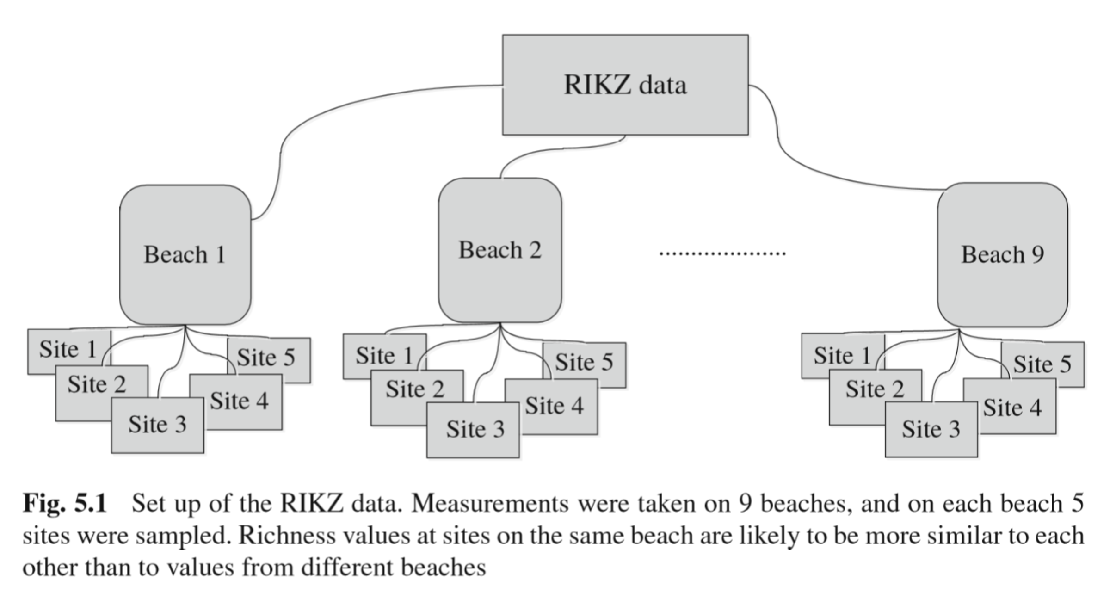
5.1 Introduction

Slide 5
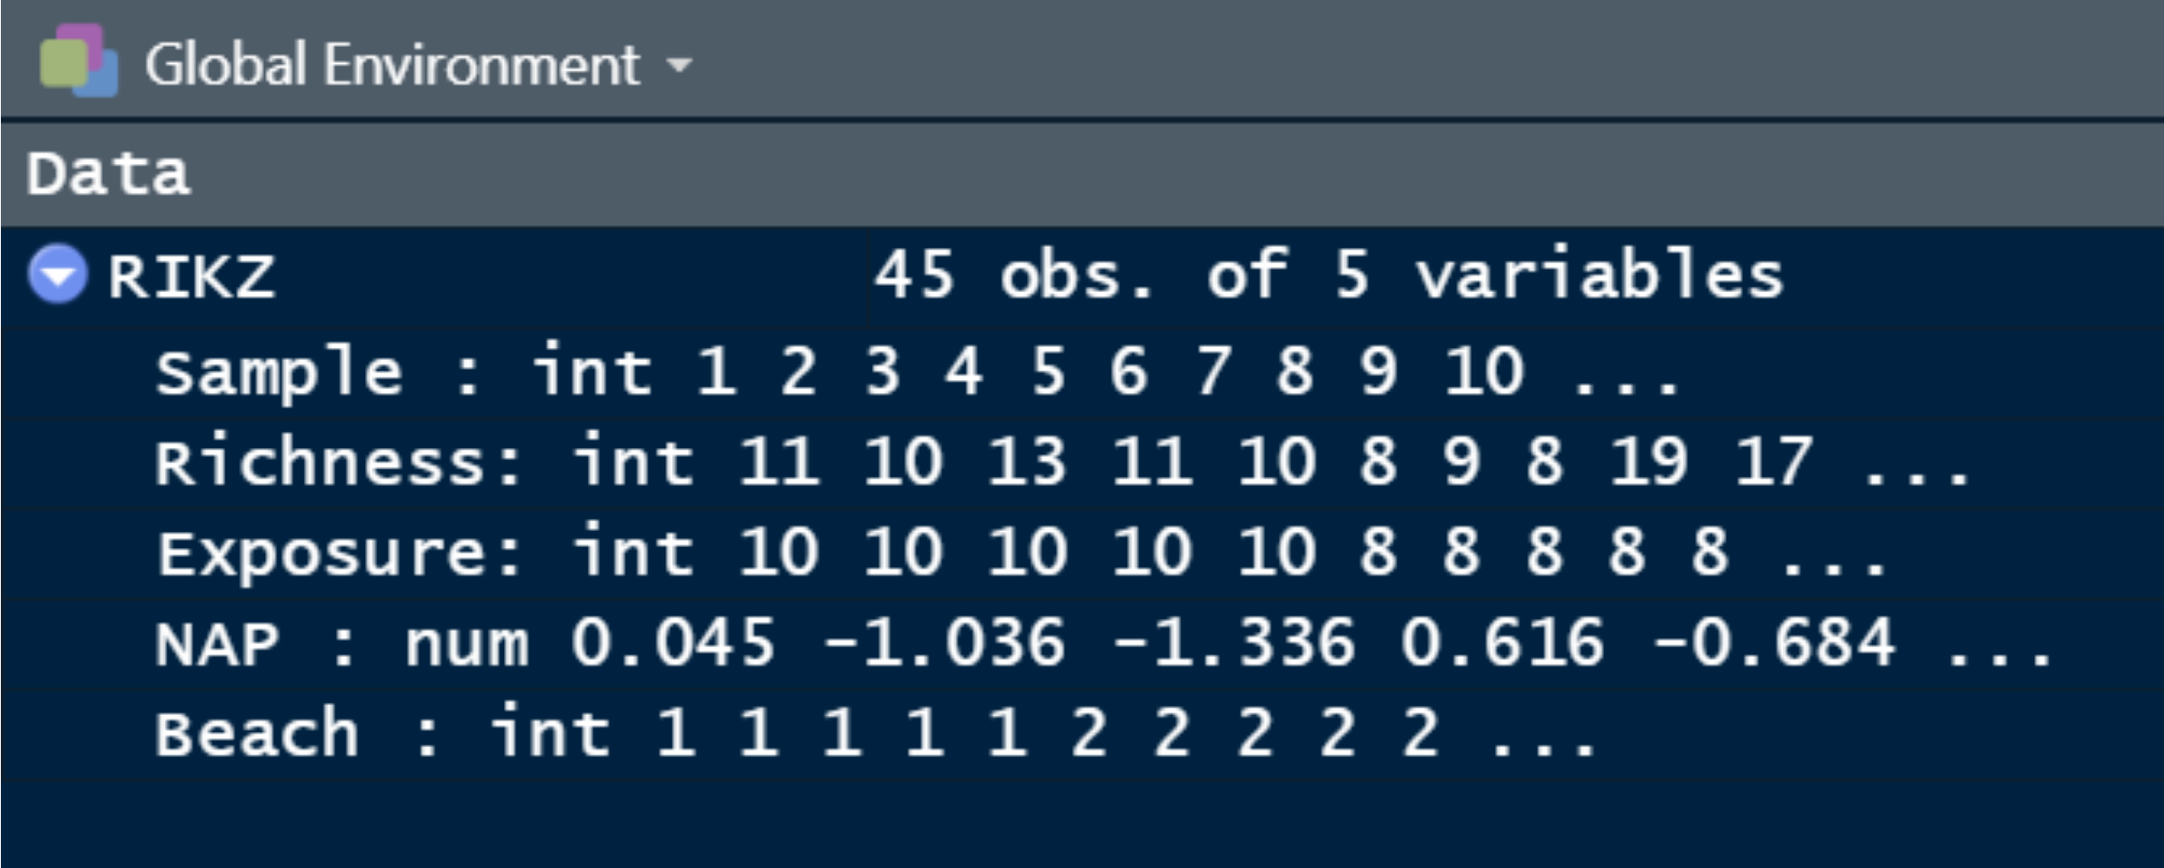
5.1 Introduction

Slide 6
5.1 Introduction
Richness ~ NAP + Exposure $R_{ij}=α+β_{1}×NAP_{ij}+β_{2}×Exposure_{i}+ϵ_{ij}$ $ϵ_{ij}∼N(0,σ^{2})$ (beach $i$, site $j$) (NB Gaussian ass. is probably not quite right, just an example)

Slide 7
5.2 2-stage analysis
Stage 1 - estimate regression slope for each beach separately to see if they look different Richness ~ NAP, for each beach Stage 2 - Model individual slope as a function of a grouping var

Slide 8
5.2 2-stage analysis
slope <- vector(length = 9) for(i in 1:9){ Mi <- summary(lm(Richness ~ NAP, subset = (Beach == i), data = RIKZ)) slope[i] <- Mi$coefficients[2,1] } round(slope, 2)
## [1] -0.37 -4.18 -1.76 -1.25 -8.90 -1.39 -1.52 -1.89 -2.97

Slide 9
5.2 2-stage analysis
Can instead use LmList from {nlme}…

Slide 10
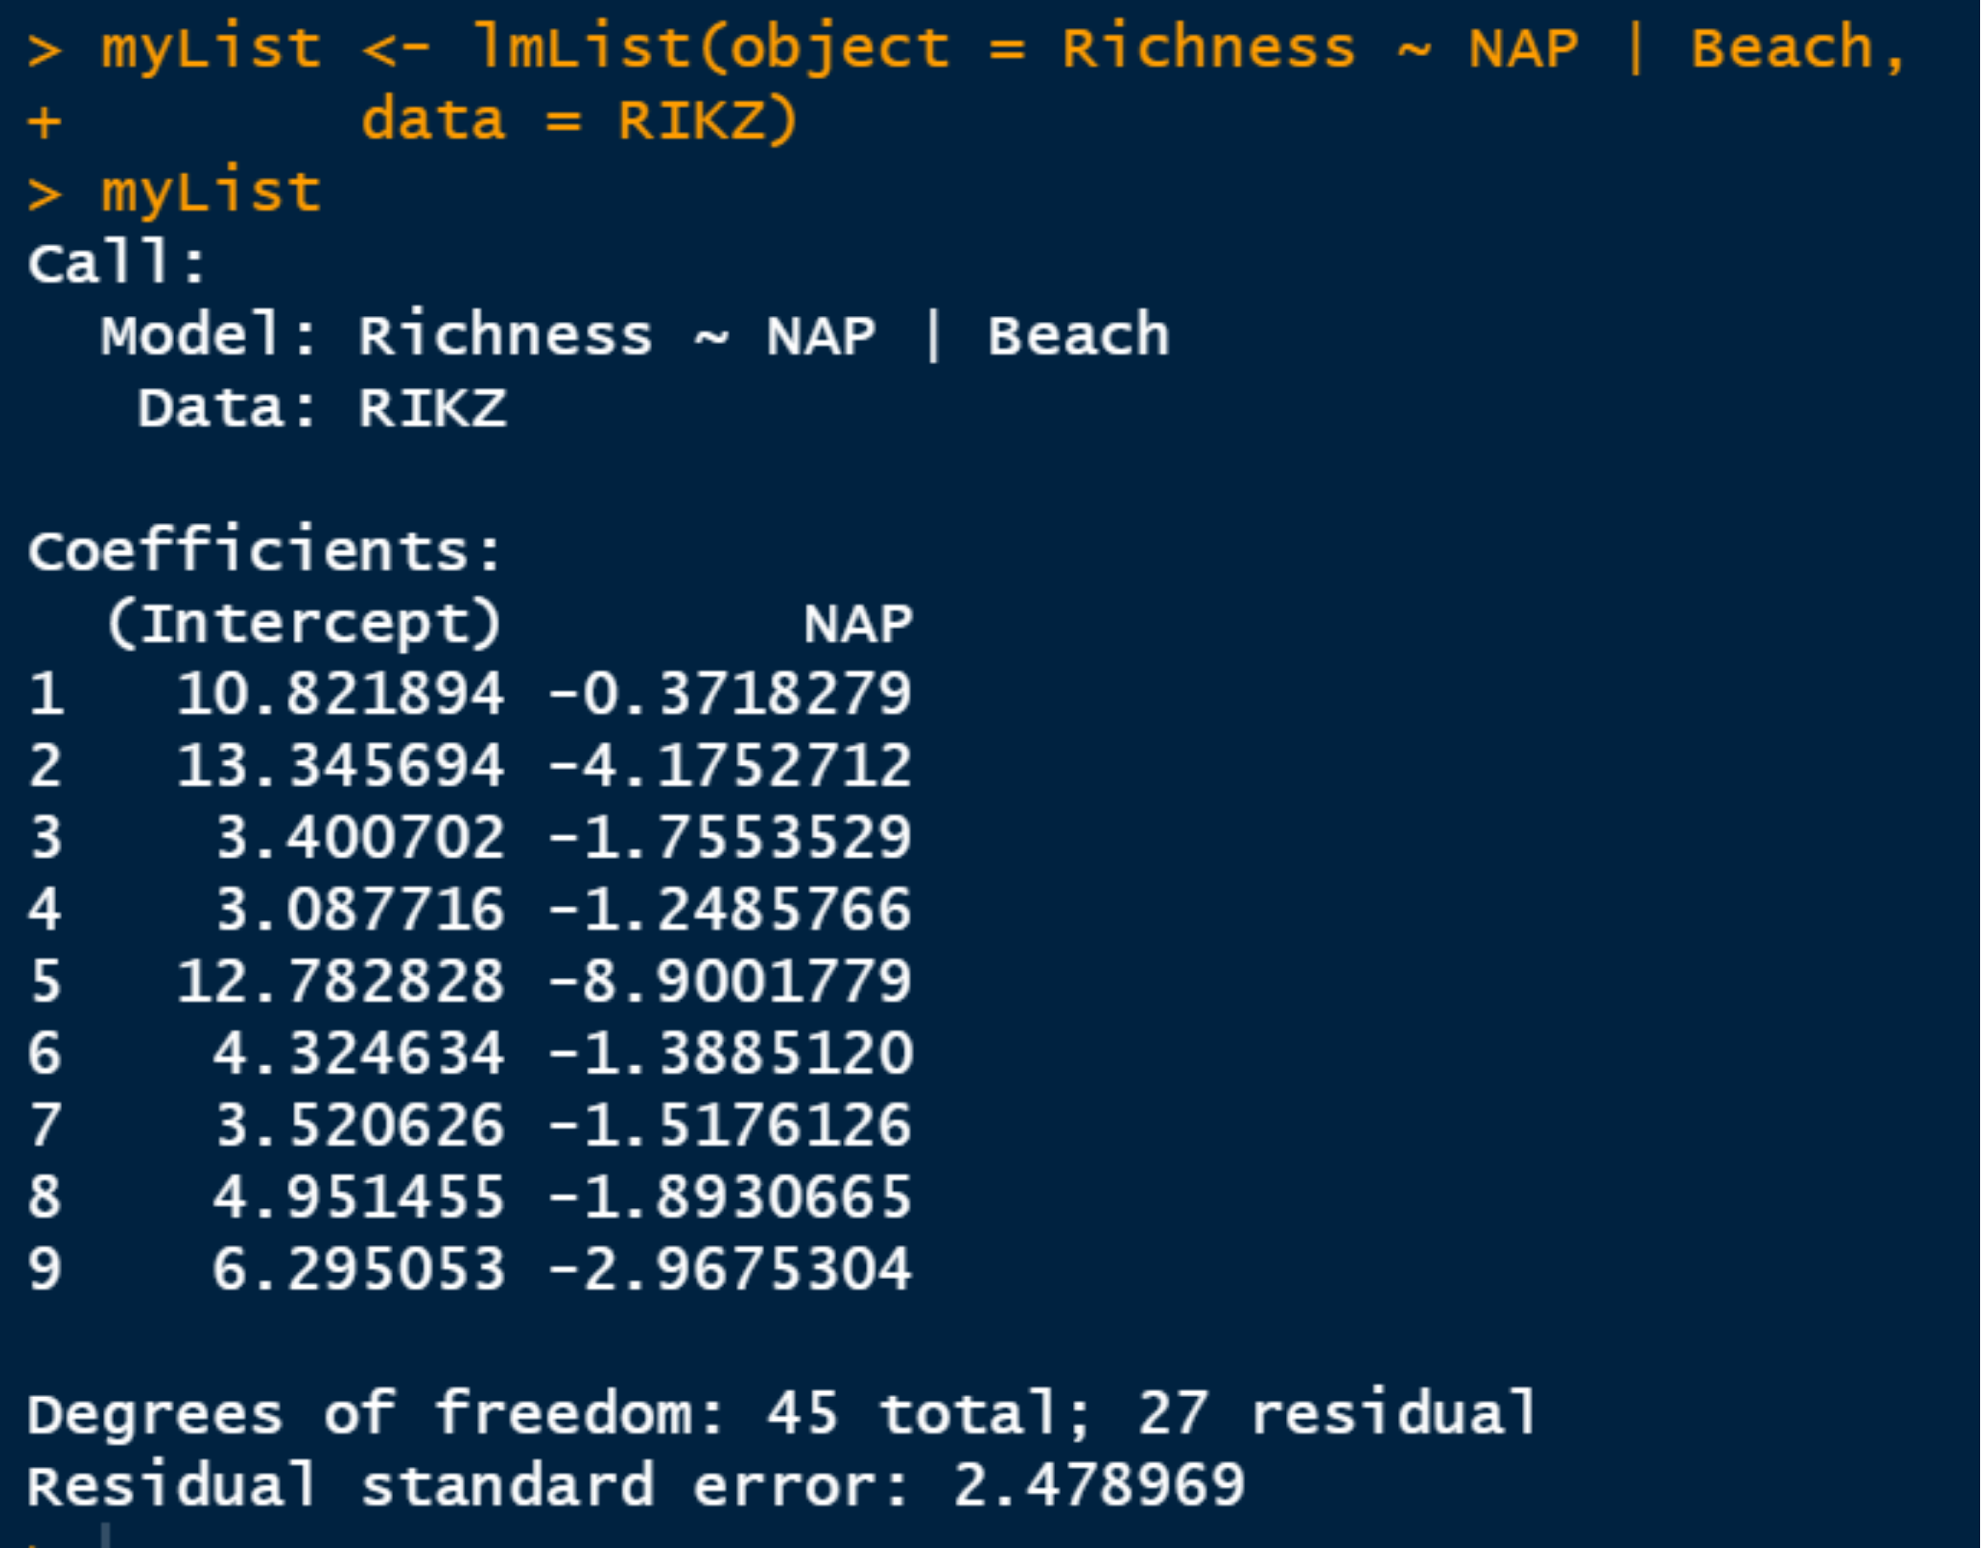
5.2 2-stage analysis

Slide 11
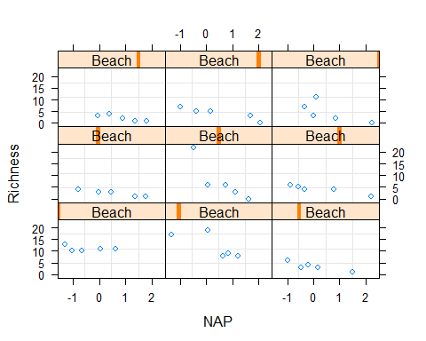
5.2 2-stage analysis

Slide 12
5.2 2-stage analysis
Zuur stage 2 is only an example and the factor levels he chooses are arbitrary. We will ignore this for now. He models Slope/Beach ~ grouping factor to see if there is objective evidence of a difference in slope. (bad example because here there is not!)

Slide 13
5.3 Mixed effects
$R_{i}=X_{i}×β+Z_{i}×b_{i}+ε_{i}$ NB this should be matrix notation, bold $Z_{i}×b_{i}$ “random effect” of richness ~ NAP for each Beach $Xi×β$ “fixed effect” of explanatory vars

Slide 14
5.3 Mixed effects
We will explore with examples and graphs (it is ok not to understand the eq. at this point)

Slide 15
5.3 Mixed effects
Tale of 3 models Random intercept Random intercept + slope vanilla Random effects

Slide 16
5.3.2 Random intercept
In plain language, here we will model: Richness ~ NAP single slope, separate intercept for each Beeach

Slide 17
5.3.2 Random intercept
2 assumptions: The random effects (intercepts) are Gaussian distributed relative to the grand mean intercept The residuals are also Gaussian for each beach (we will ignore the comment about the covariance matrix for now)

Slide 18
5.3.2 Random intercept
lme(Richness ∼ NAP, random = ~1 | fBeach, data = RIKZ)

Slide 19
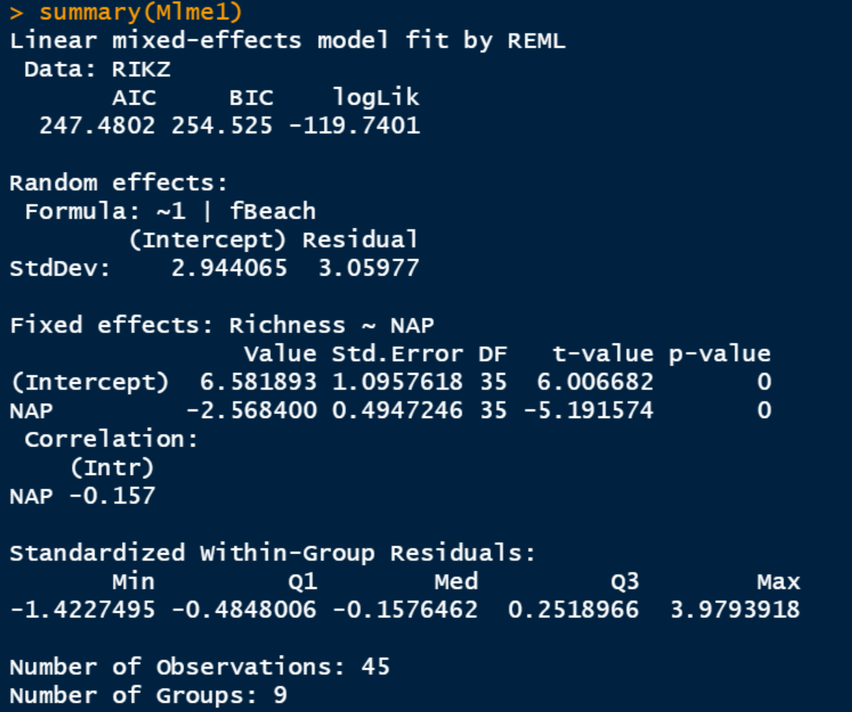
5.3.2 Random intercept

Slide 20
5.3.2 Random intercept
Note: Est. std dev for the intercept is $\hat{d}$ = 2.94 Est intercept (at NAP = 0) is 6.58 Est slope of Richness ~ NAP = -2.57

Slide 21
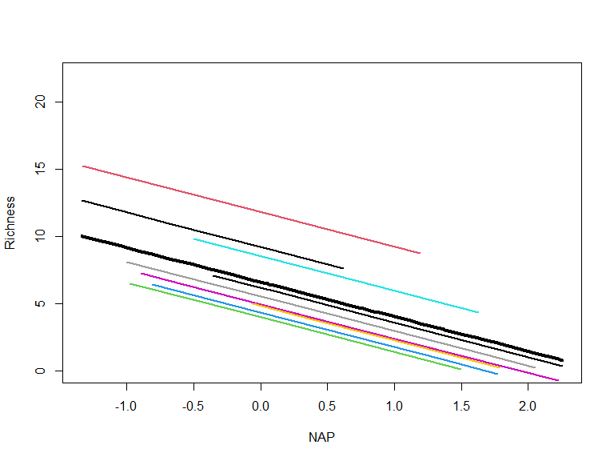
5.3.2 Random intercept

Slide 22
5.3.3 Random intercept + slope
The basic deal here is that now we will estimate a different intercept and a different slope for each beach…
lme(Richness ∼ NAP, random = ∼1 + NAP | fBeach, data = RIKZ)

Slide 23
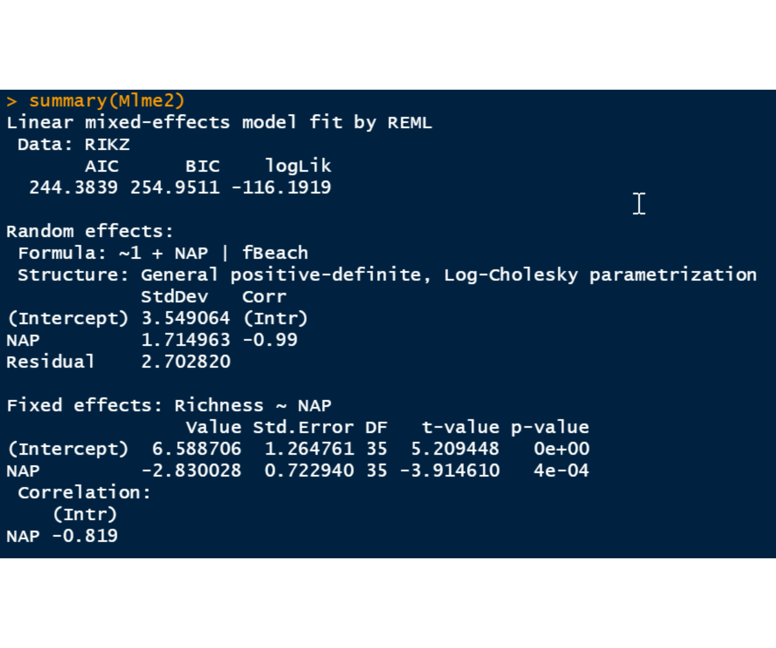
5.3.2 Random intercept

Slide 24
5.3.2 Random intercept
Note lower AIC (so evidently fits data better) NB 3 random variances, + a correlation term, -0.99 cor between the random intercepts and slopes Beaches with high intercept have lowest (steep negative) slope

Slide 25
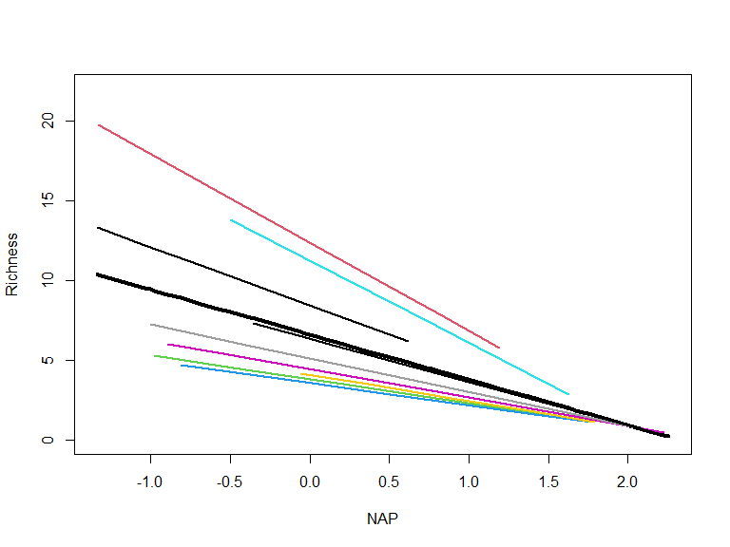
5.3.2 Random intercept

Slide 26
5.3.4 Random effects model
No fixed effects (kind of weird) lme(Richness ∼ 1, random =∼ 1 | fBeach, data = RIKZ) This drops the NAP variable and is basically a roundabout way of asking if richness varianced is explained by beach alone

Slide 27
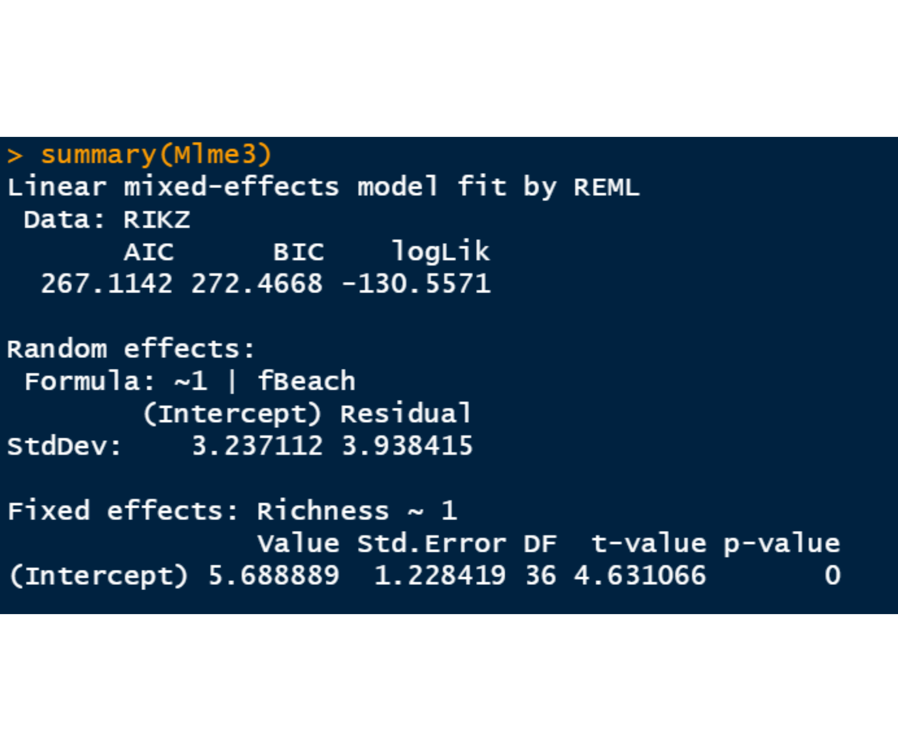
5.3.4 Random effects model

Slide 28
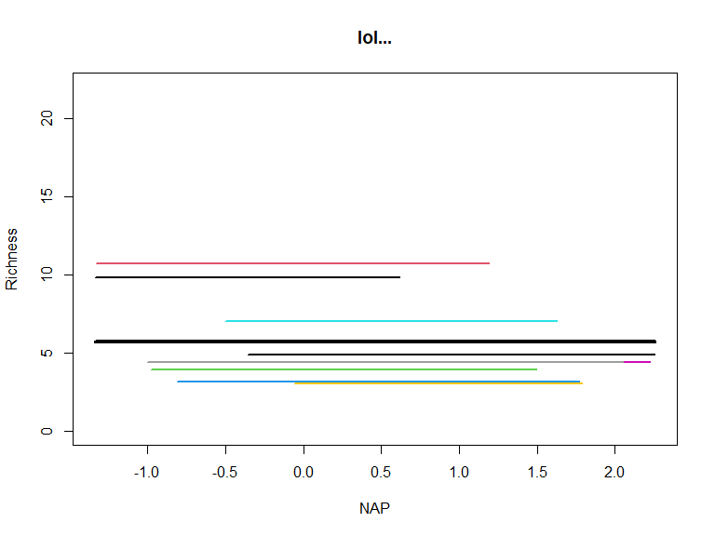
5.3.4 Random effects model

Slide 29
5.3.4 Random effects model
Note The fit (AIC) is not good compared to the earlier models

Slide 30
5.4 Correlation issues
We shant linger in this section intraclass correlation coefficient is important Use it to correct sample size relative to uncorrelated samples (typically assumed in fixed effects models) An important point here is the mixed effects models CORRECT for this effect, avoiding pseudoreplication…

Slide 31
5.5 Marginal model
This is described an alternative way to achieve e.g. the random intercept model We make some technical assumptions about the correlation of variance between beaches Mention the variance-covariance matrix… (mention evolution of it, selection, etc…)

Slide 32
5.5 Marginal model
M.mixed <- lme(Richness ∼ NAP, random =∼ 1 | fBeach, method = “REML”, data = RIKZ) M.gls <- gls(Richness ∼ NAP, method = “REML”, correlation = corCompSymm(form =∼ 1 | fBeach), data = RIKZ) Important point is you can explicitly model the correlation structure if you are able and willing :)

Slide 33
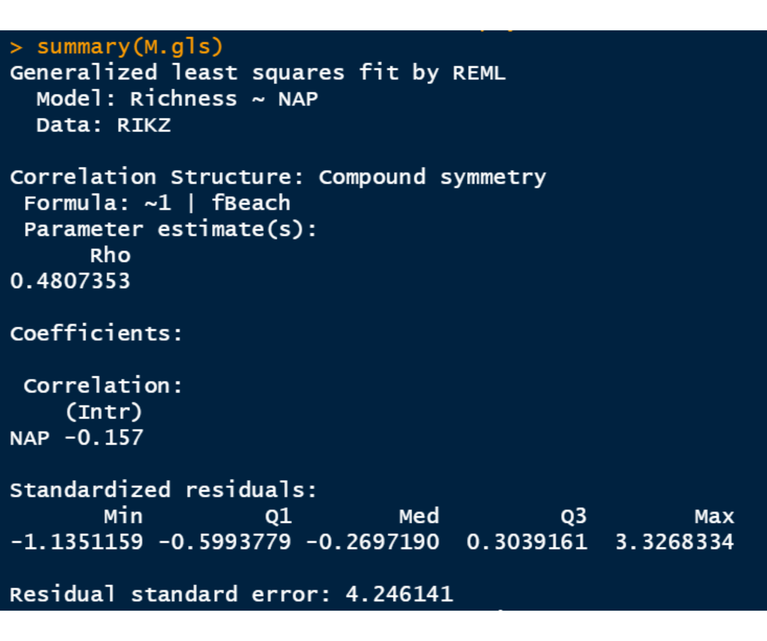
5.5 Marginal model

Slide 34
5.6 ML versus REML
We have touched on this before We will skip this optional section because of the need for lots of heavy linear algebra

Slide 35
5.7 Model selection for LME
Model selection idea is the use objective criterion to choose best model amongst potential competing ones Weights residual variance (more is worse) Model complexity (more terms is worse) AIC versus BIC are typical

Slide 36
5.7 Model selection for LME
Some points
REML is typically favoured and more flexible ML works fine if data are perfectly balanced and no missing values AIC based on ML versus REML not comparable

Slide 37
5.7 Model selection for LME
Another option for model comparison is hypothesis testing We have already looked at this Zuur describes the “top down” model selection approach (via Diggle et al. 2002)

Slide 38
5.7 Model selection “top down”
Start with all main and interaction effects as beyond optimal
Compare competing structures of random component, find the best (REML only if nested)
Compare competing structures of fixed component, find best (probably REML)
Run final model (REML only)

Slide 39
5.8 Good, bad and all ugly
Zuur goes through poor practice first, then good practice

Slide 40
5.8.1 Wrong approach

Slide 41
5.8.1 Wrong approach
Wrong1 <- gls(Richness ~ 1 + NAP, #no random term method = "REML", data = RIKZ) Wrong2 <- lme(Richness ~ 1 + NAP, # random intercept random = ~ 1 | fBeach, method = "REML", data = RIKZ) Wrong3 <- lme(Richness ~ 1 + NAP, # random intercept + slope random = ~ 1 + NAP | fBeach, method = "REML", data = RIKZ)

Slide 42
5.8.1 Wrong approach

Slide 43
5.8.1 Wrong approach
Technical point about using generated P to compare models “on the boundary”
# To compare models 1 and 2 p-correction == 0.5 * (1 - pchisq(12.720753, 1))
## [1] 0.0001808101

Slide 44
5.8.1 Wrong approach
Technical point about using generated P to compare models “on the boundary”
# To compare models 2 and 3 p-correction == 0.5 * ((1 - pchisq(7.09, 1)) + (1 - pchisq(7.09, 2)))
## [1] 0.01831007

Slide 45
5.8.1.2 Step 3 of the Protocol
Test options for Fixed compenents NAP, NAP + Exposure, NAP * Exposure Richness ∼1 + NAP * fExp, #full model random =∼1 + NAP | fBeach

Slide 46
5.8.1.2 Step 3 of the Protocol
## numDF denDF F-value p-value ## (Intercept) 1 34 34.87139 <.0001 ## NAP 1 34 18.65502 0.0001 ## fExp 1 7 5.65495 0.0490 ## NAP:fExp 1 34 3.32296 0.0771

Slide 47
5.8.1.2 Step 3 of the Protocol
Can use F-value (anova()), or t-value (summary()) We can try dropping the interacting term Richness ∼ 1 + NAP + fExp

Slide 48
5.8.1.2 Step 3 of the Protocol

Slide 49
5.8.1.3 Step 4 of the Protocol
We will skip the ML comparison Zuur concludes we go with model without Exposure or interaction Richness ∼1 + NAP, random =∼1 + NAP | fBeach

Slide 50
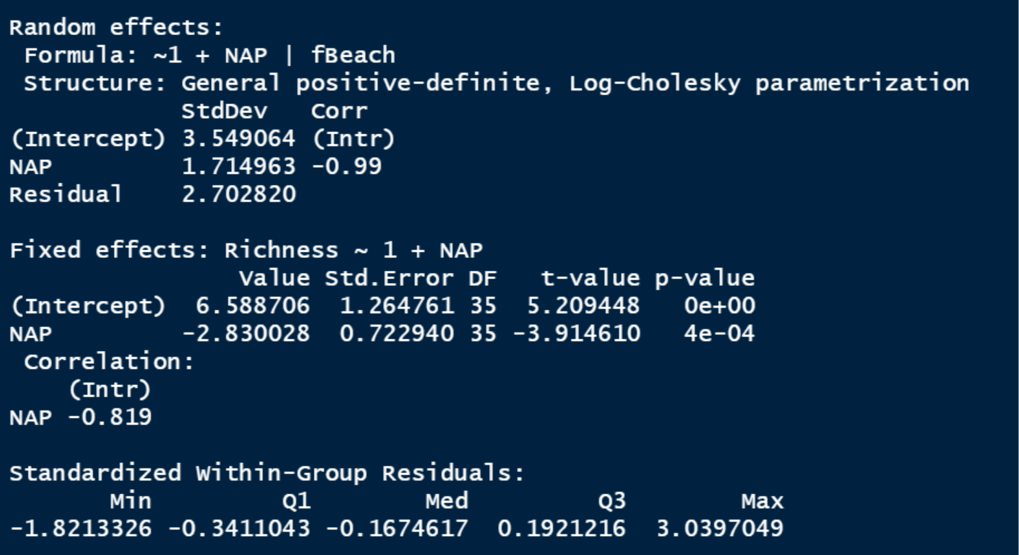
5.8.1.3 Step 4 of the Protocol

Slide 51
5.8.2 The Good Approach
This is basically the “top down” approach, starting with all the vars
B1 <- gls(Richness ~ 1 + NAP * fExp, # no random ef. method = "REML", data = RIKZ) B2 <- lme(Richness ~1 + NAP * fExp, random =~ 1 | fBeach, data = RIKZ, method = "REML") B3 <- lme(Richness ~ 1 + NAP * fExp, random = ~1 + NAP | fBeach, data = RIKZ, method="REML")

Slide 52
5.8.2.2 Step 2 of the Protocol

Slide 53
5.8.2.3 Step 3 of the Protoco

Slide 54
5.8.2.4 Step 4 of the Protocol
Drop interaction because of marginal p-val Top down ends up with different model Richness ∼ 1 + NAP + fExp , random = ∼1 | fBeach

Slide 55
5.9 Model Validation
Test model using normalised residuals based on REML (like ch 04) Plot residuals against each explanatory var Look at distribution of resduals with histogram

Slide 56
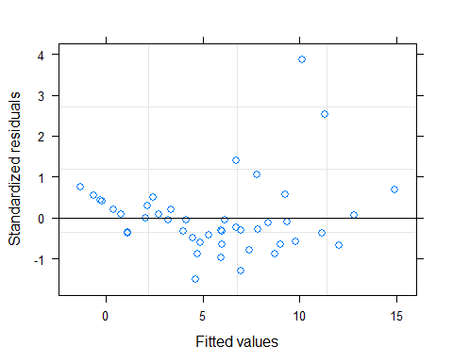
5.9 Model Validation

Slide 57
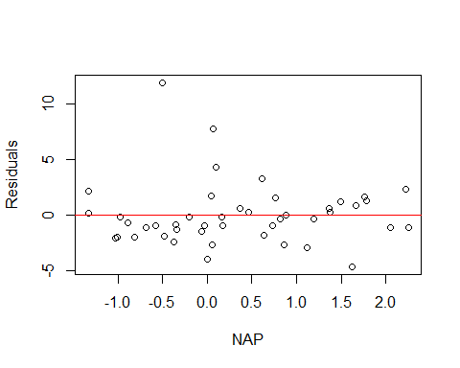
5.9 Model Validation

Slide 58
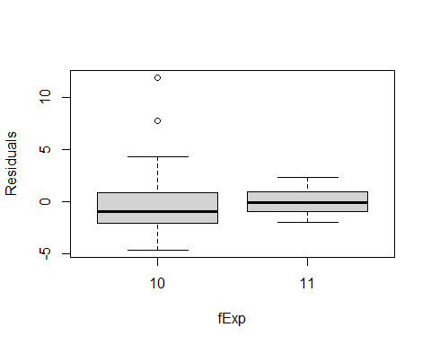
5.9 Model Validation

Slide 59
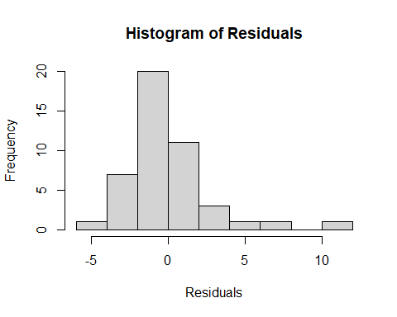
5.9 Model Validation

