Slide 1
Zuur Ch 05.10 mixed effects example
HARUG! QRantine edition Ed Harris

Slide 2
Chapter 05 Section 10
-This section goes through a “full blown” example of model validation using Zuur’s protocol of 10 steps (you remember the steps don’t you?)

Slide 3
THE PROTOCOL (top down)
1 Start with beyond optimal model 2 Model selection on optimal random effects 3 Model selection on optimal fixed effects 4 Final model formulation with REML (but NB he will use detailed one from Ch 04…)

Slide 4
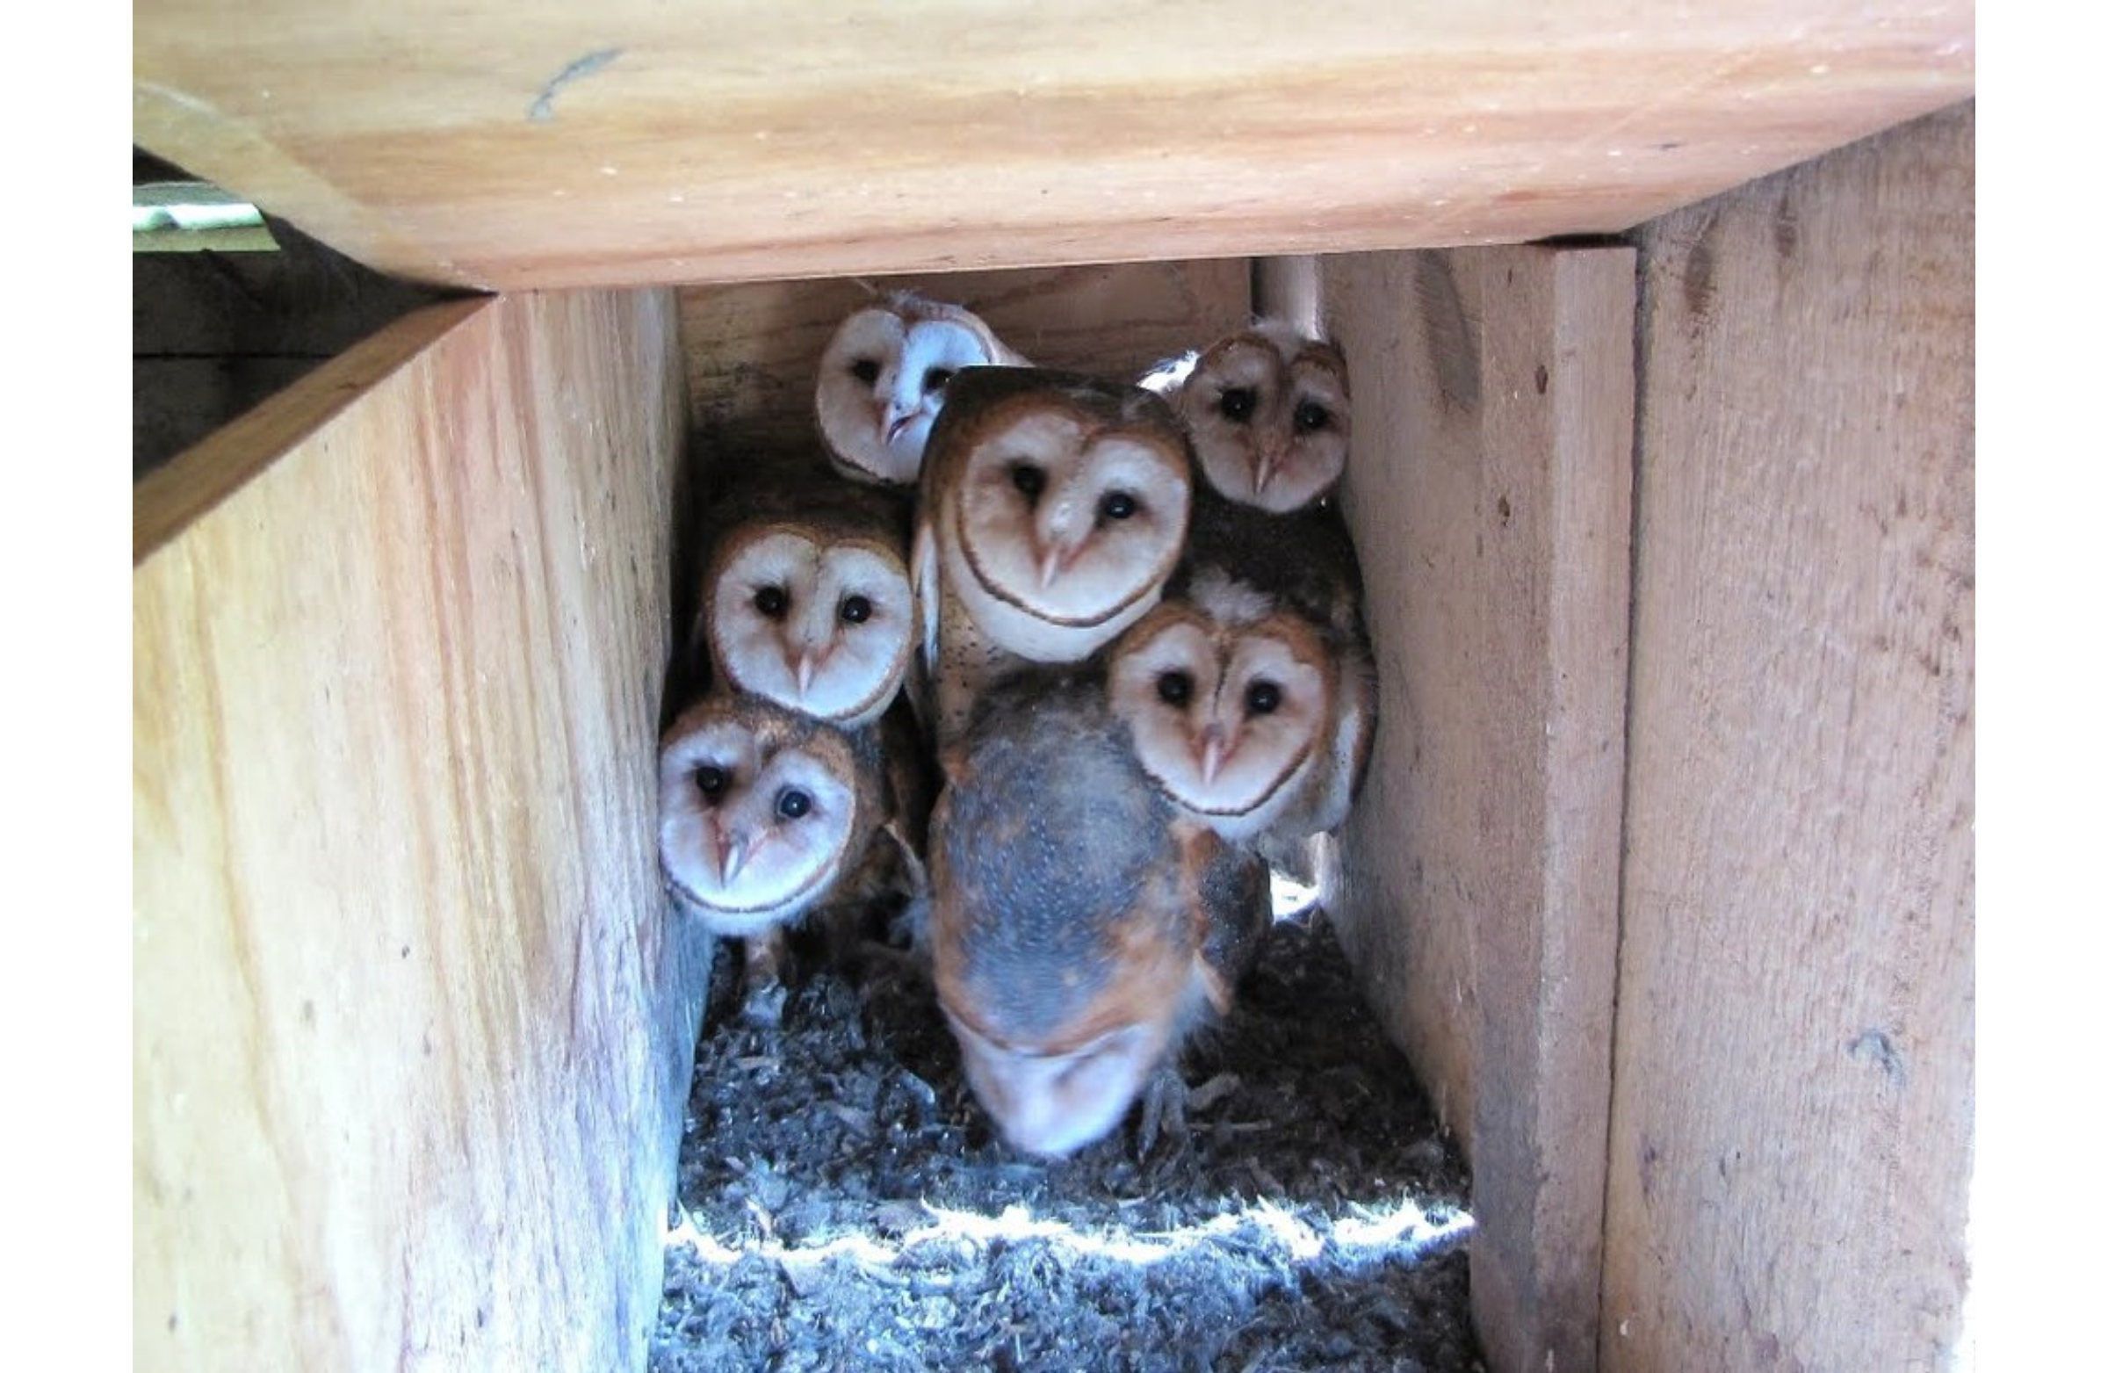
5.10 Example

Slide 5
5.10 Example
Nestling barn owl begging data Response to male and female Sibling negotiation, vocalisation Conflict and rivalry…

Slide 6
5.10 Example
Owls.rdata Dependent var: NegPerChick (# calls per chick before parent arrives) Explanatory vars: SexParent, FoodTreatment, ArrivalTime Briefly dicuss motivation and predictions

Slide 7
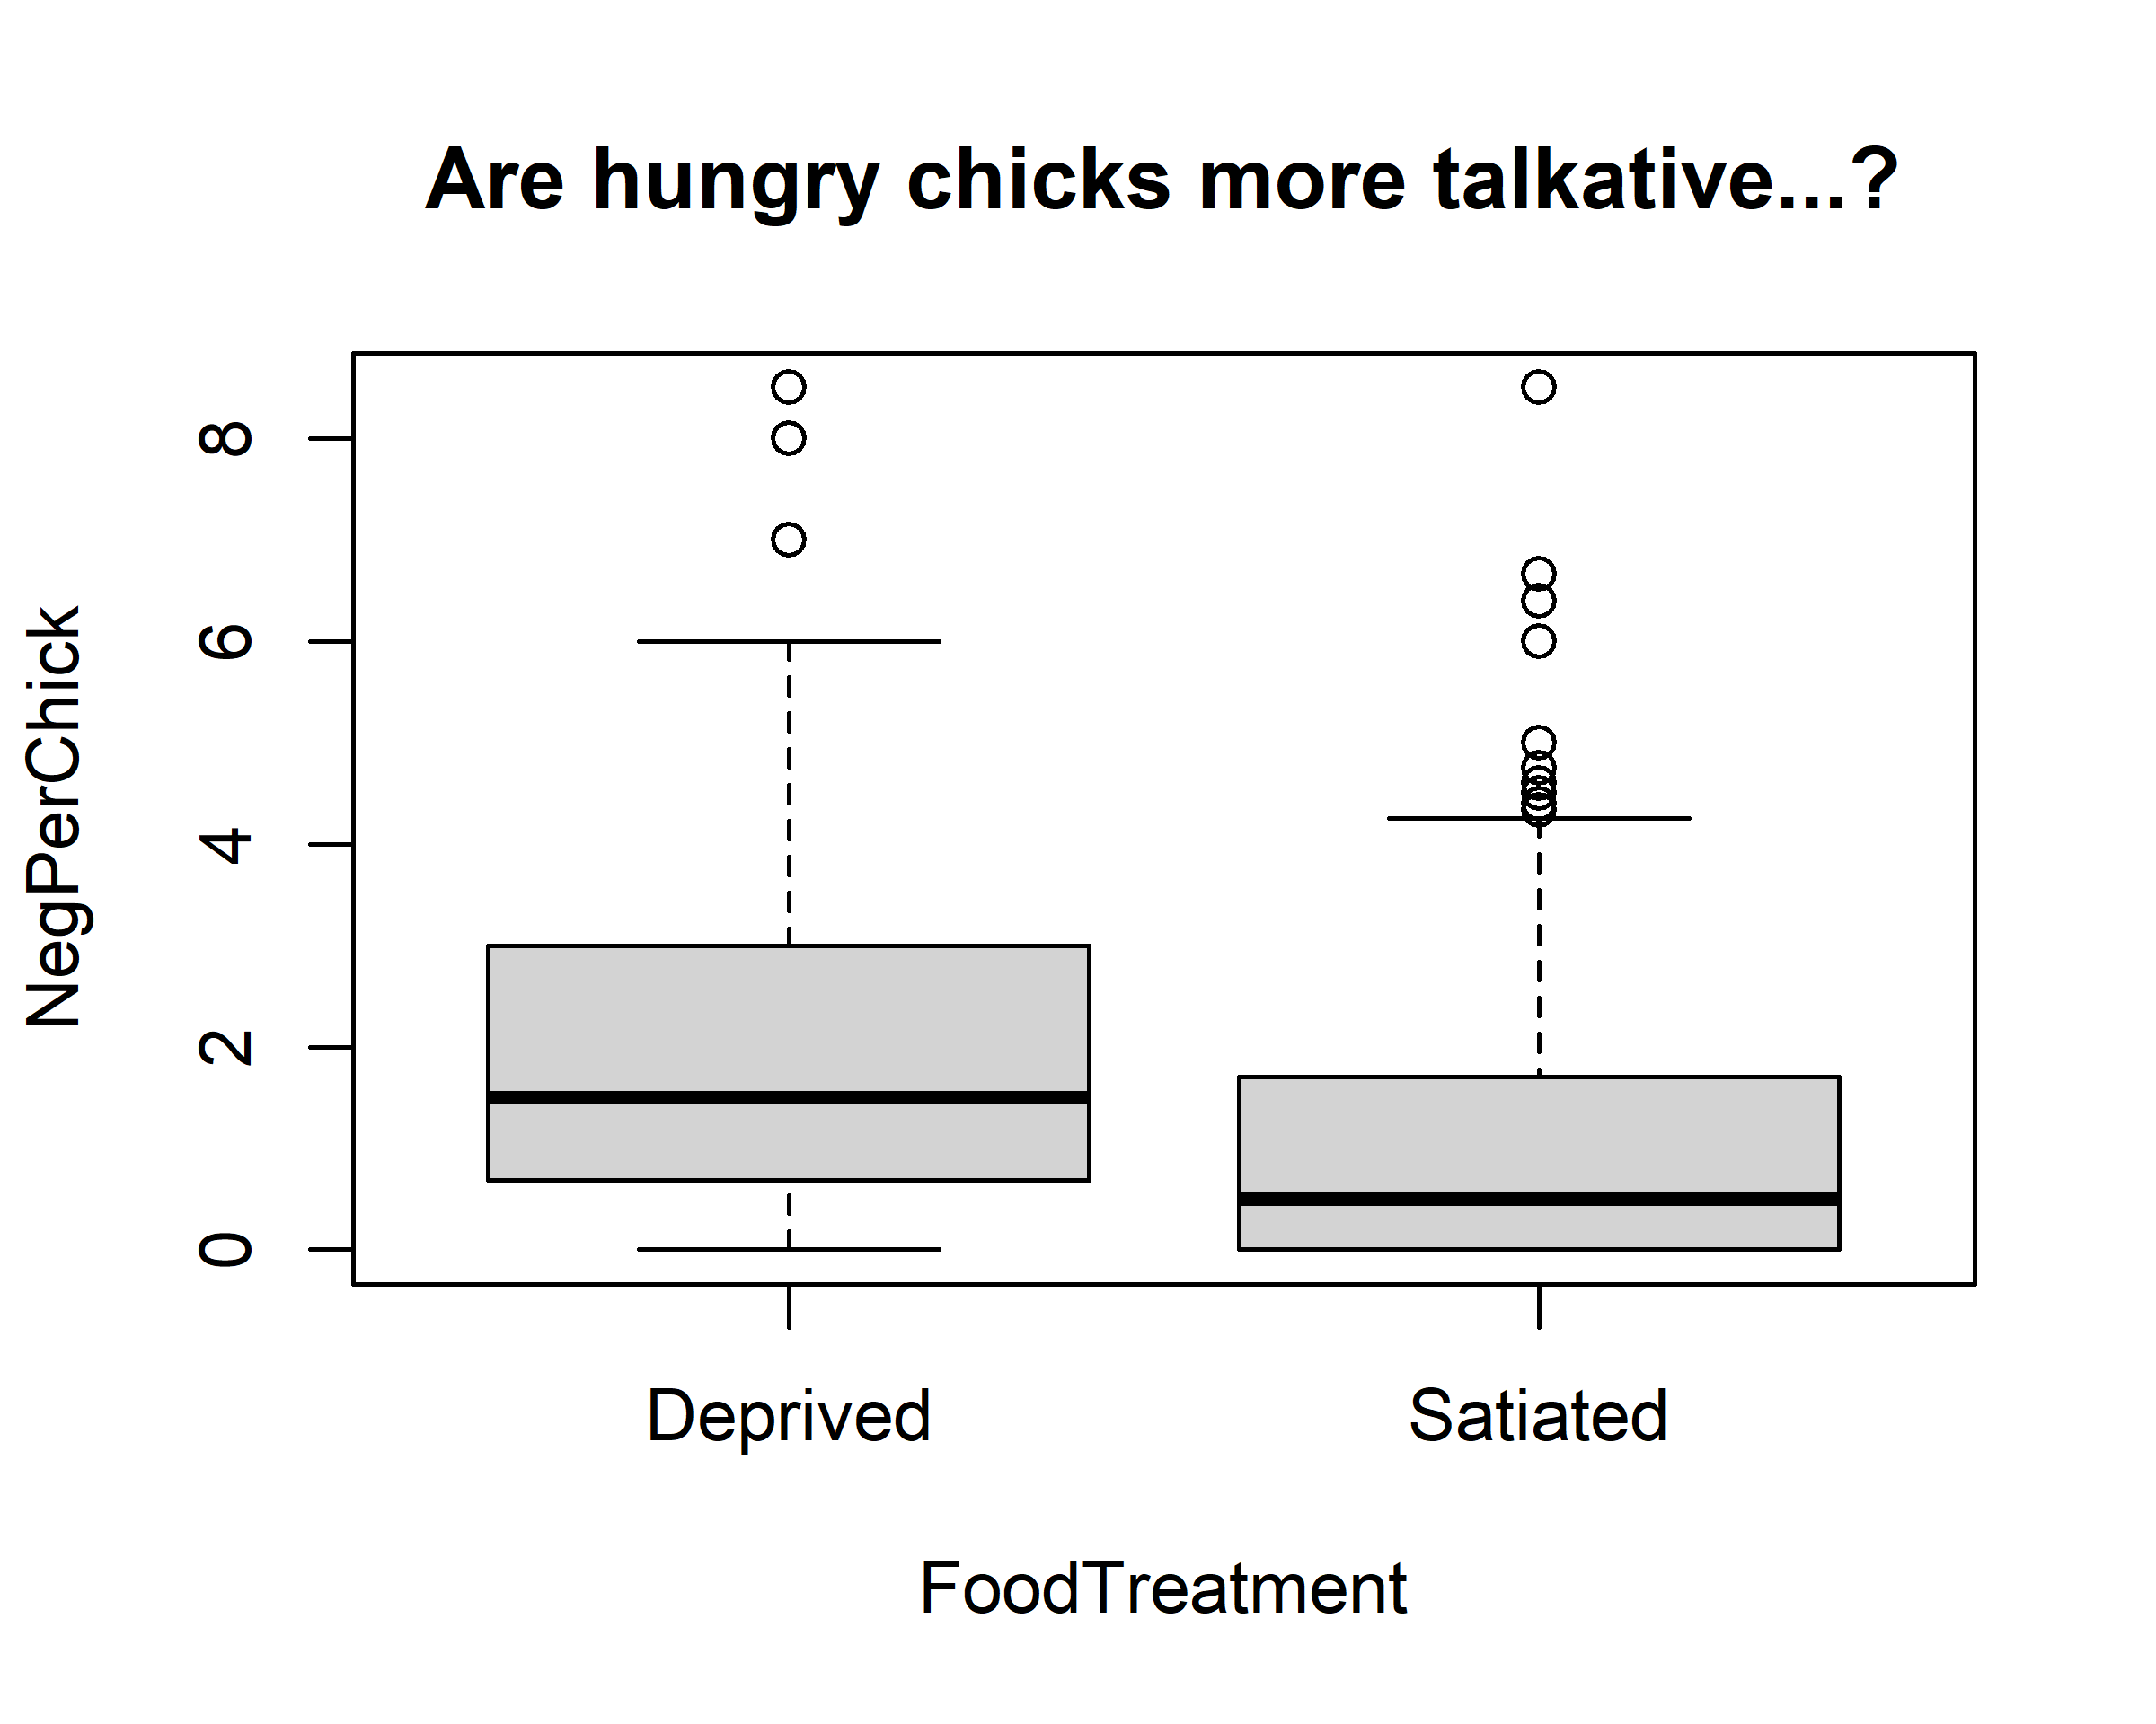
5.10 Example

Slide 8
5.10 Example
27 nests were repeatedly measured and included in this study Ergo, does this suggest the random factor?

Slide 9
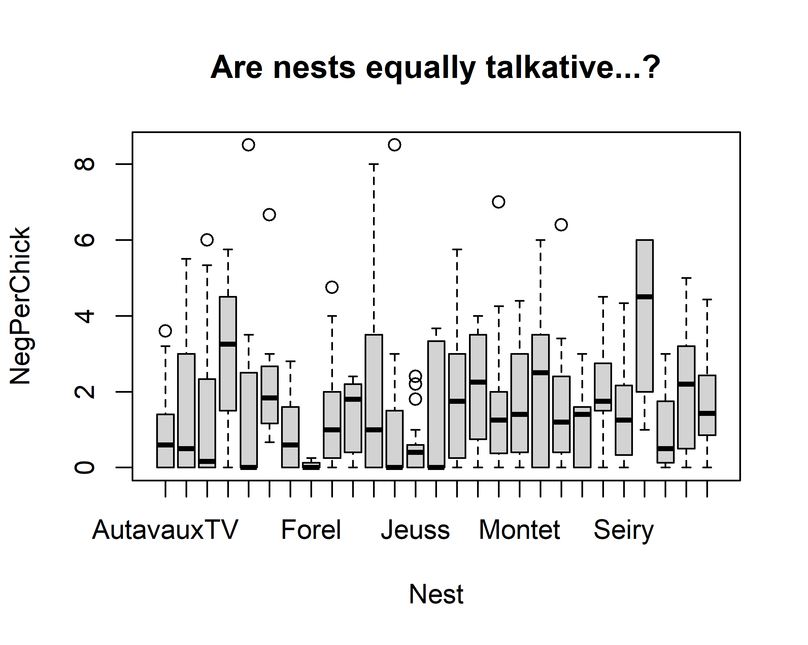
5.10 Example

Slide 10
5.10 Example
Zuur: “If we use nest as a random effect, we allow for correlation between multiple observations from the same nest, and we only need to estimate one variance, and our statements will hold for all similar nests.”

Slide 11
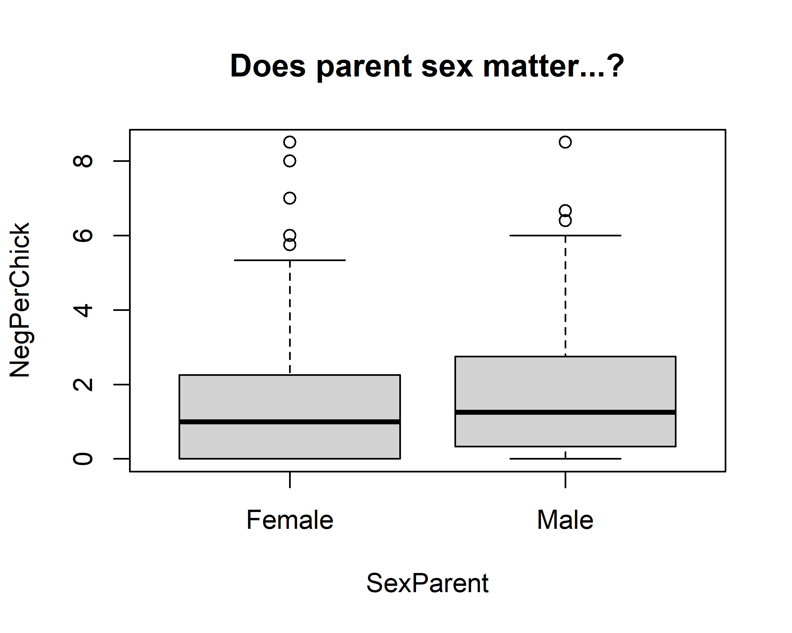
5.10 Example

Slide 12
Step 1 vanilla linear model
Run beyond optimal model NegPerChick ∼ SexParent * FoodTreatment + SexParent * ArrivalTime, data = Owls plot residuals vs fitted

Slide 13
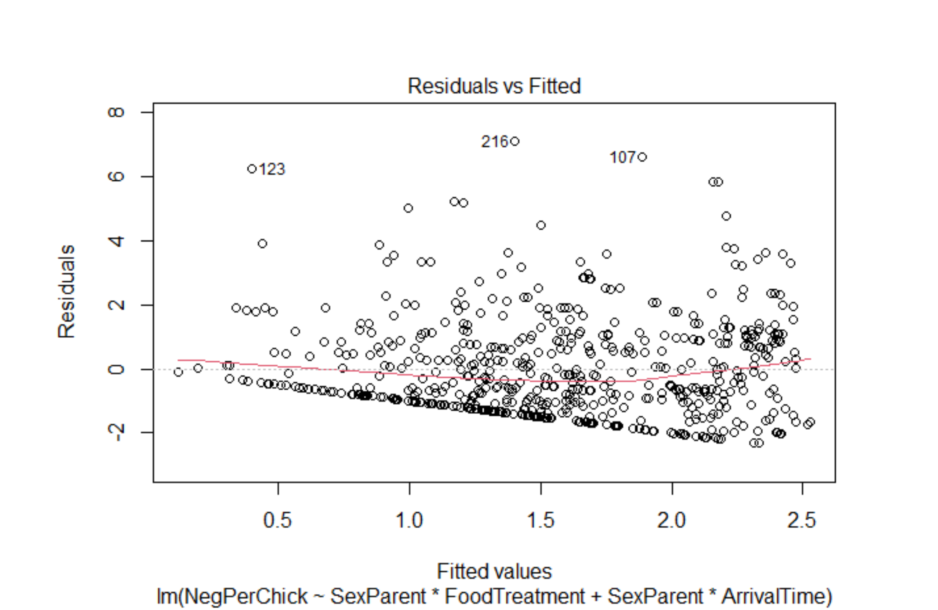
Step 1 vanilla linear model

Slide 14
Step 1 vanilla linear model
Per protocol, examine figs of residuals versus each explanatory var. There is no pattern, so Zuur opts to apply log10(Y + 1) transformation Discuss and examine figs…

Slide 15
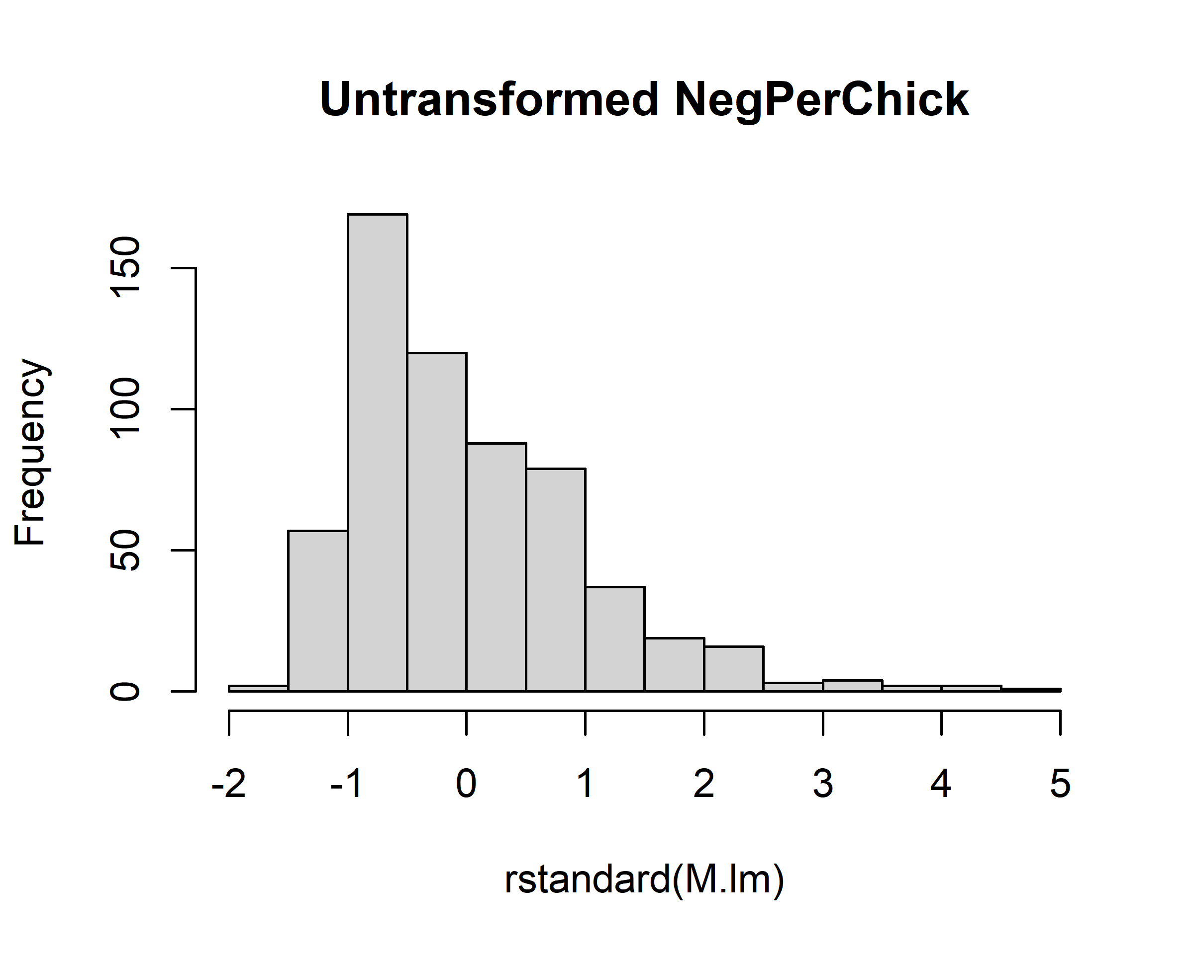
Step 1 vanilla linear model

Slide 16
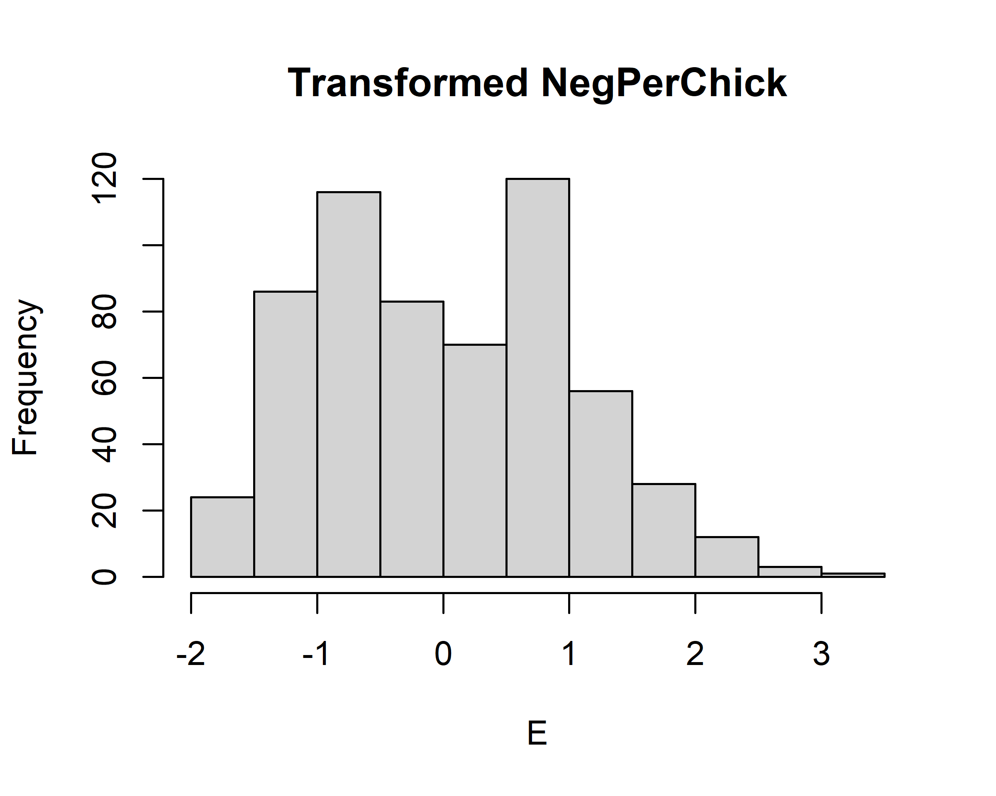
Step 1 vanilla linear model

Slide 17
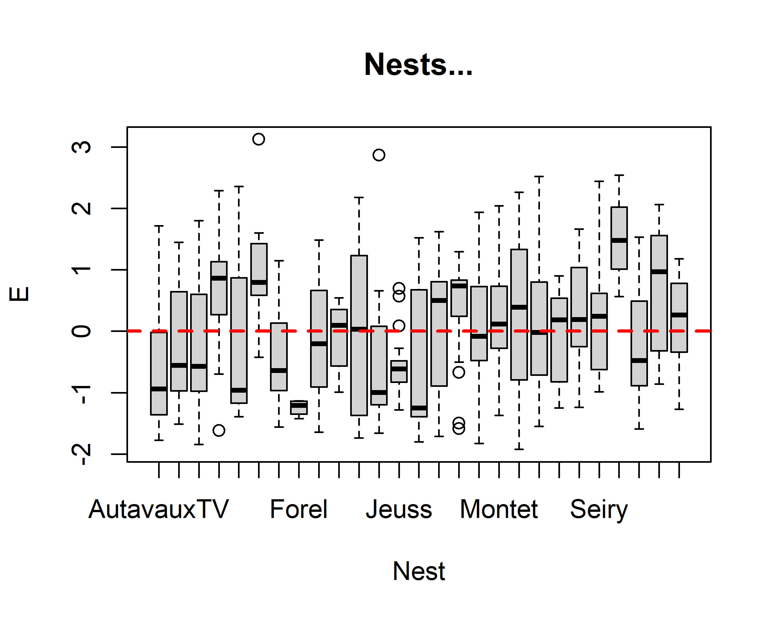
Step 1 vanilla linear model

Slide 18
Step 2 fit model with gls
Fit model with gls() Remember we need this for comarison with mixed effects objects Form <- formula(LogNeg ∼ SexParent * FoodTreatment + SexParent * ArrivalTime) M.gls <- gls(Form, data = Owls)

Slide 19
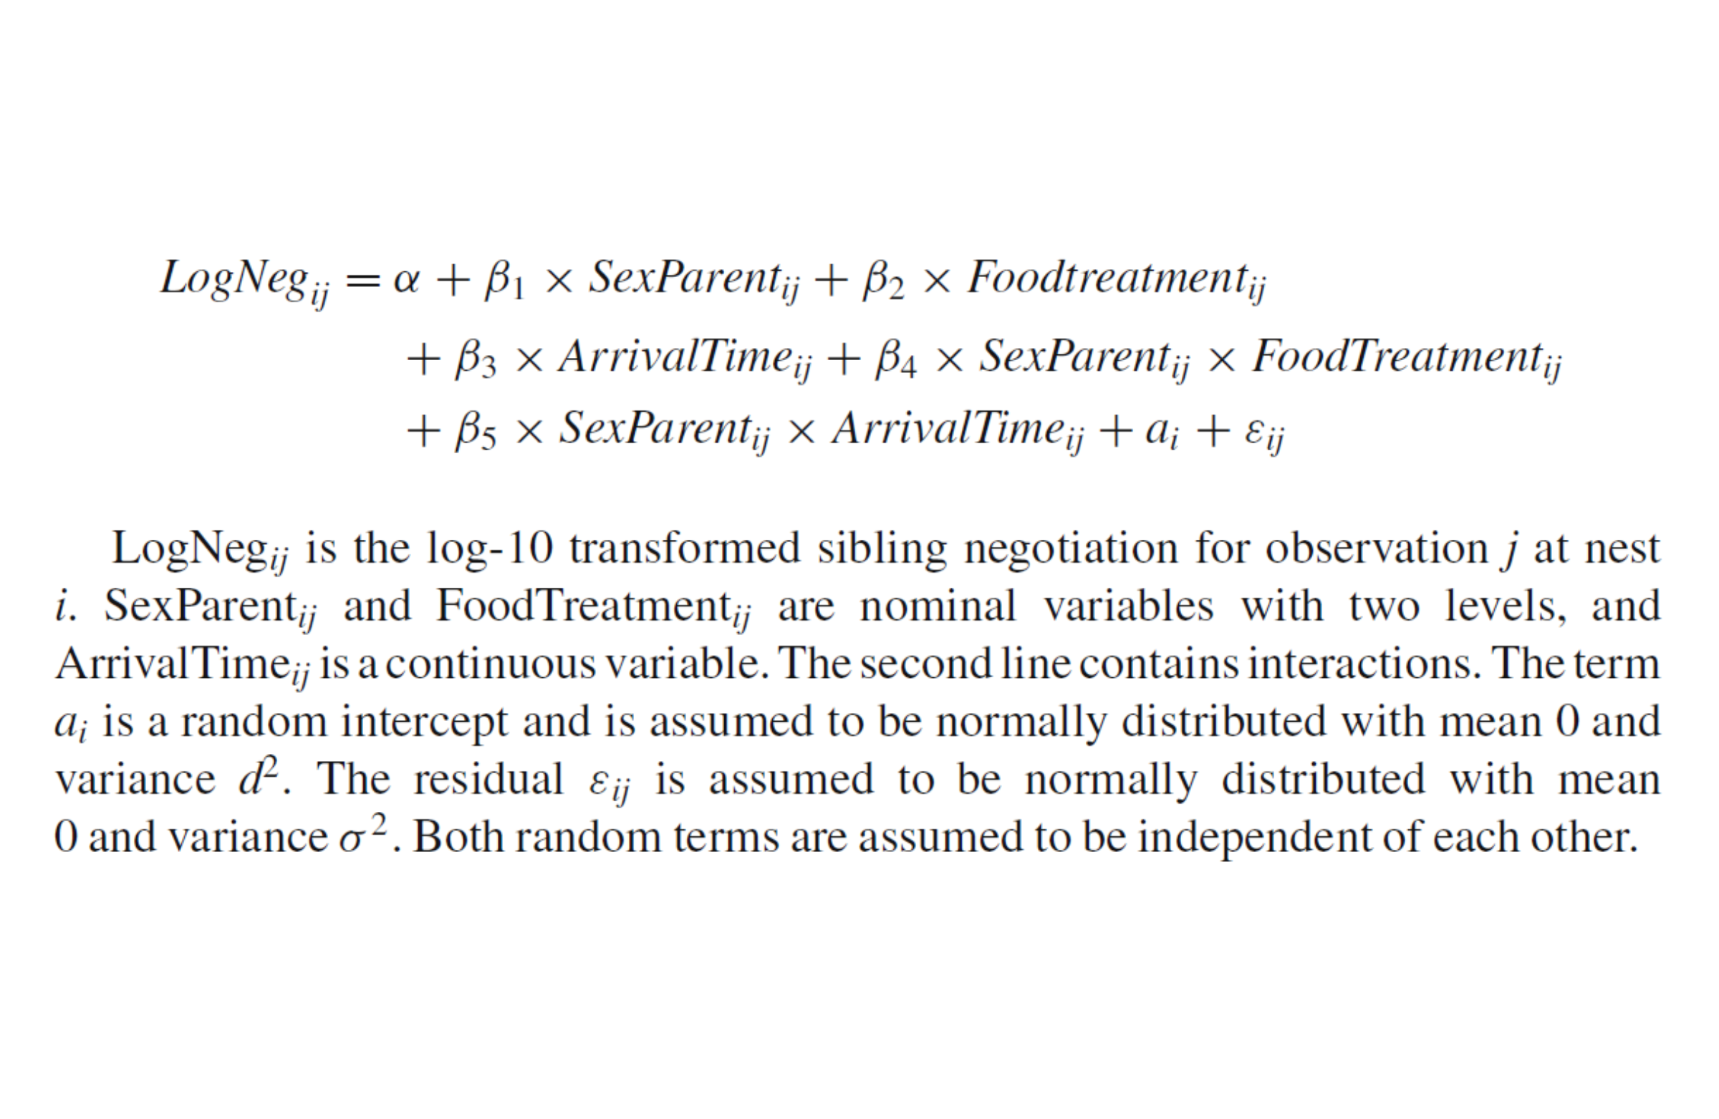
Step 3 var structure

Slide 20
Step 4 fit the model
Form <- formula(LogNeg ∼ SexParent * FoodTreatment + SexParent * ArrivalTime) M1.lme <- lme(Form, random = ∼1|Nest, method = “REML”, data = Owls)

Slide 21
Step 5 Compare models
Compare gls() with lme() - essentially what is effect of adding random effects variance structure…?

Slide 22
Step 5 Compare models
# Models anova(M.gls, M1.lme)[[1]]
## [1] "gls(model = Form, data = Owls)" ## [2] "lme.formula(fixed = Form, data = Owls, random = ~1 | Nest, method = \"REML\")"
# AIC anova(M.gls, M1.lme)[[4]]
## [1] 64.37422 37.71547
# p-val anova(M.gls, M1.lme)[[9]]
## [1] NA 8.632297e-08

Slide 23
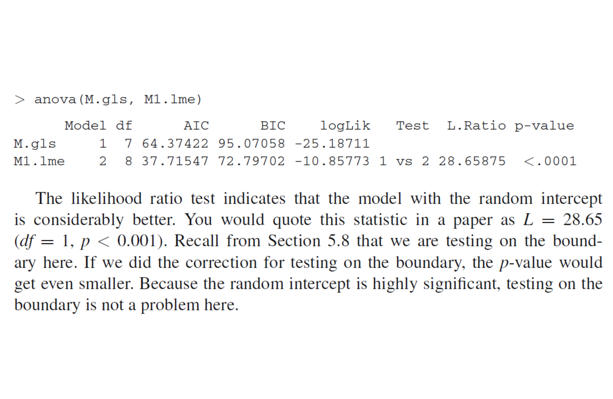
Step 5 Compare models

Slide 24
Step 6 validation
Testing for homogeneity of variance, and independence of residuals with predictor variables NB Zuur’s diagnostic plot code hacking does not work in R v4.0 (not a biggie, you just have to write your own code)

Slide 25
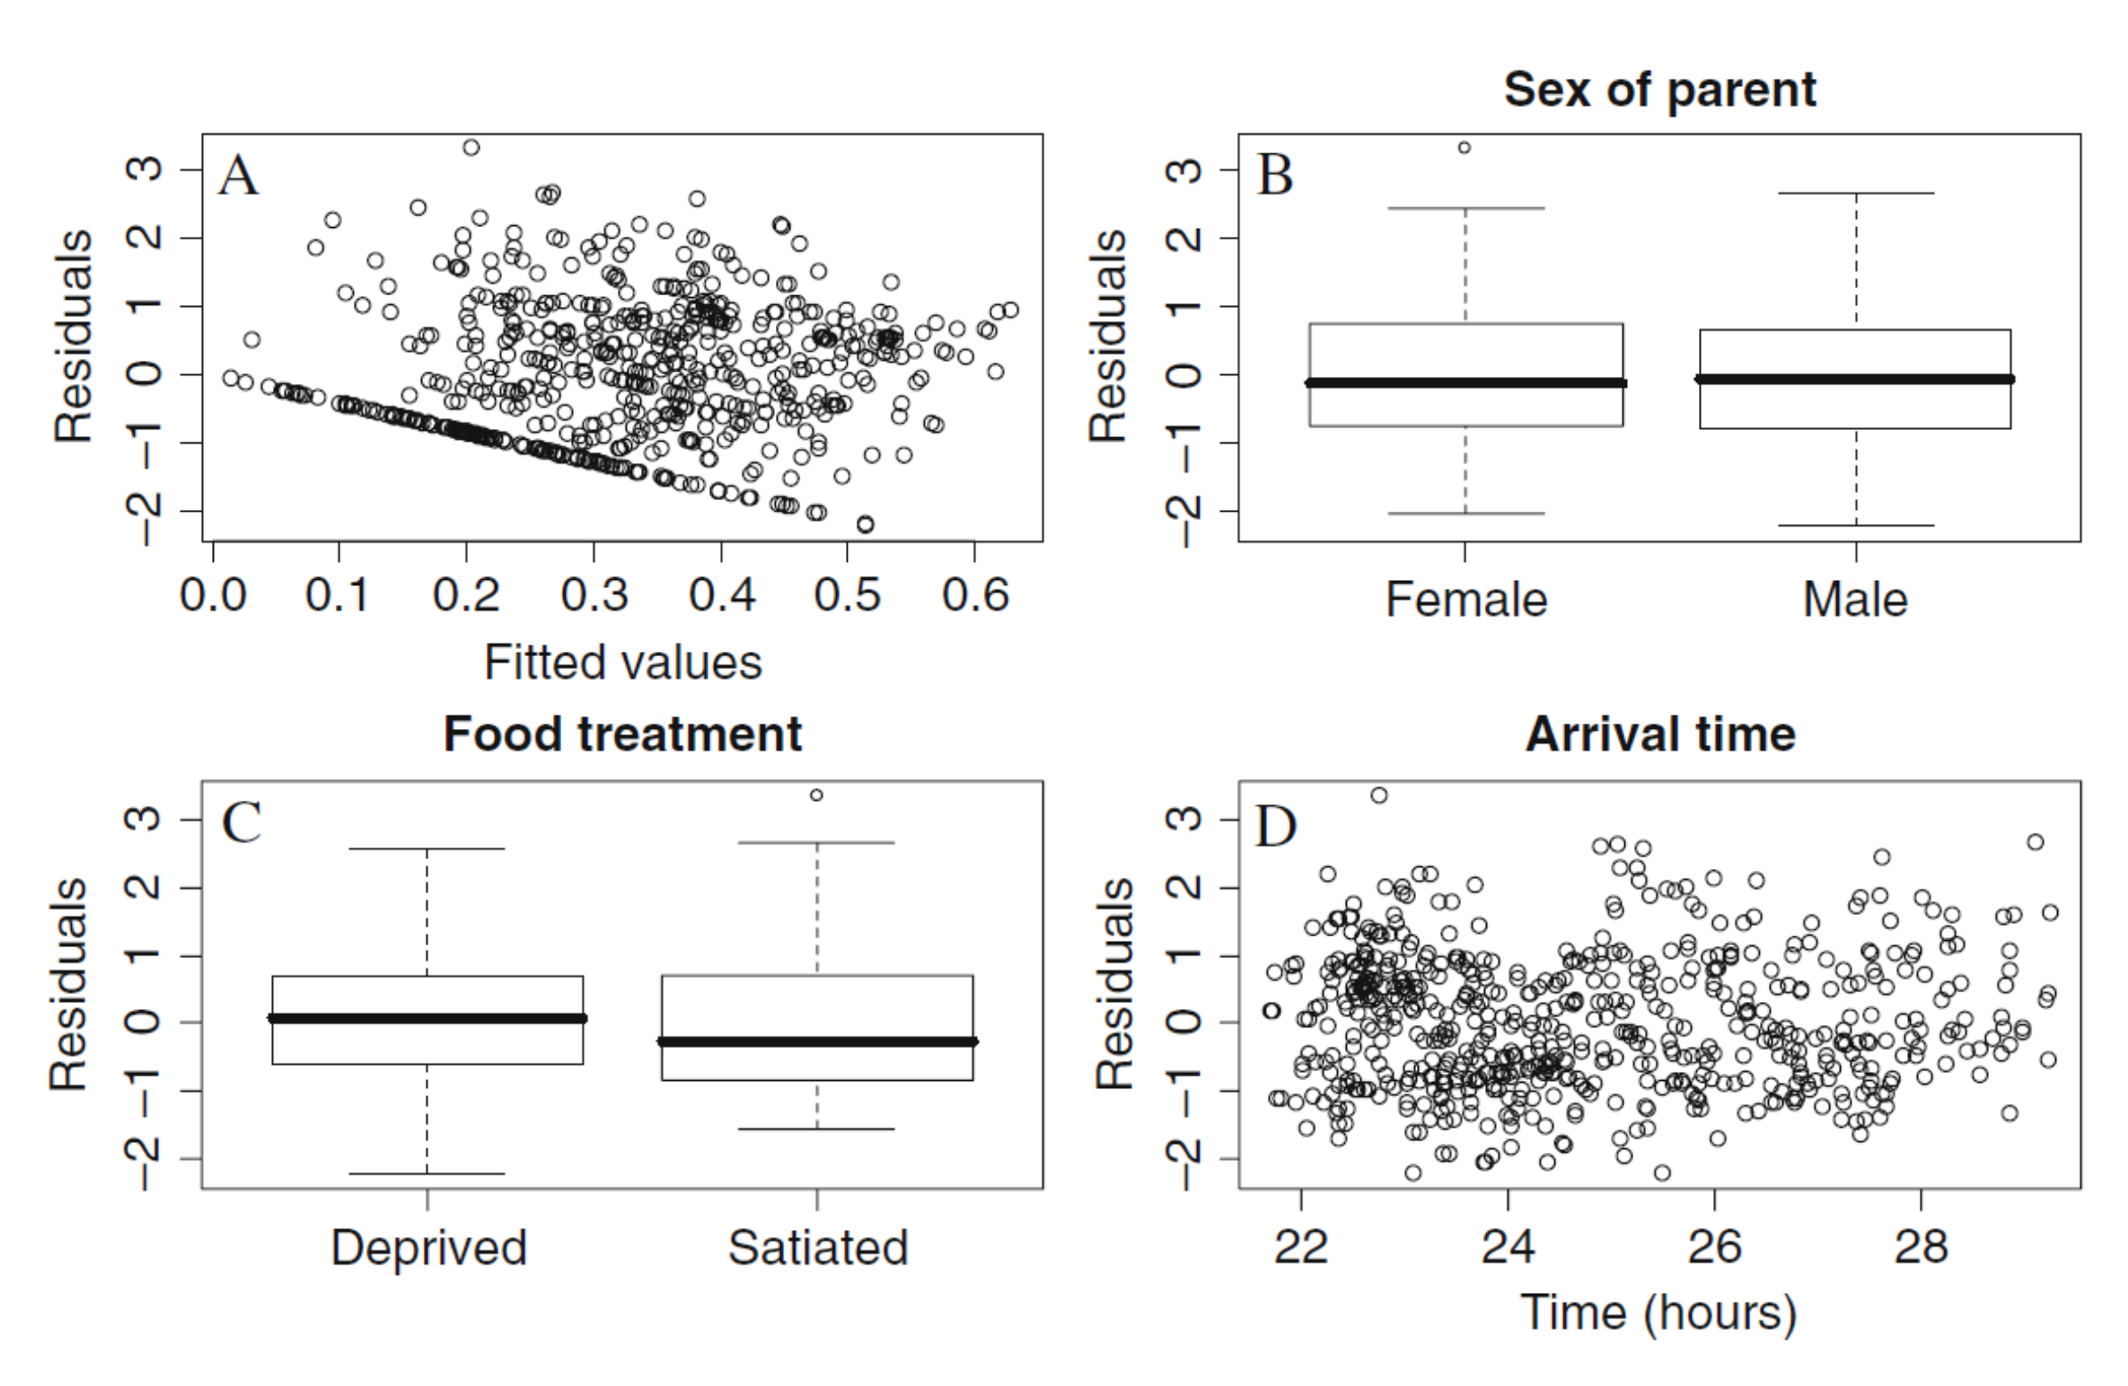
Step 6 validation

Slide 26
Steps 7&8 fixed structure
Look at model results with our chosen random structure Explore other models, working “down” Zuur shows summary, anova,

Slide 27
Steps 7&8 fixed structure
## Effects F P ## 1 (Intercept) 252.6 0.000 ## 2 SexParent 1.5 0.217 ## 3 FoodTreatment 71.4 0.000 ## 4 ArrivalTime 37.1 0.000 ## 5 SexParent:FoodTreatment 0.1 0.714 ## 6 SexParent:ArrivalTime 0.1 0.707

Slide 28
Steps 7&8 fixed structure
Have to be careful with anova() due to an order effect for interaction term Particulary important if you have specific hypotheses for the interactions, like here Look at summary()…

Slide 29
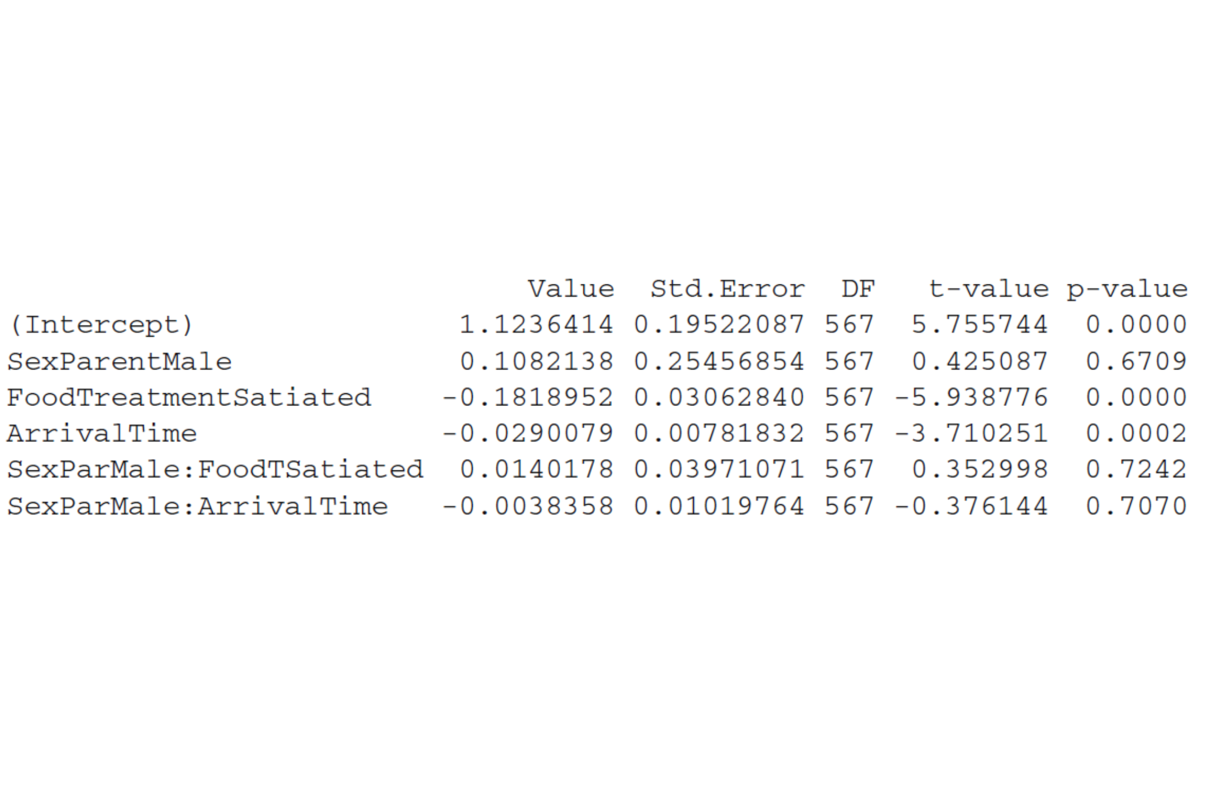
Steps 7&8 fixed structure

Slide 30
Steps 7&8 fixed structure
Likelihood ratio testing is preferred… M1.Full <- lme(Form, random =∼ 1 | Nest, method = “ML”, data = Owls) M1.A <- update(M1.Full, .∼. -SexParent:FoodTreatment) M1.B <- update(M1.Full, .∼. -SexParent:ArrivalTime)

Slide 31
Steps 7&8 fixed structure
Based on the evidence on the next slide, it is decided to drop the parentSex:FoodTreatment interaction The reasons for this specific choice are weak and subjective NB there can be several to many rounds of this kind of model selection

Slide 32
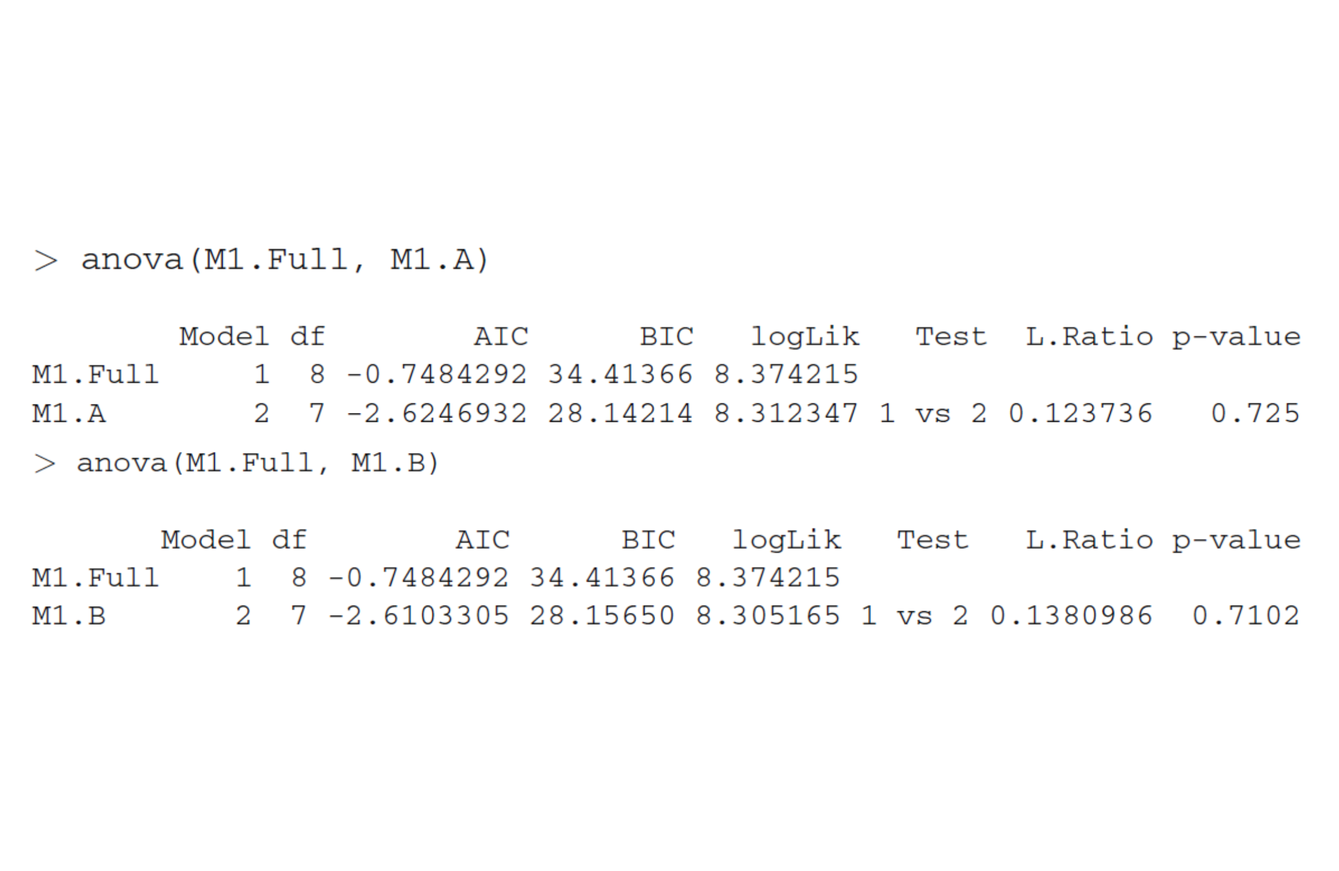
Steps 7&8 fixed structure

Slide 33
Steps 7&8 fixed structure

Slide 34
Steps 7&8 fixed structure
Choices: -drop sex:arrivalTime interaction -test dropping each main effect -drop parent sex lmeLogNeg ∼ FoodTreatment + ArrivalTime, random= ∼1 | Nest

Slide 35
Step 9 REML & validate
M5 <- lme(LogNeg ∼ FoodTreatment + ArrivalTime, random= ∼1 | Nest, method = “REML”, data = Owls) summary(M5)

Slide 36
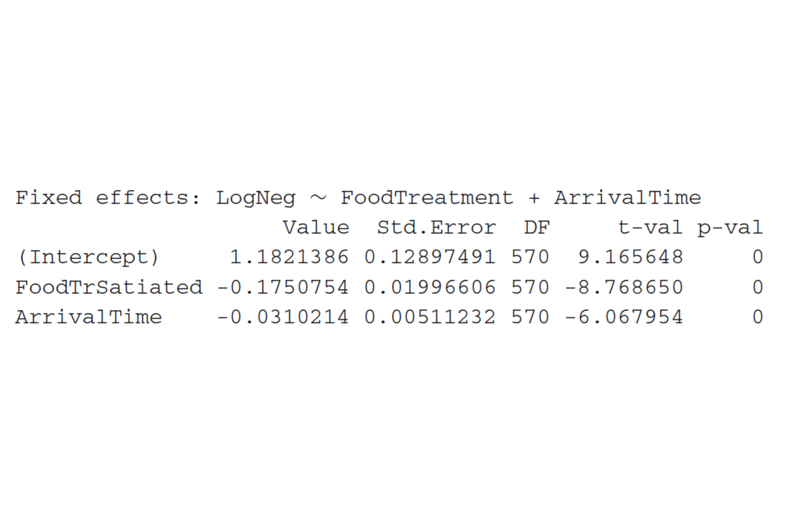
Step 9 REML & validate

Slide 37
Step 9 REML & validate
-food treeatment and arrival time of parent both highly sig. -FoodTr parameter -0.175 (log) calls less for satiated owls -Arrival parameter -0.03 (log) calls less the alter parents arrive

Slide 38
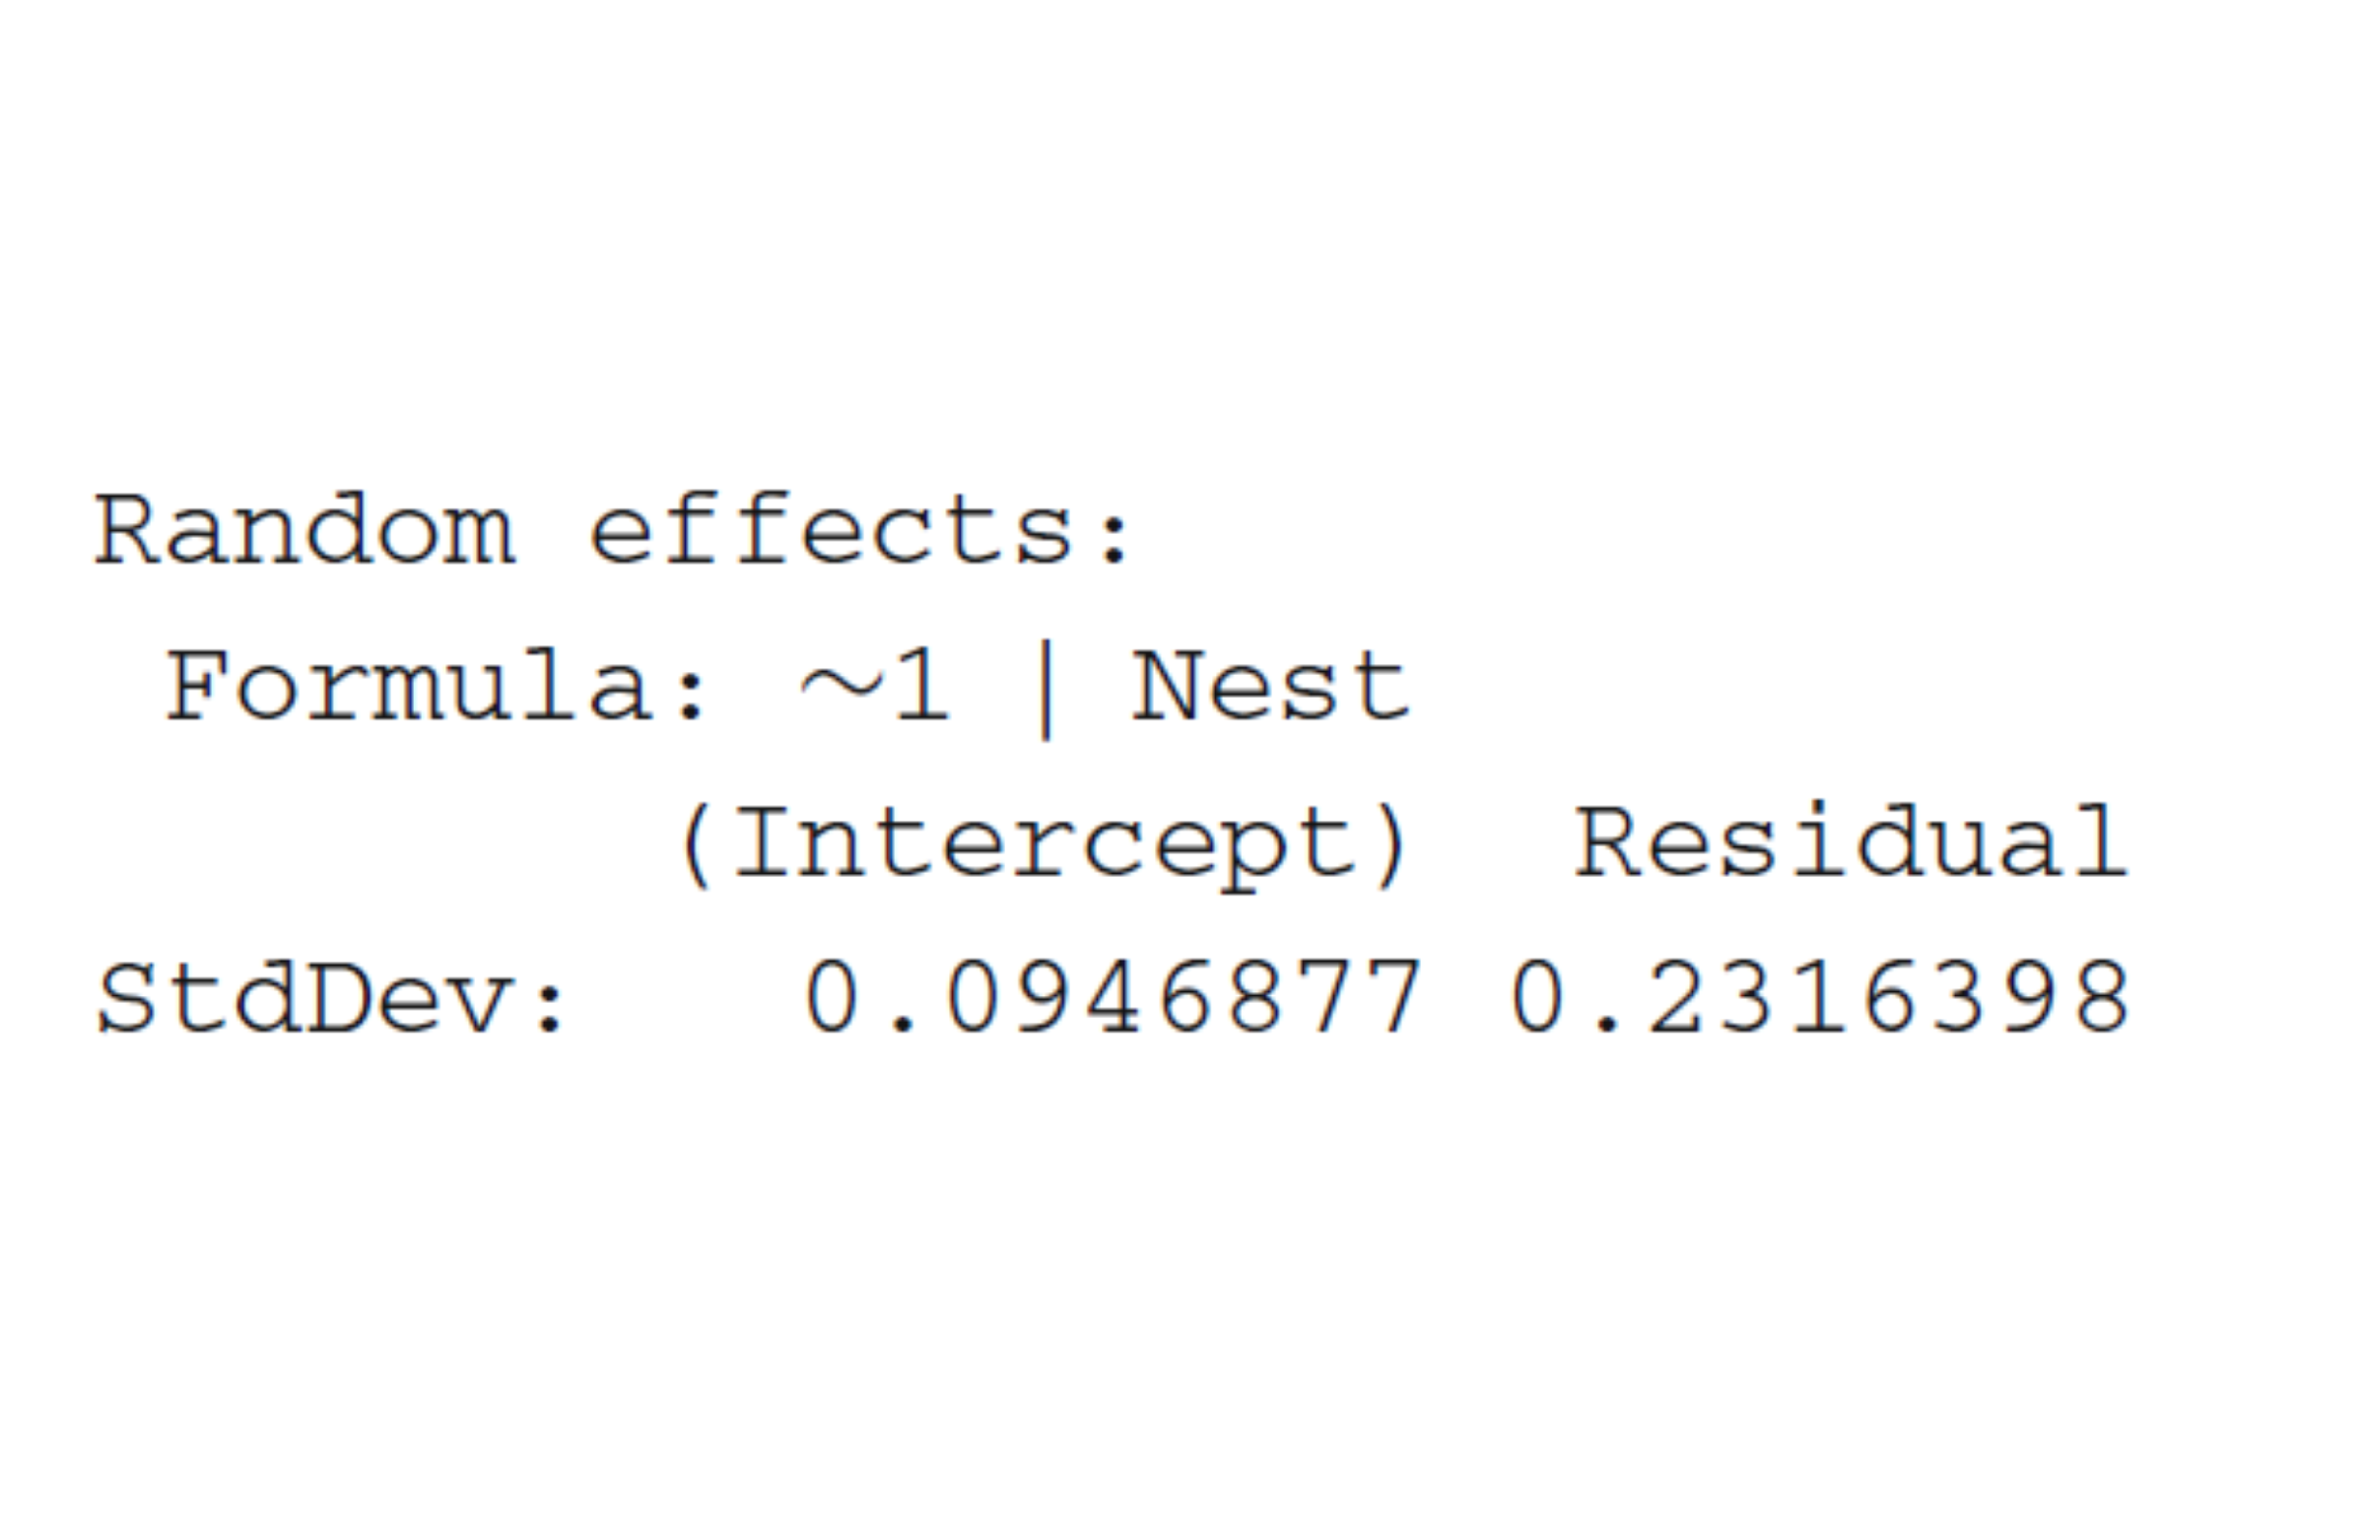
Step 9 REML & validate

Slide 39
Step 9 REML & validate
The random effects variance can be used to calculate how correlated observations are within our random effect parameter (nest)

Slide 40
Step 9 REML & validate
“As to the random effects, the random intercept … variance 0.09^2” “The residual term … variance 0.23^2” “These two variances … calculate the correlation between observations from the same nest:” “0.09^{2/(0.09}2 + 0.23^2) = 0.13 (low, but significant”

Slide 41
Step 10 Explain it
This is really the hard but interesting part If interested in owls: Roulin, A. and Bersier, L.F., 2007. Nestling barn owls beg more intensely in the presence of their mother than in the presence of their father. Animal Behaviour, 74(4), pp.1099-1106.

