Slide 1
Zuur Ch 07 Violation of Independence II
HARUG! QRantine edition Ed Harris

Slide 2
HARUG Schedule
This week Zuur Ch 07
July 08 Meta analysis I (+ MSc)
Volunteers/topics please
July 08 Meta analysis II (+ MSc)

Slide 3
Chapter 07
Principle assumption of independence of observations
Part II: spatial non-independence
“Spatial autocorrelation”
Perfect e.g. instead of “blocked” experiments

Slide 4
Chapter 07
The general principle with spatial data is that things that are close to each other are likely to be more similar than things that are further apart (Tobler, 1979).

Slide 5
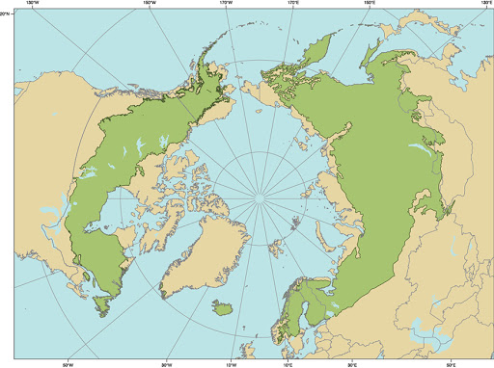
Boreality data
Boreal forests

Slide 6
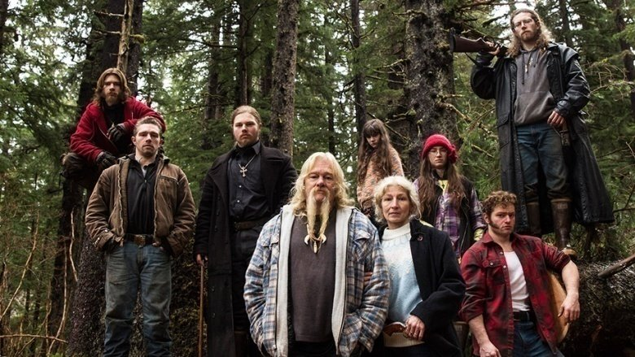
Boreality data
Boreal forests

Slide 7
Boreality data
Dependent var = Boreal index
(# boreal spp / # all spp) Response vars = wetness, NDVI, Temp, greenness Also, x and y (lat and long)

Slide 8
Boreality data
$z_{i}=(1000×(S_{i}+1)n_{i}+i)^{1/2}$
$S_{i}$ - Boreal spp at site $i$ (Cressie 1993 or a newer spatial stats reference)

Slide 9
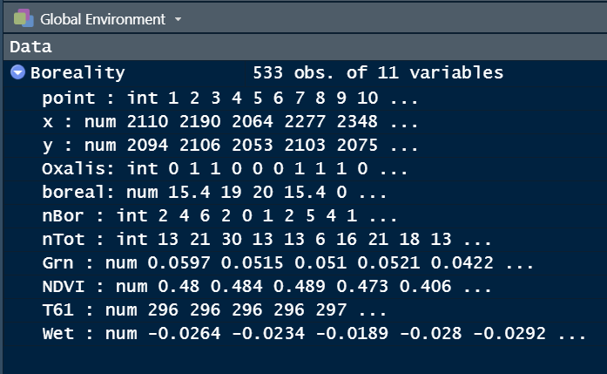
Boreality data
Boreal forests

Slide 10
Boreality data
Step 1 baseline regression $z_{i}=α+β×Wetness+ϵ_{i}$ R formula
lm(Bor ∼ Wet, data = Boreality)

Slide 11
Boreality data
# load("data/Boreality.rdata") Boreality$Bor <- sqrt(1000 * (Boreality$nBor + 1) / (Boreality$nTot)) B.lm <- lm(Bor ~ Wet, data = Boreality)

Slide 12
Boreality data
round(summary(B.lm)$coefficients, 3)
## Estimate Std. Error t value Pr(>|t|) ## (Intercept) 18.488 0.379 48.817 0 ## Wet 165.804 10.599 15.643 0

Slide 13
Boreality data
E <- rstandard(B.lm) mydata <- data.frame(E, Boreality$x, Boreality$y) # library(sp) coordinates(mydata) <- c("Boreality.x","Boreality.y") # library(gstat) << worth trying bubble(mydata, "E", col = c("black","grey"), main = "Residuals", xlab = "X-coordinates", ylab = "Y-coordinates")

Slide 14
Boreality data
## E Boreality.x Boreality.y ## 1 0.31163650 2109.70 2093.52 ## 2 0.23607506 2190.18 2105.71 ## 3 -0.02143534 2064.48 2052.77 ## 4 0.38794273 2277.34 2103.42 ## 5 -1.39691987 2347.91 2074.81 ## 6 1.02411018 2437.21 2086.95
## coordinates E ## 1 (2109.7, 2093.52) 0.31163650 ## 2 (2190.18, 2105.71) 0.23607506 ## 3 (2064.48, 2052.77) -0.02143534 ## 4 (2277.34, 2103.42) 0.38794273 ## 5 (2347.91, 2074.81) -1.39691987 ## 6 (2437.21, 2086.95) 1.02411018

Slide 15
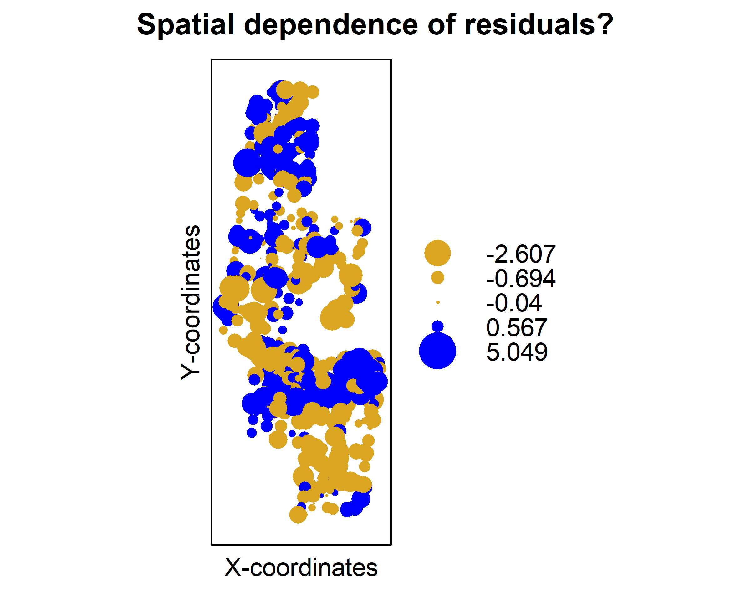
Boreality data

Slide 16
Boreality data
Another method of assessing non-independence of data is the variogram, looking at similarity of values that are near one another There is a lot of detail here; if you are serious see Zuur 2007 or a spatial stats text

Slide 17
Boreality data
BASICALLY You model similarity (correlation) between values sampled at differeng distances from one another

Slide 18
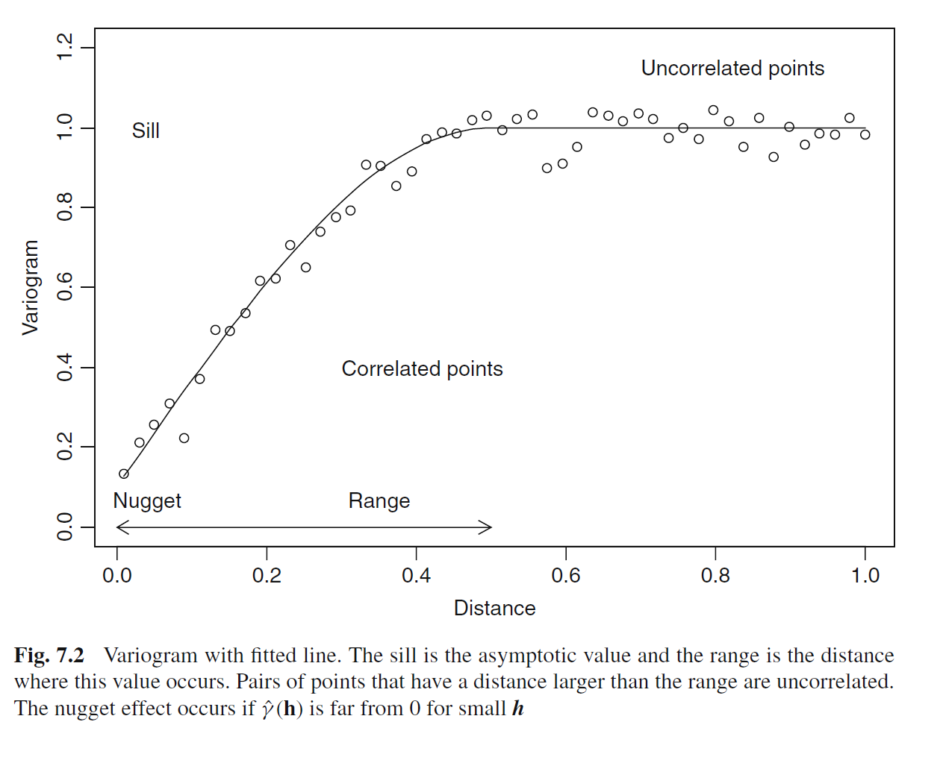
Example variogram
Boreal forests

Slide 19
Boreality data
# Looking for an obvious "sill effect" Vario1 = variogram(E ~ 1, mydata) plot(Vario1) # Looking for directionality Vario2 <- variogram(E ~ 1, mydata, alpha = c(0, 45, 90,135) ) plot(Vario2)

Slide 20
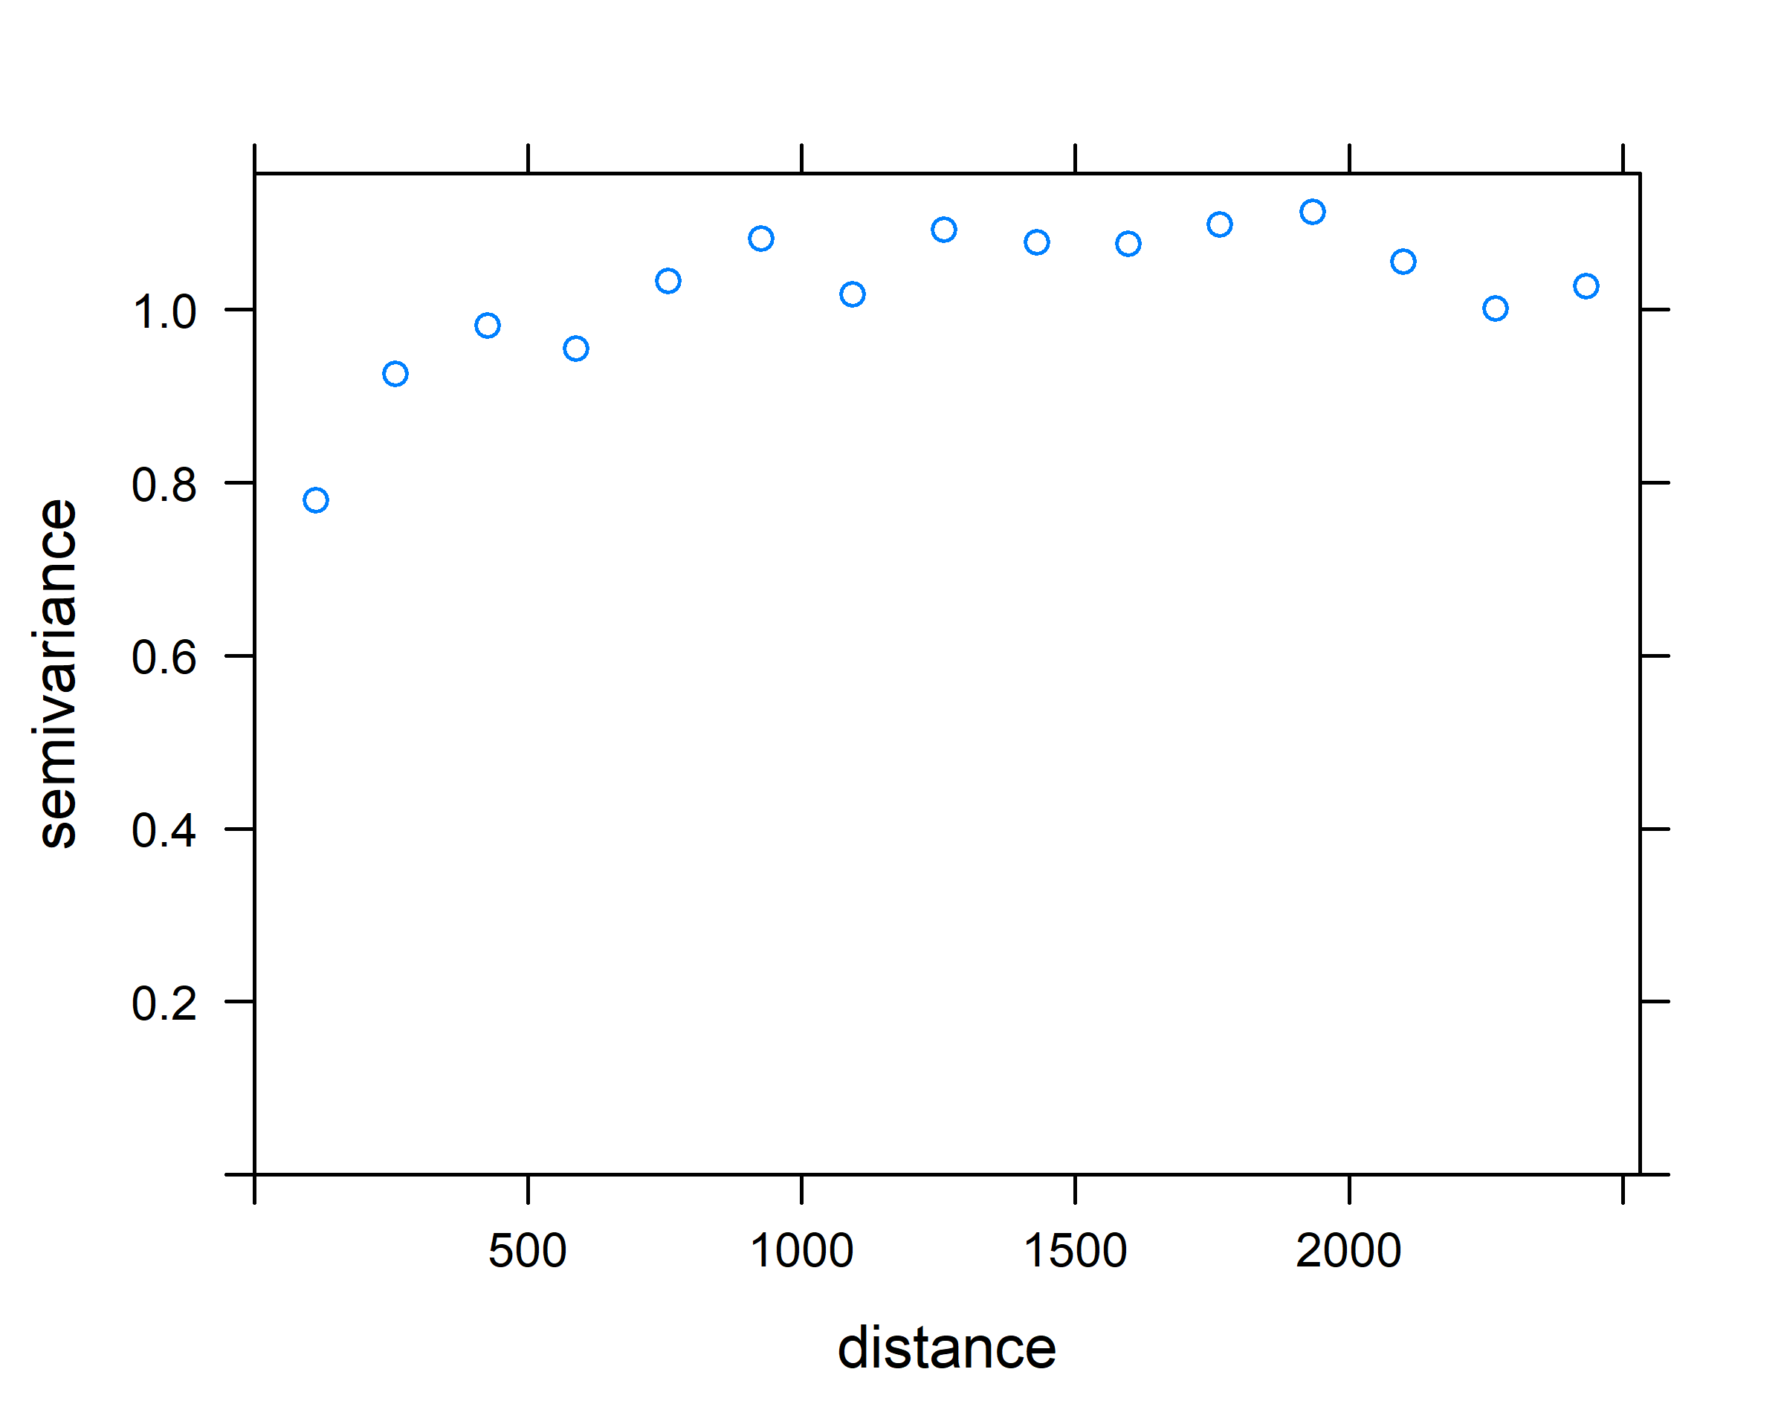
Boreality data

Slide 21
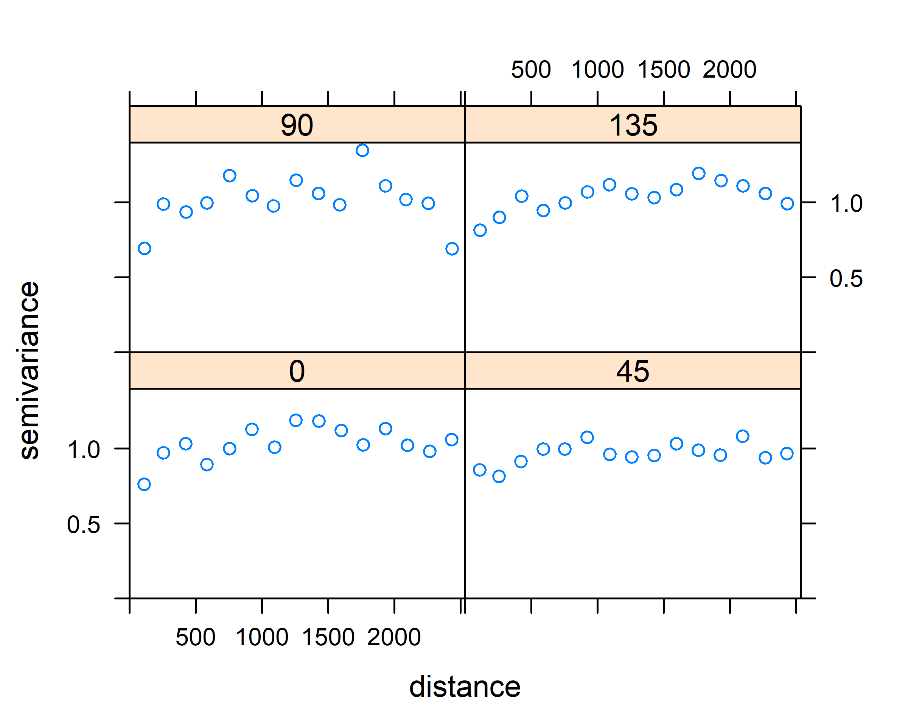
Boreality data

Slide 22
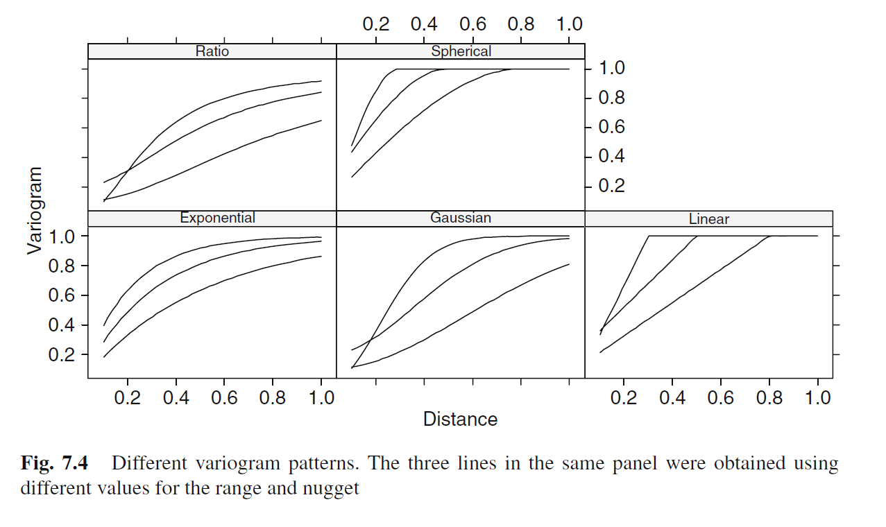
gls() to model cor structure
Boreal forests

