Slide 1
Data Science Skills Test
DS Garage + test-of-test Ed Harris

Slide 2
HARUG
Website with files: http://operorgenetic.com/wp/
Join us on Slack: https://bit.ly/38AocSD
If you want HARUG emails (for MSc folks), email Ed with subject: “ADD ME TO HARUG EMAIL PLEASE”

Slide 3
HARUG
July 22 Meta analysis II (+ MSc)
July 29
Aug 05 Suggestions… or summer break?

Slide 4
Data Science MSc
You may know about the new Data Science MSc in Ag, food, and environment?
https://bit.ly/3jTxoqc

Slide 5
I had a vision
“We live in a fantasy world, a world of great illusion. The great task in life is to find reality.”
Iris Murdoch

Slide 6
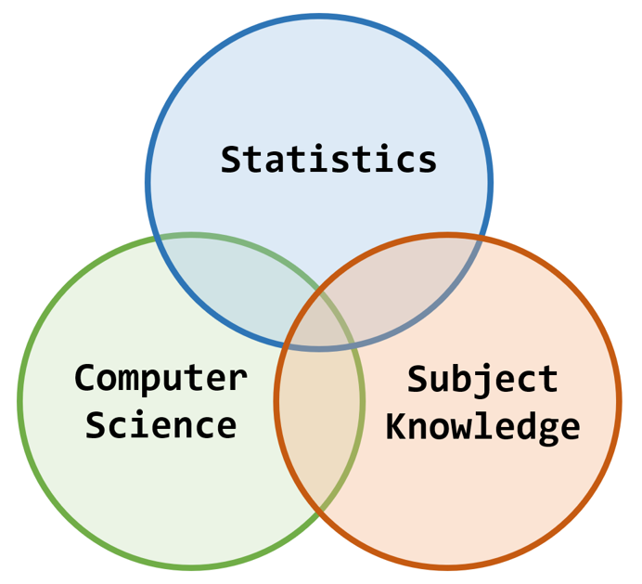
I had a vision

Slide 7
I had a vision
Folks with specific interests and knowledge
No background in programming or stats
“first stats course” does not count
Require bootcamp…

Slide 8
I had a vision
Bootcamp training online
https://dsgarage.netlify.app/
3 modules (R prog, stats, markdown and github)
Minimal assessment…

Slide 9
Bootcamp assessment
Should be easy to administer
Training + test ~ 20 hours
Should be easy to pass
(if the bootcamp material has been engaged with…)

Slide 10
Bootcamp assessment
Try Shiny app + {learnr}
NB “constructive alignment”
We will test drive this

Slide 11
Bootcamp assessment
https://bit.ly/3fh8vl6

