Slide 1
Meta-Analysis Methods I
Basics of effect size and meta-analysis Ed Harris

Slide 2
HARUG
Website with files: http://operorgenetic.com/wp/
Join us on Slack: https://bit.ly/38AocSD
If you want HARUG emails (for MSc folk), email Ed with subject: “ADD ME TO HARUG EMAIL PLEASE”

Slide 3
HARUG Schedule
July 08 Meta analysis I (+ MSc)
Joe R: Make your own R + Hugo + Github + Netlify website
July 22 Meta analysis II (+ MSc)
Suggestions?

Slide 4
Meta-analysis
meta-analysis

Slide 5
Meta-analysis
“the statistical analysis of a large collection of analysis results from individual studies for the purpose of integrating the findings” –Glass (1976)
Standard tool
Common in Psych and Health
Several core methods…

Slide 6
Meta-analysis
The evidence you extract is based on the concept of effect size There are several kinds of effect size in meta-analysis
Compare means (Cohen’s d)
Correlation (r)

Slide 7
Effect size
meta-analysis

Slide 8
Effect size
We will focus on comparison of means, Cohen’s d
$d=\frac{{\overline{X}}_{1}−{\overline{X}}_{2}}{sd_{pooled}}$ $sd_{pooled}=\sqrt[​]{\frac{(n_{1}−1)S_{1}^{2}+(n_{2}−1)S_{2}^{2}}{n_{1}+n_{2}−2}}$

Slide 9
Info you need
$d=\frac{{\overline{X}}_{1}−{\overline{X}}_{2}}{sd_{pooled}}$ ${\overline{X}}_{1}$ - mean of group 1
${\overline{X}}_{2}$ - mean of group 2
$sd_{pooled}$ - pooled std. dev…

Slide 10
Info you need
$sd_{pooled}=\sqrt[​]{\frac{(n_{1}−1)S_{1}^{2}+(n_{2}−1)S_{2}^{2}}{n_{1}+n_{2}−2}}$
$n_{1},n_{2}$ - sample sizes
$S_{1},S_{2}$ - std. dev.s (note $S^{2}$!)

Slide 11
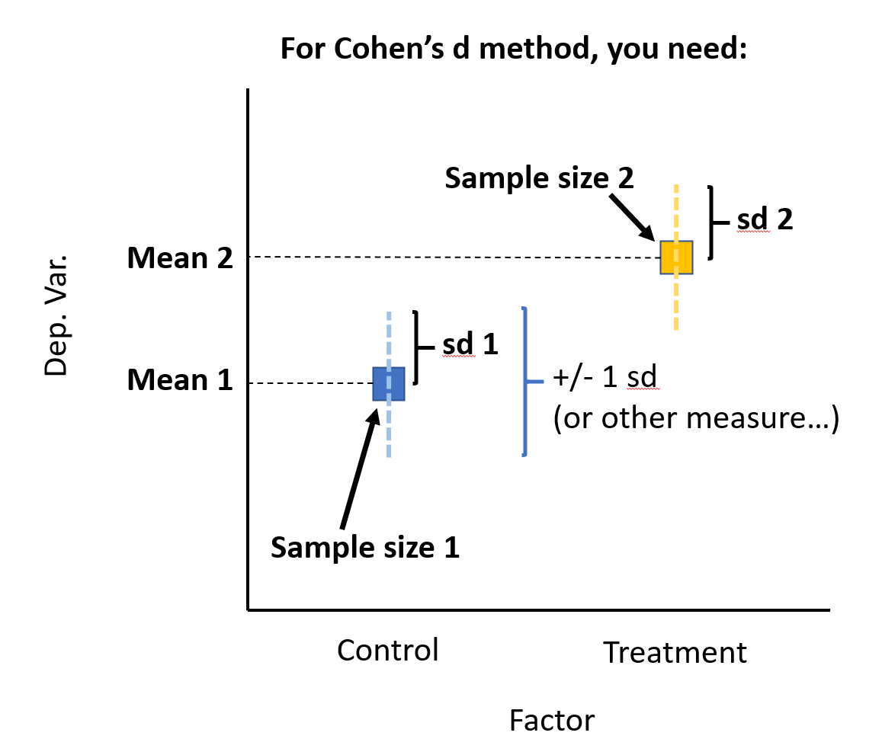
Effect size
meta-analysis

Slide 12
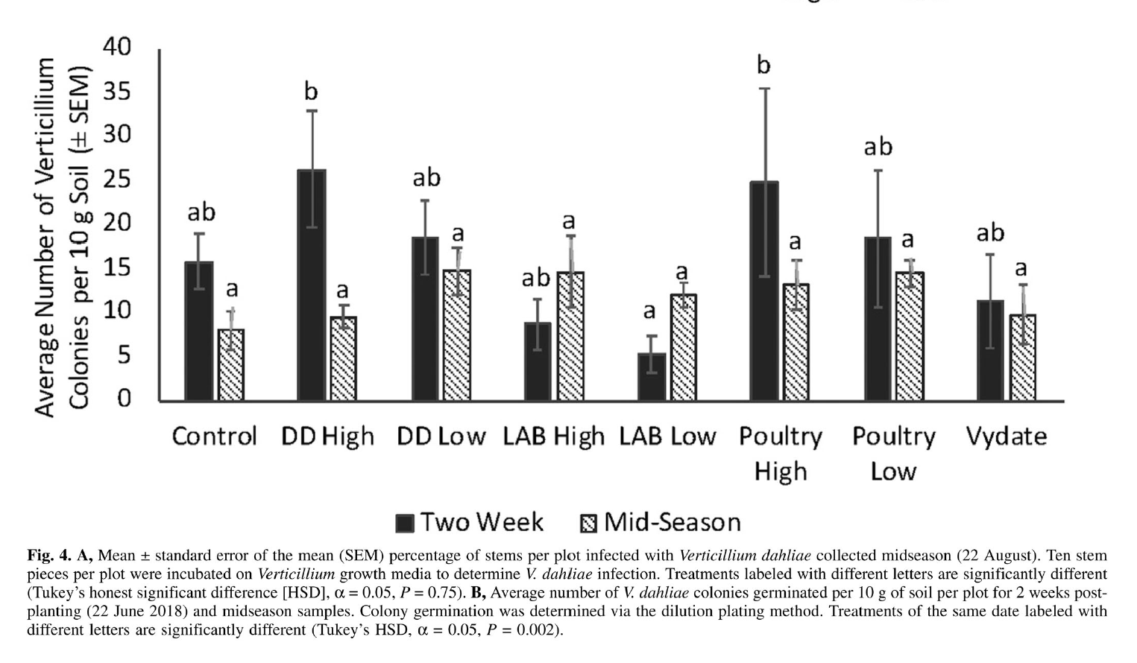
Effect size
meta-analysis

Slide 13
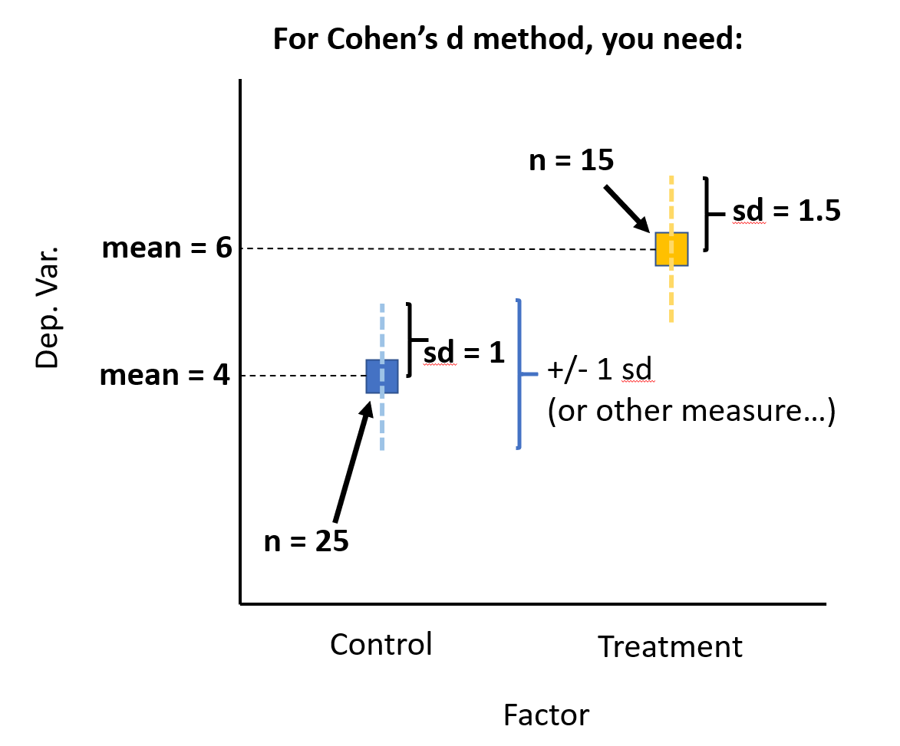
Effect size
meta-analysis

Slide 14
Challenge 1
Calculate your own Cohen’s d from the previous slide!

Slide 15
Challenge 1 Example
$n_{1}$ = 25, $n_{2}$ = 15
$X_{1}$ = 4, $X_{2}$ = 6
$S_{1}$ = 1, $S_{2}$ = 1.5
$sd_{pooled}=\sqrt[​]{\frac{(25−1)1^{2}+(15−1){1.5}^{2}}{25+15−2}}$

Slide 16
Challenge 1 Example R code
# Example calculation sd_pooled <- sqrt(( (25 - 1)*1^2 + (15-1)*1.5^2 ) / (25 + 15 - 2)) sd_pooled
## [1] 1.208522

Slide 17
Challenge 1 Example
Now, calculate d
${\overline{X}}_{1}$ - 4
${\overline{X}}_{2}$ - 6
$sd_{pooled}$ - 1.208522
$d=\frac{6−4}{1.208522}$

Slide 18
Challenge 1 Example
d <- (6 - 4) / 1.208522 d
## [1] 1.654914
# NB Cohen's rules of thumb for "d-family" effect size # small = 0.2 # med = 0.5 # large = 0.8

Slide 19
d is biased by sample size
Your samples for estimates of d are likely to differ in size
d is biased for small sample sizes (especially, e.g. < 30)
It is important to fix this
Naturally we have another variable: Hedge’s g

Slide 20
Hedge’s g correction
$g=J×d$
$J$ is a correction factor
$J=1−\frac{3}{4×df−1}$
$df$ = pooled sample size

Slide 21
Challenge 2
Convert your $d$ to $g$ (say what?!)

Slide 22
Challenge 2 Example
df = n1 + n2 = 25 + 15
$J=1−\frac{3}{4×(25+15)−1}$

Slide 23
Challenge 2 Example R code
J <- 1-(3/(4*(25 + 15) - 1)) J
## [1] 0.9811321

Slide 24
Challenge 2 Example
$g=J×d$
$g=0.9811321×1.208522$
g <- 0.9811321 * 1.208522 round(g, 2) # Recall d = 1.65
## [1] 1.19

Slide 25
Some tools to automate this stuff
R libraries:
library(compute.es) # effect size tools library(MAd) # meta-anaysis tools library(metafor) # more meta-analysis tools

Slide 26
The mes() function
Used to calculate effect sizes from means and SDs
# Example data head(dat.sim.raw[,c(1,2,3,4,7,8,9)])
## id nT m1T sd1T nC m1C sd1C ## 1 204 21 20.76223 5.770542 21 17.94628 6.509704 ## 2 493 19 20.58822 6.023511 19 17.59291 5.231403 ## 3 506 27 20.97342 7.343080 27 17.16798 6.871264 ## 4 509 35 22.10445 6.260434 35 14.68657 6.750049 ## 5 359 20 19.60258 4.892381 20 16.32054 6.497853 ## 6 661 27 19.15768 4.621781 27 14.51018 5.230693

Slide 27
The mes() function
res1 <- mes(m.1 = m1T, m.2 = m1C, sd.1 = sd1T, sd.2 = sd1C, n.1 = nT, n.2 = nC, id = id, data = dat.sim.raw )

Slide 28
The mes() function
# Cohen's d for studies 1-8 res1$d
## [1] 0.46 0.53 0.54 1.14 0.57 0.94 1.46 -0.19
# # # Hedge's h for studies 1-8 res1$g
## [1] 0.45 0.52 0.53 1.13 0.56 0.93 1.45 -0.19

Slide 29
“Aggregating” effect sizes
It is common that more than one effect size might be extracted from a single study.

Slide 30
“Aggregating” effect sizes
E.g., what if you were comparing the use of pesticide to a control, but the studies you measure may have 1, 2 or more separate experiments (leading to 1, 2, or more effect size estimates)

Slide 31
“Aggregating” effect sizes
Choice 1 - ignore and treat all es as independent (problematic because bigger studies are weighted more heavily)
Choice 2 - aggregate effect sizes to 1 per study (there are many methods)

Slide 32
“Aggregating” effect sizes
The “BHHR method” accounts for correlation amongst effect size estimates and is considered robust
Also, it is easy to calculate

Slide 33
“Aggregating” effect sizes
agg() function in {MAd} package
dat.sim.agg <- agg(id = id, es = g, var = var.g, n.1 = nT, n.2 = nC, cor = 0.5, # << safe guess method = "BHHR", # method data = dat.sim.es)

Slide 34
“Aggregating” effect sizes
## id nT nC g var.g pval.g outcome ## 3 506 27 27 0.53 0.07 0.06 g1 ## 4 509 35 35 1.13 0.06 0.00 g1 ## 5 359 20 20 0.56 0.10 0.08 g1 ## 6 661 27 27 0.93 0.08 0.00 g1 ## 7 549 35 35 1.45 0.07 0.00 g1 ## 8 119 31 31 -0.19 0.06 0.46 g1 ## 11 506 27 27 0.57 0.07 0.04 g2 ## 12 509 35 35 1.14 0.07 0.00 g2 ## 13 359 20 20 0.42 0.10 0.19 g2 ## 14 661 27 27 1.13 0.08 0.00 g2 ## 15 549 35 35 1.00 0.06 0.00 g2 ## 16 119 31 31 0.64 0.07 0.02 g2

Slide 35
“Aggregating” effect sizes
## id es var ## 1 204 0.840 0.07487469 ## 2 493 0.865 0.08238613 ## 3 506 0.550 0.05250000 ## 4 509 1.135 0.04870185 ## 5 359 0.490 0.07500000 ## 6 661 1.030 0.06000000 ## 7 549 1.225 0.04870185 ## 8 119 0.225 0.04870185

Slide 36
Estimating summary effect size
This is the estimate of the overall expected effect size for your studies
This is the whole point of meta-analysis

Slide 37
Estimating summary effect size
This is important but subtle (i.e. hard)
Some form of weighted average (e.g. weighted by variance)
Fixed effects, versus random effects

Slide 38
Fixed versus random effects
meta-analysis

Slide 39
Fixed versus random effects
Fixed effects assumes all studies sampled the exact same population (rarely if ever true)
Random effects assumes the studies themselves are sampled from a larger population of studies

Slide 40
Fixed versus random effects
The explanation is…
~ 7 Years Later ~
In conclusion, for almost all meta-analyses, random effects is more appropriate

Slide 41
Random effects
# Arrage aggregated data dat.sim.final <- cbind( dat.sim.agg, dat.sim.raw[, c(12:13)] ) # Just a sample dat.sim.final[sample(nrow(dat.sim.final),3),]
## id es var dose stress ## 1 204 0.840 0.07487469 10 high ## 7 549 1.225 0.04870185 14 high ## 2 493 0.865 0.08238613 11 high

Slide 42
Meta-regression mareg()
## Warning in model.matrix.default(terms, mf, contrasts): non-list contrasts ## argument ignored
## ## Model Results: ## ## estimate se z ci.l ci.u p ## intrcpt 0.797 0.130 6.121 0.542 1.053 0 ## ## Heterogeneity & Fit: ## ## QE QE.df QEp QM QM.df QMp ## [1,] 16.228 7.000 0.023 37.469 1.000 0

Slide 43
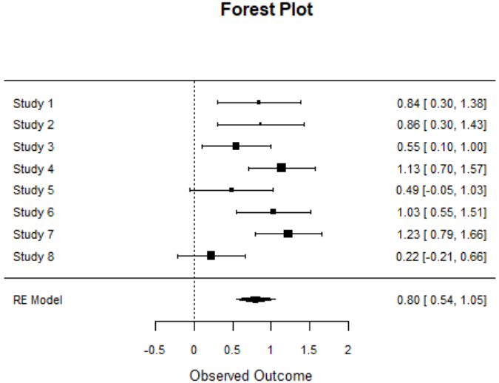
Forest plot for our model
meta-analysis

Slide 44
References: a note
Web tutorials should be avoided by beginners
Books are not realistic
Some papers I think are useful…

Slide 45
References
meta-analysis

Slide 46
References
meta-analysis

Slide 47
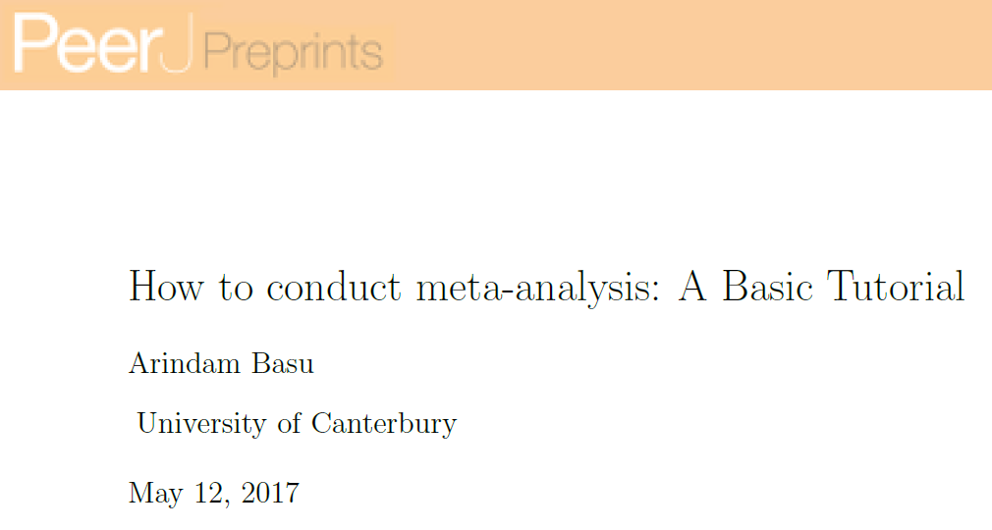
References
meta-analysis

Slide 48
References
meta-analysis

