Slide 1
Meta-Analysis Methods II
Basics of effect size and meta-analysis Ed Harris

Slide 2
HARUG
Website with files: http://operorgenetic.com/wp/
Join us on Slack: https://bit.ly/38AocSD
If you want HARUG emails (for MSc folks), email Ed with subject: “ADD ME TO HARUG EMAIL PLEASE”

Slide 3
HARUG
July 15 Joe R: Make your own R + Hugo + Github + Netlify website
July 22 Meta analysis II (+ MSc)
July 29 Data Science Bootcamp self-assessment

Slide 4
The mystery of Teams Video
(Effect size video) https://web.microsoftstream.com/video/755aaa3e-8c1e-4c2b-ba14-dbf0f9cd551f
(Meta-analysis I) https://web.microsoftstream.com/video/68de67cf-769b-4909-8977-9c10d74d4f39

Slide 5
The mystery of Teams Video
What we know so far
Sign in to Teams!
(for real, sign in)

Slide 6
What we did last time
meta-analysis

Slide 7
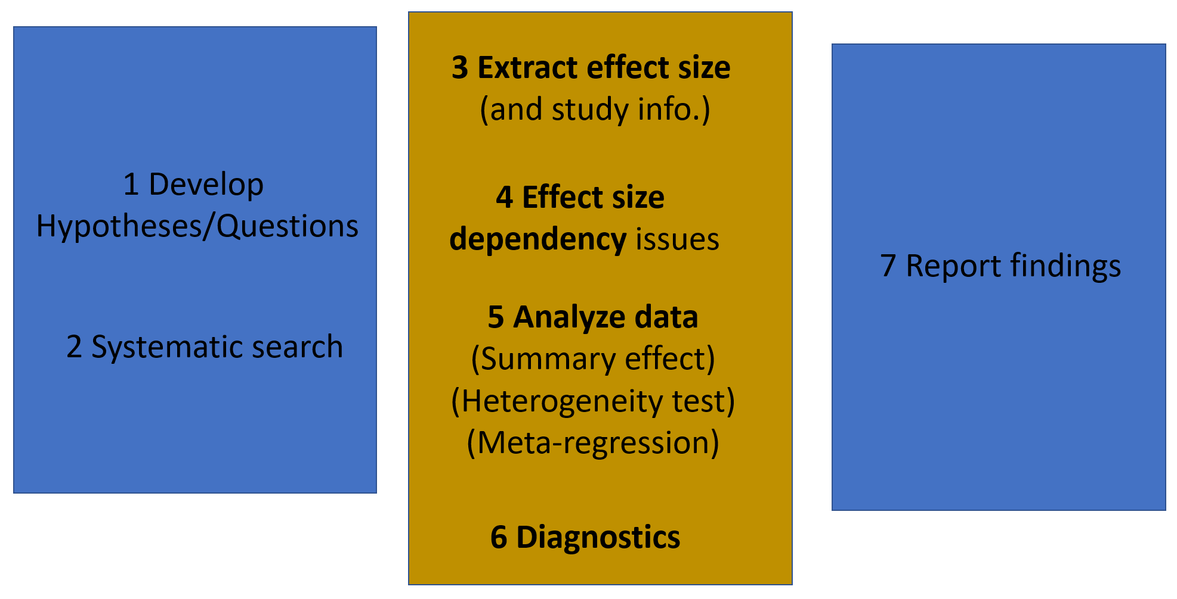
What we did last time
meta-analysis

Slide 8
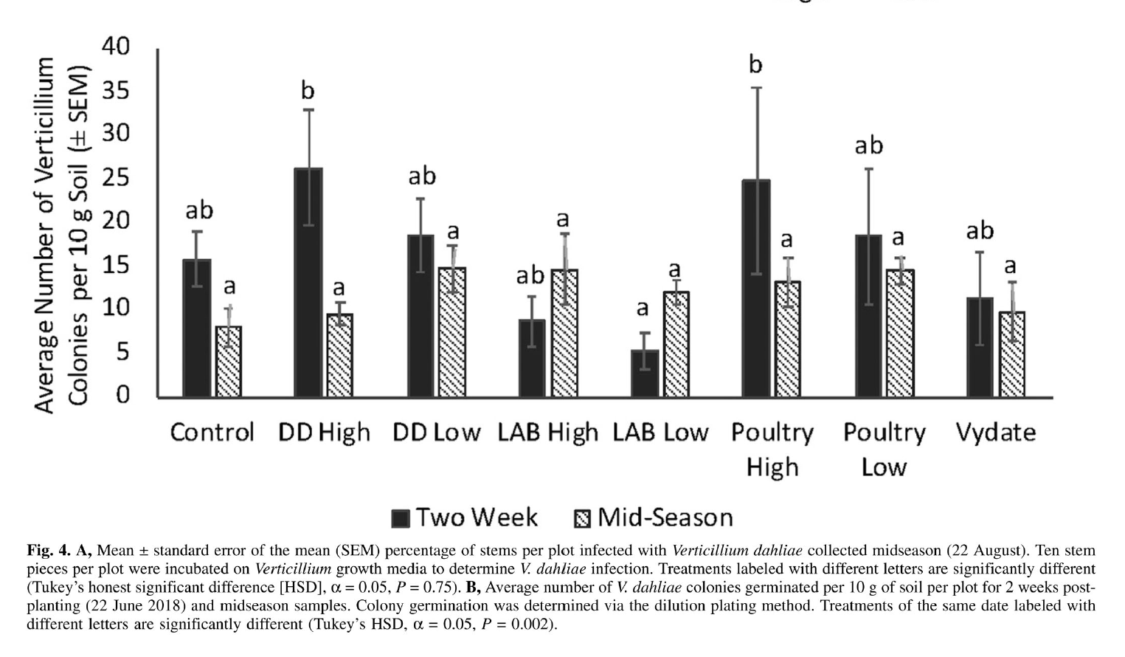
What we did last time
meta-analysis

Slide 9
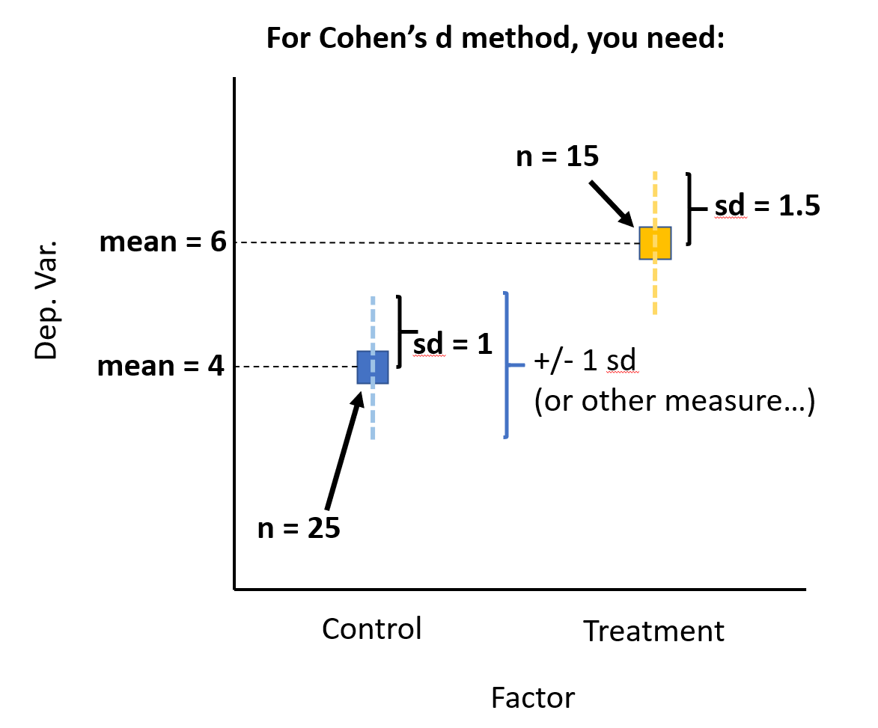
What we did last time
meta-analysis

Slide 10
What we did last time
Defined Cohen’s d
Example calculation for Cohen’s d
ES bias and Hedge’s g
R tools
library(compute.es) # effect size tools library(MAd) # meta-anaysis tools library(metafor) # more meta-analysis tools

Slide 11
What we did last time
The mes() function Used to calculate effect sizes from means and SDs
# Example data head(dat.sim.raw[,c(1,2,3,4,7,8,9)])
## id nT m1T sd1T nC m1C sd1C ## 1 204 21 20.76223 5.770542 21 17.94628 6.509704 ## 2 493 19 20.58822 6.023511 19 17.59291 5.231403 ## 3 506 27 20.97342 7.343080 27 17.16798 6.871264 ## 4 509 35 22.10445 6.260434 35 14.68657 6.750049 ## 5 359 20 19.60258 4.892381 20 16.32054 6.497853 ## 6 661 27 19.15768 4.621781 27 14.51018 5.230693

Slide 12
What we did last time
The mes() function in action
res1 <- mes(m.1 = m1T, m.2 = m1C, sd.1 = sd1T, sd.2 = sd1C, n.1 = nT, n.2 = nC, id = id, data = dat.sim.raw )

Slide 13
What we did last time
The mes() function output
# mes() output names(res1)[c(1, 3:6, 13)]
## [1] "id" "n.1" "n.2" "d" "var.d" "g"
# # Cohen's d for studies 1-8 res1$d
## [1] 0.46 0.53 0.54 1.14 0.57 0.94 1.46 -0.19
# # Hedge's h for studies 1-8 res1$g
## [1] 0.45 0.52 0.53 1.13 0.56 0.93 1.45 -0.19

Slide 14
What we did last time
aggregating effect size with agg()
fixed versus random effects mareg()
overall summary effect size

Slide 15
Today
meta-analysis

Slide 16
Meta-analysis
meta-analysis

Slide 17
What you will learn
(Marco) Alternative reporting of variation
Suggested 2 (real life) papers
Good news and bad news good news first

Slide 18
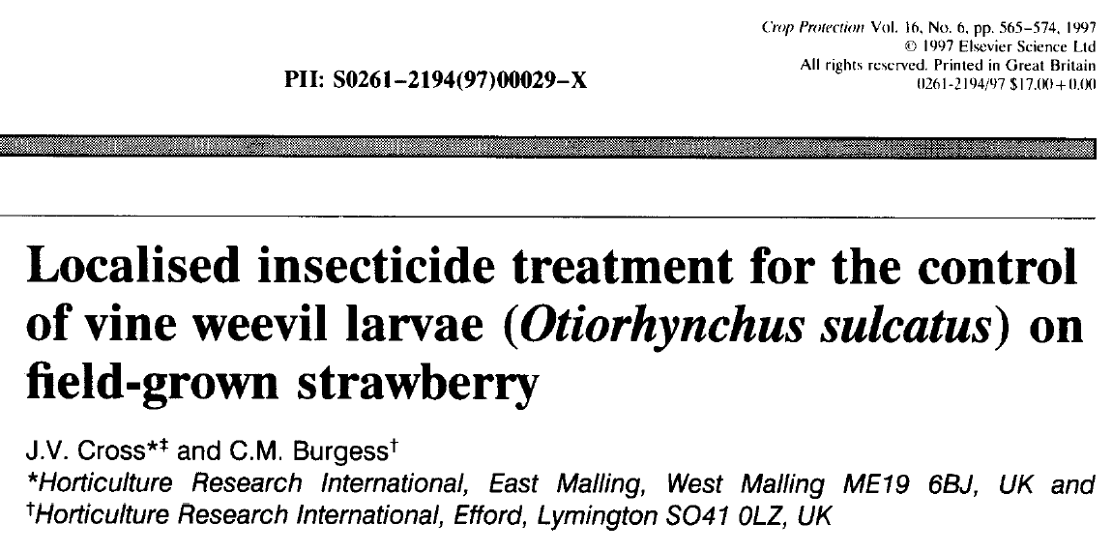
Marco’s paper 1
meta-analysis

Slide 19
Marco’s paper 1
Pest vine weevil on strawberry
Several experiments and factor (rate/dose, “module system”)
Reporting SED

Slide 20
Marco’s paper 1
meta-analysis

Slide 21
Review of what you want
mean and standard deviation and sample size
$SD_{sample}=\sqrt[​]{VAR}=\sqrt[​]{\frac{∑(x_{i}−u)^{2}}{n−1}}$
$SE_{sample}=\frac{SD_{sample}}{\sqrt[​]{n}}$

Slide 22
Review of what you want
measure <- c(3,6,2,7,8) # Example data ss <- length(measure) # Sample size (sd <- sd(measure)) # Std dev
## [1] 2.588436
(se <- sd/sqrt(ss)) # Std error
## [1] 1.157584
# back to sd se*sqrt(ss) # Convert back to sd
## [1] 2.588436

Slide 23
Marco’s paper 1
meta-analysis

Slide 24
Marco’s paper 1
This paper mentions Standard Error of the Difference (SED)
SED is the variation of the differences between means
This is a measure of certainty in our estimate of the difference (so it is similar in concept to Cohen’s d)

Slide 25
What is SED?
You are not going to understand this stuff Googling - play with some numbers
$SE_{sample}=\frac{SD_{sample}}{\sqrt[​]{n}}$

Slide 26
What is SED?
$SED=\sqrt[​]{\frac{SD_{1}^{2}}{n_{1}}+\frac{SD_{2}^{2}}{n_{2}}+...\frac{SD_{n}^{2}}{n_{n}}}$
(from Cross)
$SED=(SE_{1}^{2}+SE_{2}^{2})^{1/2}$

Slide 27
Sokal and Rohlf
meta-analysis

Slide 28
Marco’s paper 1
For Cross Table 2, we are given:
-Treatment combo means (SE)
-A formula for SED (kindness)
-A df value (37) <<what does it mean??

Slide 29
Marco’s paper 1
Activity: what does df = 37 mean?
You can find the paper here:
https://bit.ly/3hpVVkG
(last paragraph beginning on pg 567, “The second field experiment…”)

Slide 30
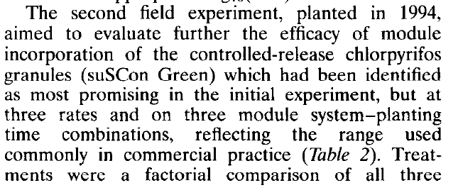
Marco’s paper 1
meta-analysis

Slide 31
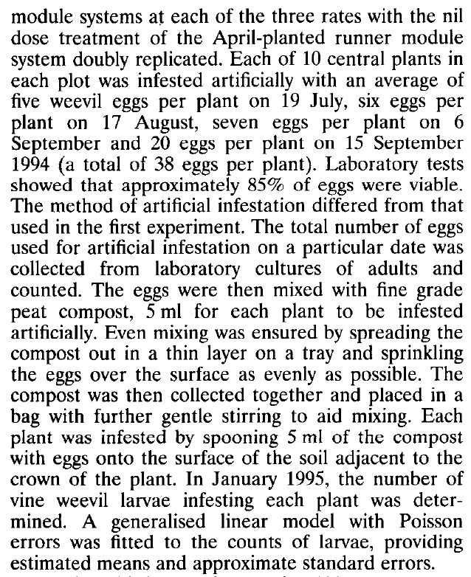
Marco’s paper 1
meta-analysis

Slide 32
Marco’s paper 1
meta-analysis

Slide 33
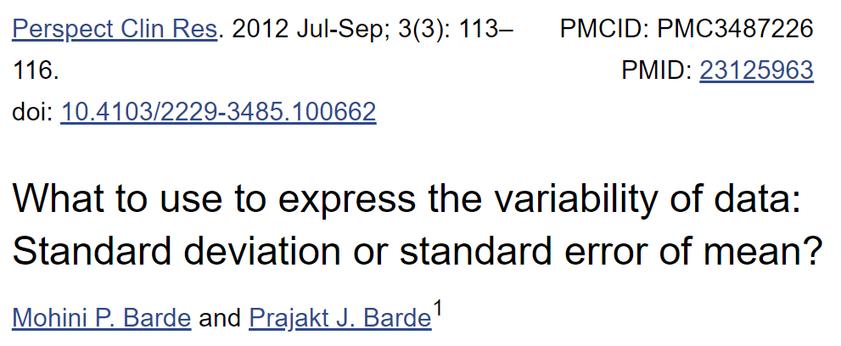
https://bit.ly/3eQAYxV
meta-analysis

Slide 34
Also see
meta-analysis

Slide 35
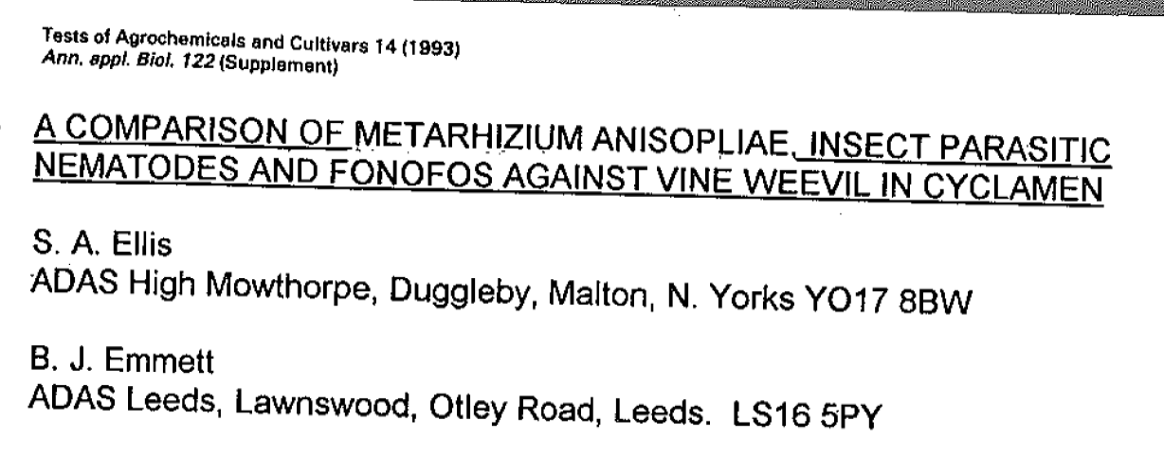
Marco’s paper 2
meta-analysis

Slide 36
https://bit.ly/3jsCHwC
Vine weevil and strawberry
8 replicates, 7 treatment = ss of 56 (gently comment about “star wars”)
Hypothesis: post hoc comparison of treatment means
Duncan’s test (exactly same hypothesis as Tukey HSD, but higher probability of type 1 errors)
Popular in older articles

Slide 37
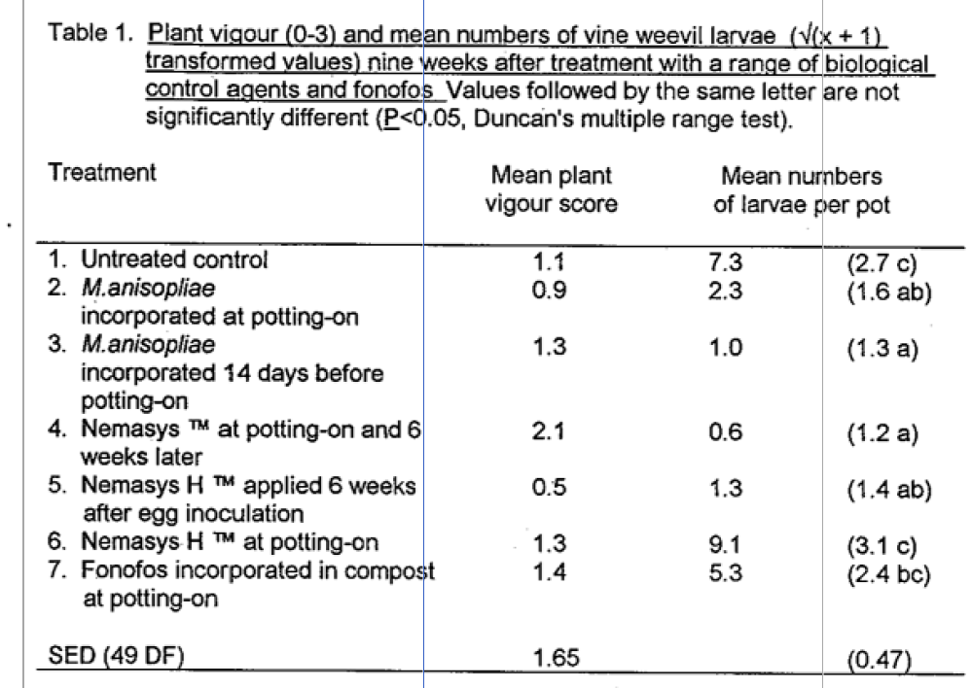
Marco’s paper 2
meta-analysis

Slide 38
Marco’s paper 2
# vigour column vig <- c(1.1,0.9,1.3,2.1,0.5,1.3,1.4) mean(vig)
## [1] 1.228571
# larvae count column larv <- c(7.3, 2.3, 1.0, 0.6, 1.3, 9.1, 5.3) mean(larv)
## [1] 3.842857
# the "thing" column thing <- c(2.7,1.6,1.3,1.2,1.4,3.1,2.4)

Slide 39
Marco’s paper 2
# is thing the variance of mean? (sqrt(thing[1]/8 + thing[2]/8 + thing[3]/8 + thing[4]/8 + thing[5]/8 + thing[6]/8 + thing[7]/8)) # nope
## [1] 1.308625
# is thing the sd of mean? (sqrt(thing[1]^2/8 + thing[2]^2/8 + thing[3]^2/8 + thing[4]^2/8 + thing[5]^2/8 + thing[6]^2/8 + thing[7]^2/8)) # nope
## [1] 1.946471
# is thing the se of mean? (sqrt(thing[1]*sqrt(8) + thing[2]*sqrt(8) + thing[3]*sqrt(8) + thing[4]*sqrt(8) + thing[5]*sqrt(8) + thing[6]*sqrt(8) + thing[7]*sqrt(8))) # nope
## [1] 6.224906

Slide 40
Marco’s paper 2
meta-analysis

Slide 41
Marco’s paper 2
Marco must choose:
Dump this paper
Contact the authors
Make assumptions or guesses

Slide 42
What we did last time
meta-analysis

Slide 43
Random effects
# Arrage aggregated data dat.sim.final <- cbind( dat.sim.agg, dat.sim.raw[, c(12:13)] ) # Just a sample dat.sim.final[sample(nrow(dat.sim.final),5),]
## id es var dose stress ## 2 493 0.865 0.08238613 11 high ## 7 549 1.225 0.04870185 14 high ## 8 119 0.225 0.04870185 7 low ## 1 204 0.840 0.07487469 10 high ## 5 359 0.490 0.07500000 8 high

Slide 44
Our baseline model from last time
head(dat.sim.final) m0 <- mareg(formula = es ~ 1, var = var, method = "REML", data = dat.sim.final) summary(m0) forest(m0)

Slide 45
Our baseline model from last time
m0 <- mareg(formula = es ~ 1, var = var, method = "REML", data = dat.sim.final) head(dat.sim.final)
## id es var dose stress ## 1 204 0.840 0.07487469 10 high ## 2 493 0.865 0.08238613 11 high ## 3 506 0.550 0.05250000 9 low ## 4 509 1.135 0.04870185 11 high ## 5 359 0.490 0.07500000 8 high ## 6 661 1.030 0.06000000 10 high

Slide 46
Our baseline model from last time
summary(m0)
## ## Model Results: ## ## estimate se z ci.l ci.u p ## intrcpt 0.797 0.130 6.121 0.542 1.053 0 ## ## Heterogeneity & Fit: ## ## QE QE.df QEp QM QM.df QMp ## [1,] 16.228 7.000 0.023 37.469 1.000 0

Slide 47
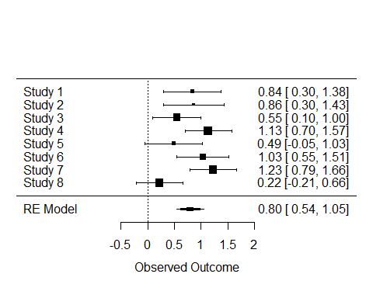
Our baseline model from last time

Slide 48
Hello heterogeneity, my old friend
Bad, normal, omnipresent
Inconsistency across ES estimates between studies
Might (probably) have something to with things like dose, dose number, duration of treatment, other sources of variation (like block effects), and sampling error

Slide 49
Hello heterogeneity, my old friend
Conceptually we partition the sources of variation into:
Within study error (plain old sampling error, because of random variation in samples between studies)
Between study variation (real ES differences between sampled populations)

Slide 50
Hello heterogeneity, my old friend
Statisticians LOVE variation, and thus there are absolutely loads of ways to measure it
$I^{2}$ == Index of heterogeneity

Slide 51
Hello heterogeneity, my old friend
$I^{2}$
Interpreted as the % variation in the grand ES that is due to variation between studies (i.e., the higher this is, the lower in comparability your studies are)

Slide 52
Hello heterogeneity, my old friend
confint(m0)
## ## estimate ci.lb ci.ub ## tau^2 0.0756 0.0007 0.4447 ## tau 0.2750 0.0262 0.6669 ## I^2(%) 56.1370 1.1519 88.2694 ## H^2 2.2798 1.0117 8.5247
56% is a moderate amount of uncertainty between studies (but the confidence interval is huge!)

Slide 53
Further analysis
ES heterogeneity can sometimes be explained by moderator variables
This should be designed consciously (rather than “fishing for p-values”)
An example might be a dose effect or similar that impacts the magnitude of expected ES

Slide 54
Further analysis
## id es var dose stress ## 1 204 0.840 0.07487469 10 high ## 2 493 0.865 0.08238613 11 high ## 3 506 0.550 0.05250000 9 low ## 4 509 1.135 0.04870185 11 high ## 5 359 0.490 0.07500000 8 high ## 6 661 1.030 0.06000000 10 high

Slide 55
Further analysis
## ## Model Results: ## ## estimate se z ci.l ci.u p ## intrcpt -0.681 0.413 -1.646 -1.491 0.130 0.1 ## mods 0.147 0.040 3.661 0.068 0.226 0.0 ## ## Heterogeneity & Fit: ## ## QE QE.df QEp QM QM.df QMp ## [1,] 2.822 6.000 0.831 13.406 1.000 0

Slide 56
Diagnostics
Model assumptions
Heteroscedasticity (== variance of resid across fitted vals)
Residual variance Gaussian or otherwise specified
“conventionally subjective”
plot(model) # automatic diagnostics

Slide 57
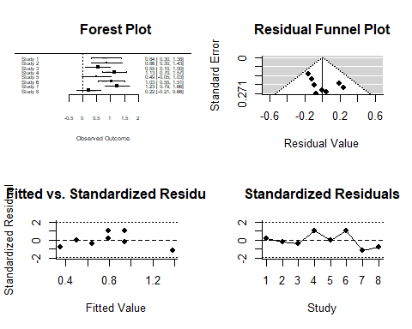
Diagnostics

Slide 58
What we did last time
meta-analysis

Slide 59
citations
Lewis, S., & Clarke, M. (2001). Forest plots: Trying to see the wood and the trees. British Medical Journal, 322, 1479–1480.
Viechtbauer, W. (2010). Conducting meta-analyses in R with the metafor package. Journal of Statistical Software, 36(3), 1–48.

