Slide 1
Structural Equation Modeling (SEM) Part 1 Why, what and how?
HARUG!
2021-04-28

Slide 4
Openness
Prejudice
Agreeableness
Research Questions
To what extent do agreeableness and openness explain variation in prejudice?
Do they explain variation to the same extent?

Slide 5
Structural Equation Modeling (SEM)—Why?
Definition
“Structural equation modeling can be defined as a class of methodologies that seeks to represent hypotheses about the means, variances, and covariances of observed data in terms of a smaller number of ‘structural’ parameters defined by a hypothesized underlying conceptual or theoretical model.”
(Kaplan, 2001, p. 15215)
SEM is a multivariate statistical modelling technique.
We hypothesize a model, which may or may not fit the data.
(Kline, 2016)

Slide 6
Structural Equation Modeling (SEM)—Why?
What is so special about SEM?
SEM can contain latent (unobserved) variables to represent constructs (i.e., measurement models) → Include random effects and control measurement error
SEM can estimate derived effects, such as indirect effects in mediation models.
SEM can be represented by path diagrams.
SEM offers a broad range of models, including multi-group models, multilevel models, growth curve models, …
SEM can handle full and summary data (i.e., covariance matrix and mean vector).
(Rosseel, 2020; Kline, 2016)

Slide 7
Structural Equation Modeling (SEM)—What?
SEM is not one statistical ‘technique’
It integrates a number of different multivariate techniques into one model fitting framework

Slide 8
Structural Equation Modeling (SEM)—What?
It is an integration of:
Measurement theory
Factor (latent variable) analysis
Path analysis
Regression
Simultaneous equations

Slide 9
Structural Equation Modeling (SEM)—What?
Covariance Structure Analysis
Analysis of Moment Structures (AMoS)
Analysis of Linear Structural Relationships (LISREL)
Causal Modeling

Slide 10
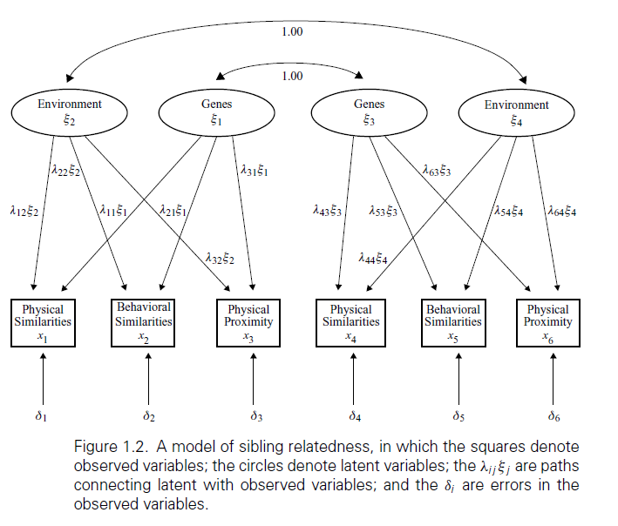
Structural Equation Modeling (SEM)—What?
(Hershberger, 1998)

Slide 11
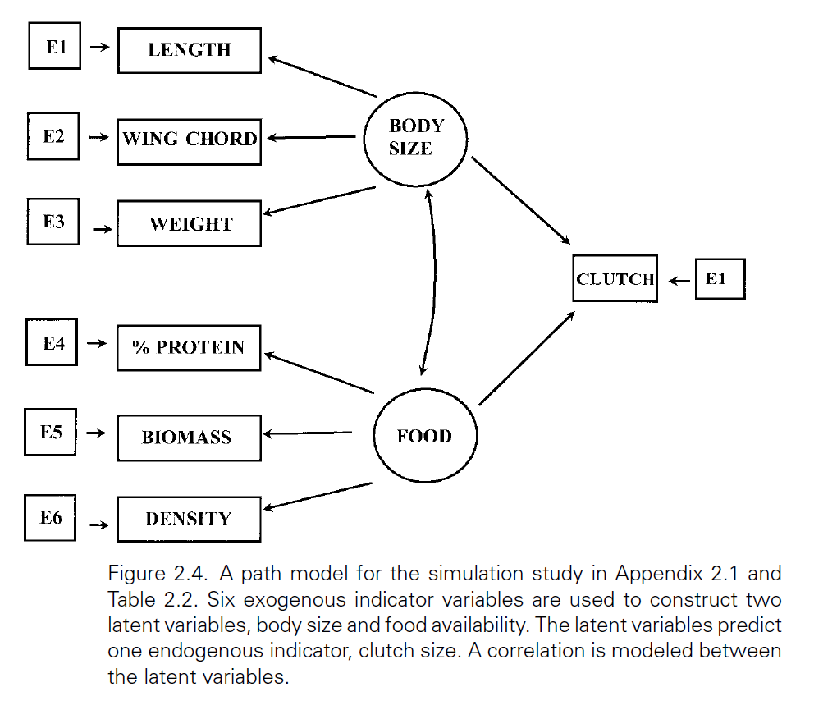
Structural Equation Modeling (SEM)—What?
(Pugesek, 1998)

Slide 12
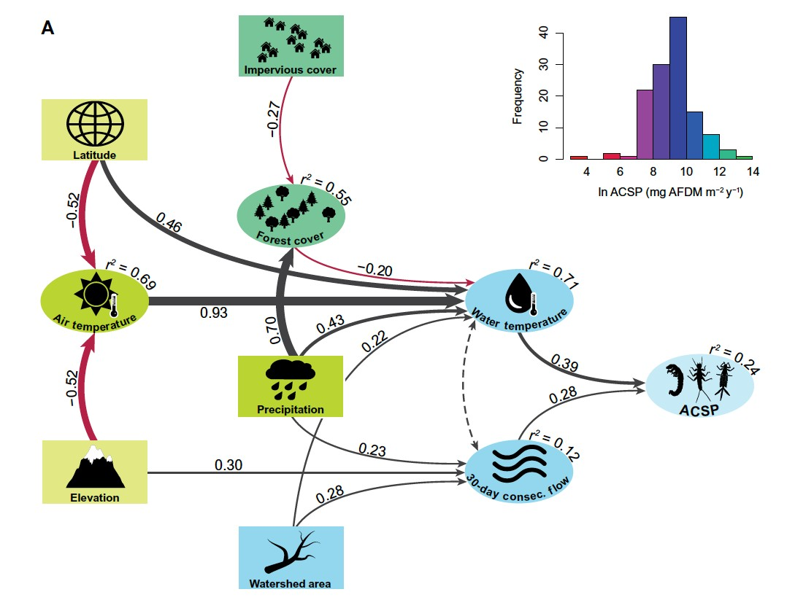
Structural Equation Modeling (SEM)—What?

Slide 13
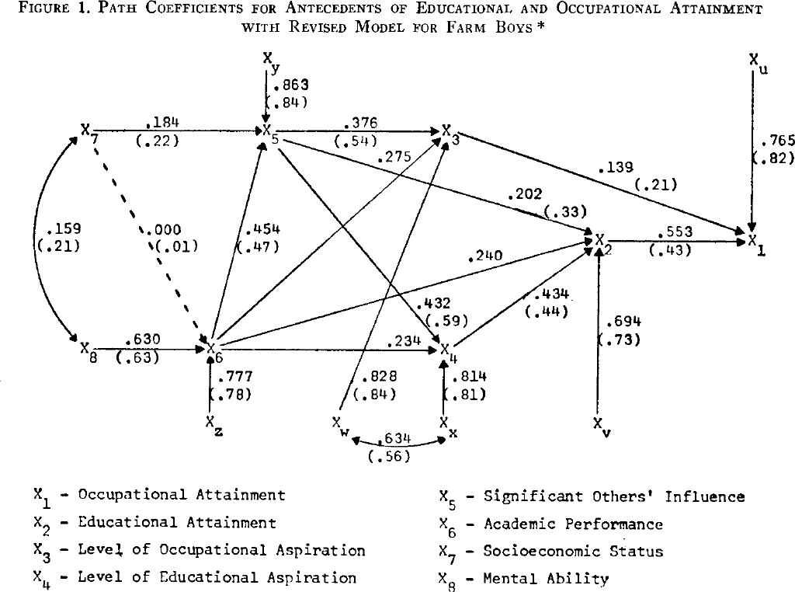
Structural Equation Modeling (SEM)—What?
Relations between attainment, aspiration, socioeconomic status, mental ability, and academic performance

Slide 14
Suggestions to read
Byrne 2016 ch 01
Pugesek et al. 1998 Ch 01 & 02
Byrne, B.M., 2016. Structural Equation Modeling With AMOS: Basic Concepts, Applications, and Programming, Third Edition, 3rd edition. ed. Routledge, New York.
Pugesek, B.H., et al., 1998. Structural Equation Modeling: Applications in Ecological and Evolutionary Biology. Cambridge University Press.

