Slide 1
Structural Equation Modeling (SEM) Part 1 Why, what and how?
HARUG!
2021-04-28

Slide 4
Openness
Prejudice
Agreeableness
Research Questions
To what extent do agreeableness and openness explain variation in prejudice?
Do they explain variation to the same extent?

Slide 5
Structural Equation Modeling (SEM)—Why?
Definition
“Structural equation modeling can be defined as a class of methodologies that seeks to represent hypotheses about the means, variances, and covariances of observed data in terms of a smaller number of ‘structural’ parameters defined by a hypothesized underlying conceptual or theoretical model.”
(Kaplan, 2001, p. 15215)
SEM is a multivariate statistical modelling technique.
We hypothesize a model, which may or may not fit the data.
(Kline, 2016)

Slide 6
Structural Equation Modeling (SEM)—Why?
What is so special about SEM?
SEM can contain latent (unobserved) variables to represent constructs (i.e., measurement models) → Include random effects and control measurement error
SEM can estimate derived effects, such as indirect effects in mediation models.
SEM can be represented by path diagrams.
SEM offers a broad range of models, including multi-group models, multilevel models, growth curve models, …
SEM can handle full and summary data (i.e., covariance matrix and mean vector).
(Rosseel, 2020; Kline, 2016)

Slide 7
Structural Equation Modeling (SEM)—What?
SEM is not one statistical ‘technique’
It integrates a number of different multivariate techniques into one model fitting framework

Slide 8
Structural Equation Modeling (SEM)—What?
It is an integration of:
Measurement theory
Factor (latent variable) analysis
Path analysis
Regression
Simultaneous equations

Slide 9
Structural Equation Modeling (SEM)—What?
Covariance Structure Analysis
Analysis of Moment Structures (AMoS)
Analysis of Linear Structural Relationships (LISREL)
Causal Modeling

Slide 10
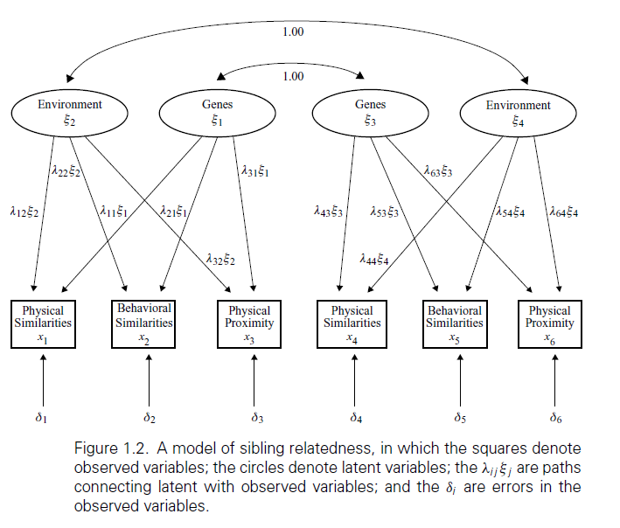
Structural Equation Modeling (SEM)—What?
(Hershberger, 1998)

Slide 11
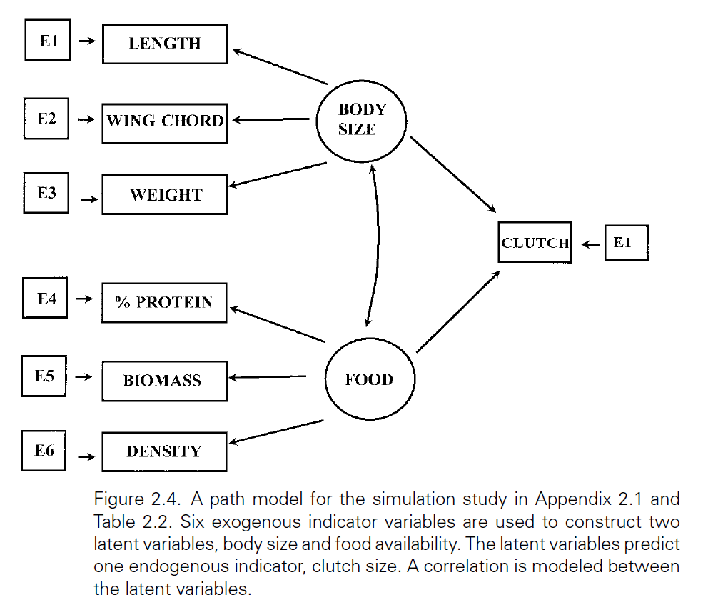
Structural Equation Modeling (SEM)—What?
(Pugesek, 1998)

Slide 12
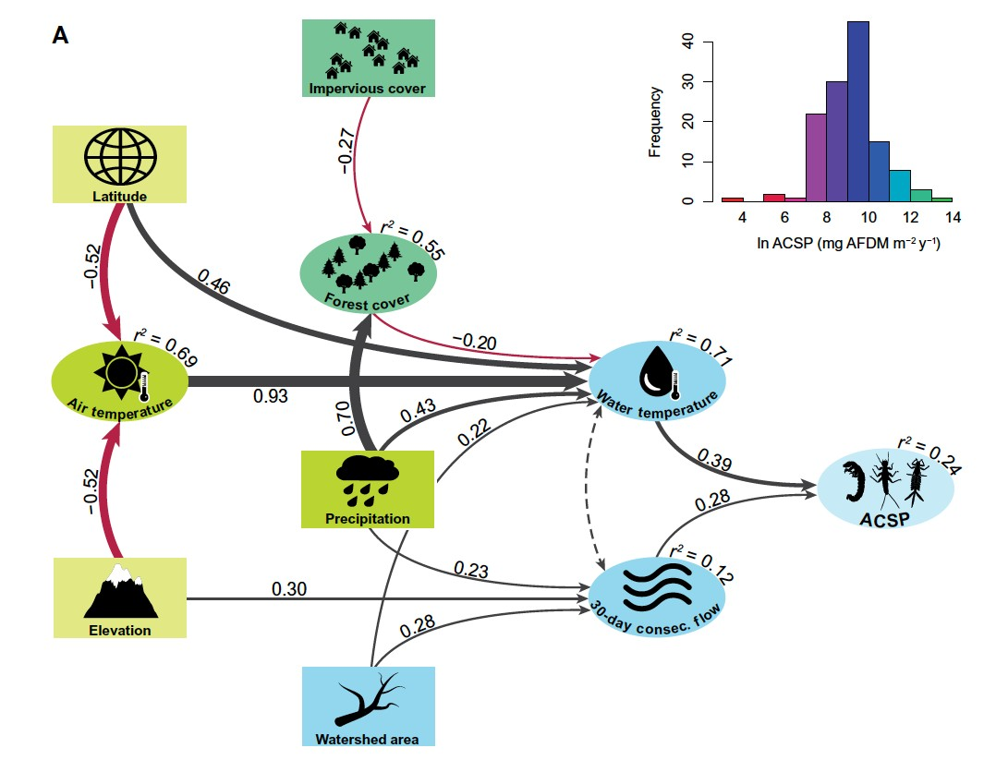
Structural Equation Modeling (SEM)—What?

Slide 13
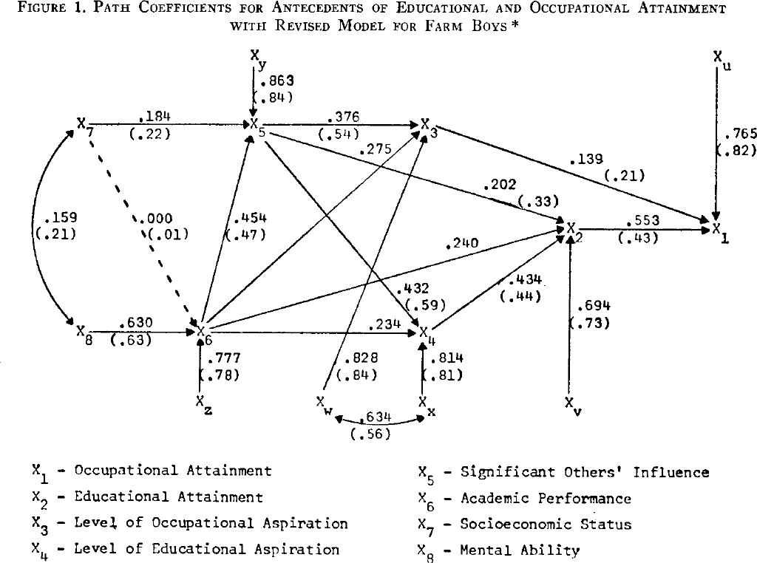
Structural Equation Modeling (SEM)—What?
Relations between attainment, aspiration, socioeconomic status, mental ability, and academic performance

Slide 14
Suggestions to read
Byrne 2016 ch 01
Pugesek et al. 1998 Ch 01 & 02
Byrne, B.M., 2016. Structural Equation Modeling With AMOS: Basic Concepts, Applications, and Programming, Third Edition, 3rd edition. ed. Routledge, New York.
Pugesek, B.H., et al., 1998. Structural Equation Modeling: Applications in Ecological and Evolutionary Biology. Cambridge University Press.

Slide 15
What we did last time
- General "idea" of SEM, concept of latent variables
- Statistical approach and terminology
- Research examples and visualization, path diagrams
- Beginning R implementation
- Key literature

Slide 16
What we will do this time
- Expand the SEM concept
- More detailed implementation of SEM models in {lavaan} package in R
- hypothesis testing framework
- Discussion, slides, coding
Let's remember to be a little skeptical...

Slide 17
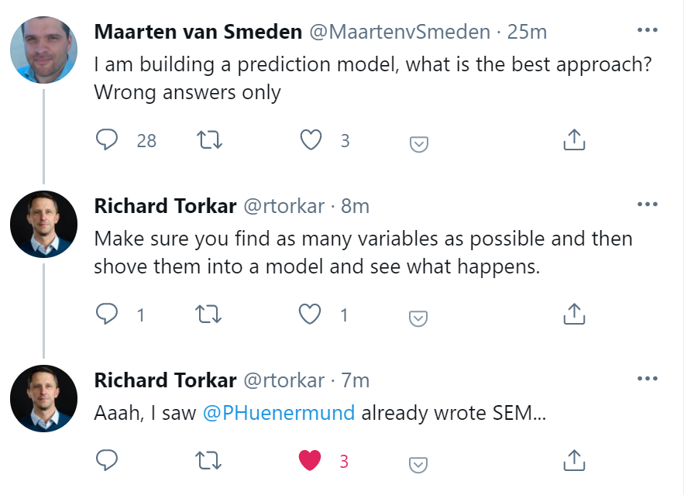
Meanwhile, on Statistician Twitter

Slide 18
Openness
Recall the questions
Prejudice
Agreeableness
Research Questions
To what extent do agreeableness and openness explain variation in prejudice?
Do they explain variation to the same extent?

Slide 19
Structural Equation Modeling (SEM)—How?

Slide 20
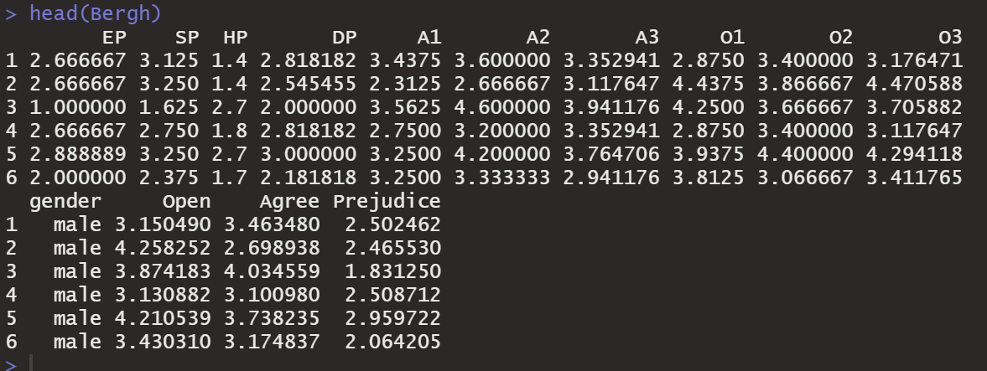
Structural Equation Modeling (SEM)—How?

Slide 21
Structural Equation Modeling (SEM)—How?

Slide 22
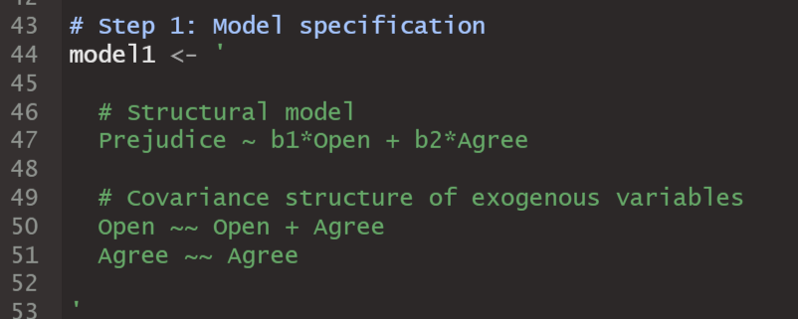
Structural Equation Modeling (SEM)—How?

Slide 23
Structural Equation Modeling (SEM)—How?
(Hoyle, 2012)
The “Grammar” of a model: Translate the hypotheses/theories into testable models.
Specification equations
Structural and measurement part
Define regressions, (co-)variances, latent variables, …
Hypotheses and Theories
1. Model Specification
2. Model Identification
3. Model Estimation
4. Model Evaluation
Lavaan:
Regression: Y ~ X
Covariance: Y ~~ X
Latent variable: eta =~ x1+x2+x3

Slide 24
Structural Equation Modeling (SEM)—How?
(Hoyle, 2012)
The “Feasibility Check” of a model:
Do we have enough information to estimate all model parameters?
Observed information (from the data): variances, covariances, means
Model parameters: variances, covariances, regression coefficients, intercepts, …
Hypotheses and Theories
1. Model Specification
2. Model Identification
3. Model Estimation
4. Model Evaluation
Rule:
Have at least the same amount of observed
information than model parameters → degrees of freedom of the model ≥ 0

Slide 25
Structural Equation Modeling (SEM)—How?
(Hoyle, 2012)
Hypotheses and Theories
Estimating model parameters: Reduce the discrepancy between the observed covariance matrix (𝑆) and the
covariance matrix implied by the model (Σ).
1. Model Specification
2. Model Identification
3. Model Estimation
4. Model Evaluation
Maximum likelihood estimation (ML)
Weighted least squares (WLS)
Bayesian estimation

Slide 26
Structural Equation Modeling (SEM)—How?
(Hoyle, 2012)
Hypotheses and Theories
Evaluate the model fit:
Well-fitting models show a small discrepancy between the observed covariance matrix (𝑆) and the covariance matrix implied by the model (Σ).
Global fit
Chi-square statistic χ%
Comparative Fit Index (CFI)
Root Mean Square Error of Approximation (RMSEA)
Standardized Root Mean Square Residual (SRMR)
“Rules”: χ% ns, CFI≥.95, RMSEA≤.08, SRMR≤.08
1. Model Specification
2. Model Identification
3. Model Estimation
4. Model Evaluation

Slide 27
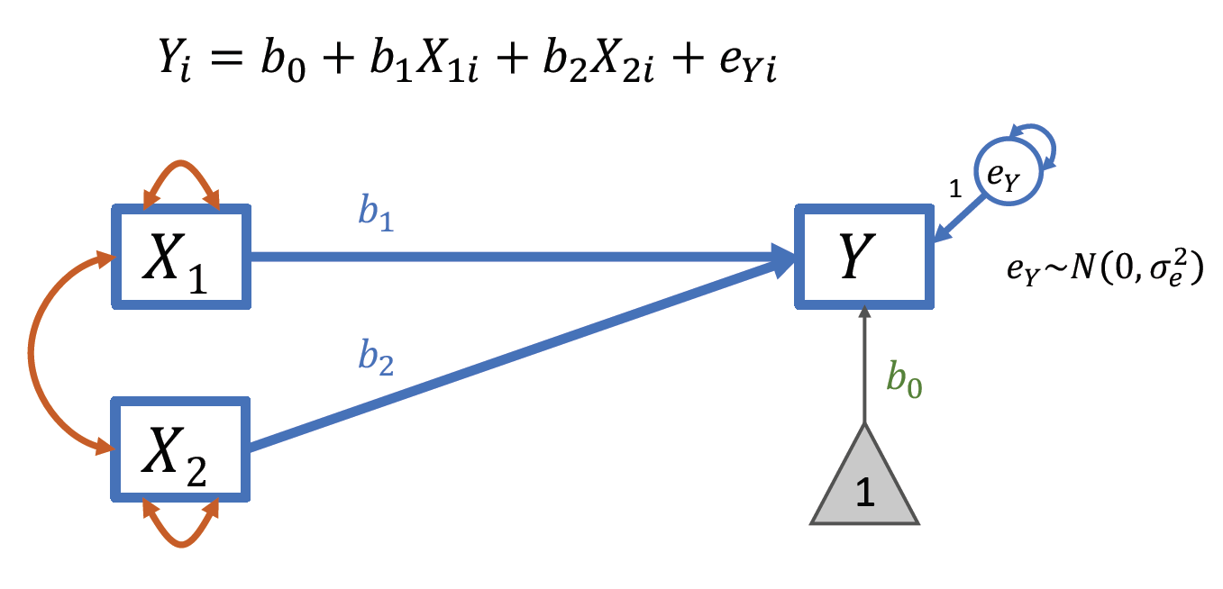
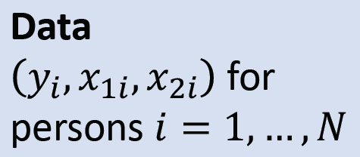
Model 1
Simple linear regression model with two predictors
𝑌 Prejudice
𝑋₁ Openness to experience (sum score)
𝑋₂ Agreeableness (sum score)
(Bergh et al., 2016; Mair, 2018)

Slide 28
Structural Equation Modeling (SEM)—How?

Slide 29
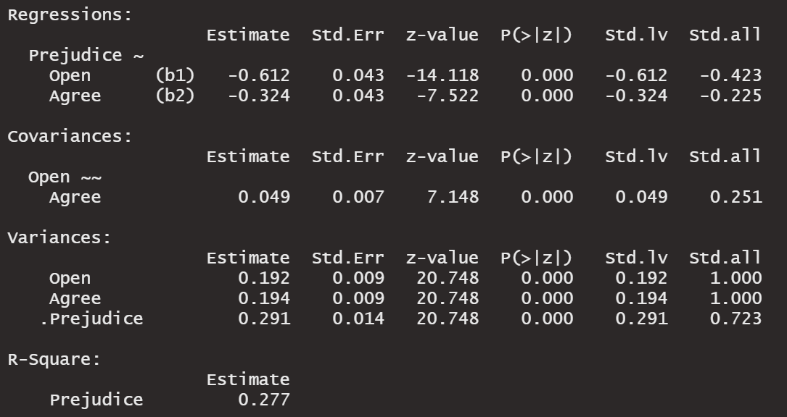
Structural Equation Modeling (SEM)—How?

Slide 30
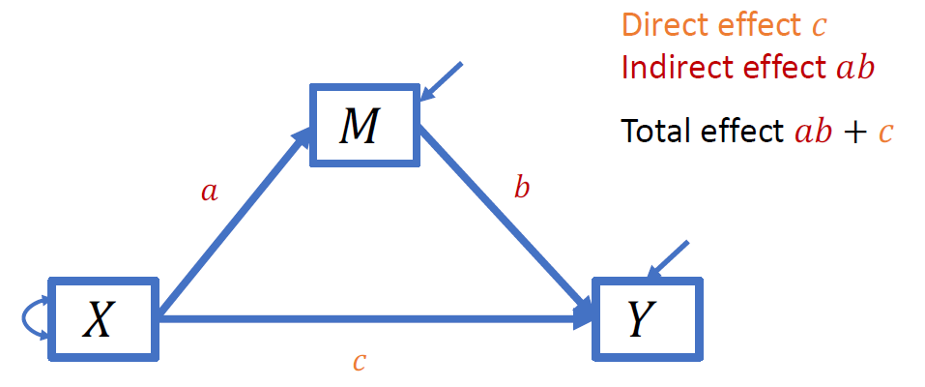
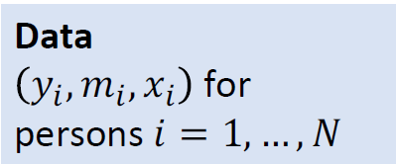
Model 2
"Mediation model" with direct and indirect effects
𝑌 Prejudice
𝑀 Openness to experience (sum score)
𝑋 Agreeableness (sum score)

Slide 31
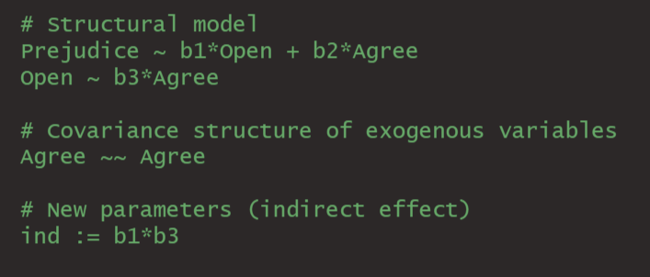
Structural Equation Modeling (SEM)—How?

Slide 32
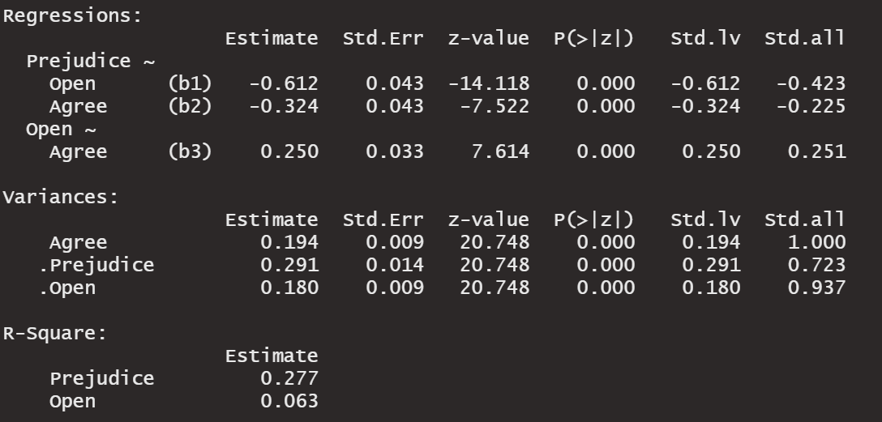
Structural Equation Modeling (SEM)—How?

Slide 33
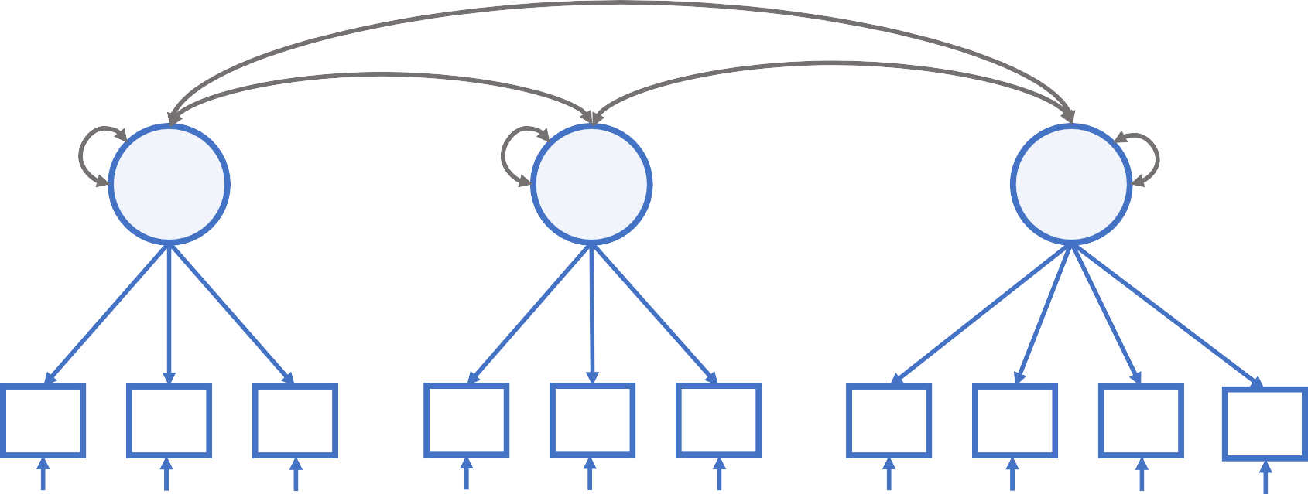
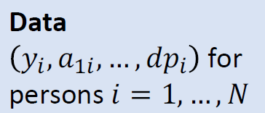
Model 3: Measurement Model
Confirmatory factor analysis with three latent (unobserved) variables
Represent constructs as latent variables and separate the “true score” and measurement error.
𝐴𝐺
𝑂𝑃
𝑃𝑅
1
1
1
𝐴₁
𝐴₂
𝐴₃
𝑂₁
𝑂₂
𝑂₃
𝐸𝑃
𝑆𝑃
𝐻𝑃
𝐷𝑃
(Bergh et al., 2016; Mair, 2018)

Slide 34
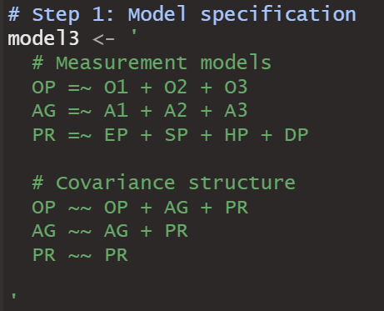
Structural Equation Modeling (SEM)—How?

Slide 35
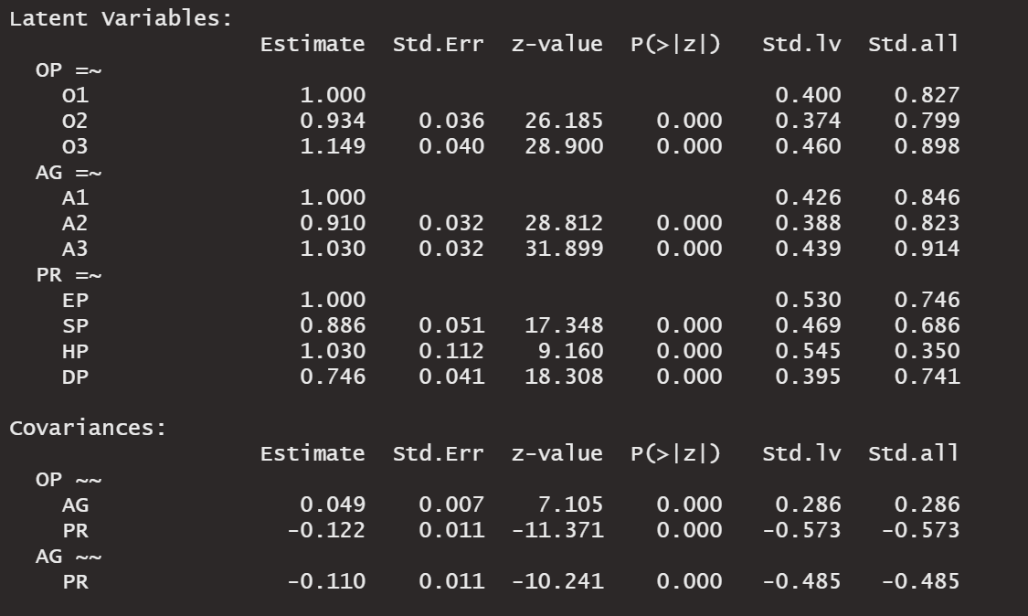
Structural Equation Modeling (SEM)—How?

Slide 36
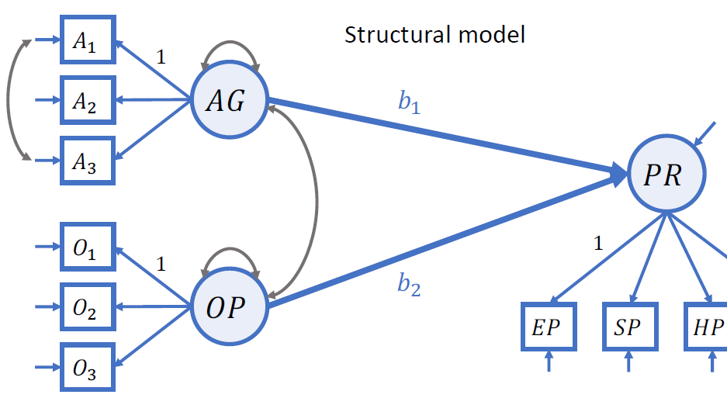
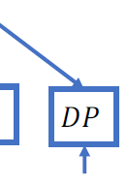
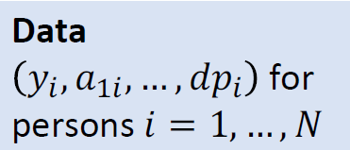
Model 4: Structural Equation Model
Structural equation model with directional paths
Note
This model has a structural and a measurement part.

Slide 37
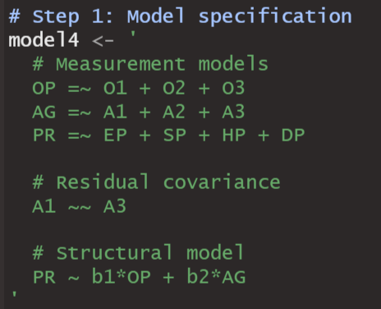
Structural Equation Modeling (SEM)—How?

Slide 38
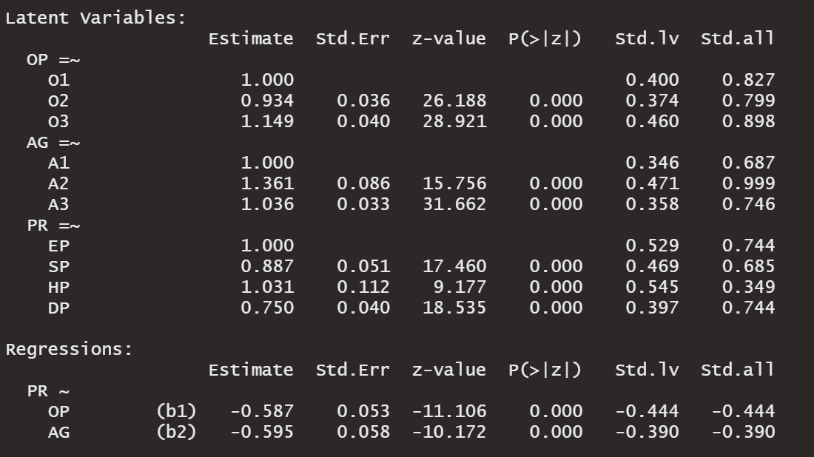
Structural Equation Modeling (SEM)—How?

Slide 39
Structural Equation Modeling—What if?
(Rosseel, 2020)
Data are not normally distributed.
Asymptotically distribution-free estimation
ML estimation with robust standard errors and/or test statistics
Bootstrapping
Lavaan:
estimator=“WLS”, “WLSMV”,…; blavaan
estimator=“MLM”, “MLR”; se=“robust”; test=“Satorra-Bentler”
se=“bootstrap”; test=“bootstrap”
Data are missing.
Full-information-maximum-likelihood
Two-stage approach (step 1: mean vector and covariance matrix, step 2: SEM)
Multiple imputation
Lavaan:
missing=“FIML”
missing=“two.stage”
Use mice to create multiply imputed datasets and
runMI() in semTools
Data are dependent (hierarchical).
Multilevel SEM
Lavaan:
cluster=“…” + level-specific model specification
lavaan.survey

Slide 40
References
Hoyle, R. H. (2012). Introduction and overview. In R. H. Hoyle (Ed.), Handbook of structural equation modeling (pp. 3-16). New York, NY: The Guilford Press.
Jöreskog, K., Olsson, K. G., Wallentin, F. T. (2016). Multivariate Analysis with LISREL. Cham: Springer International Publishing. DOI:10.1007/978-3-319- 33153-9
Kaplan, D. (2001). Structural equation modeling. In N. J. Smelser & P. B. Baltes (Eds.), International encyclopedia of the social & behavioral sciences (Vol. 11, pp. 15215-15222). Amsterdam: Elsevier
Kline, R. B. (2016). Principles and practice of structural equation modeling (4 ed.). New York, London: Guilford Press.
Mair, P. (2018). Modern Psychometrics with R. Cham: Springer International Publishing. DOI: 10.1007/978-3-319-93177-7
Rosseel, Y. (2020, January). Structural equation modeling with lavaan. Geneva: CISA.

