Slide 1
Tidy data and setting up a script 2 examples
HARUG!
2021-06-15

Slide 2
***** R and github for personal website
**** More content for those new to R
**** Group meetings for the R Bootcamp or basic stats
*** Work through a textbook (like a time series book, multivar. Stats, etc.)
*** Guest speakers (good idea, but need to arrange)
*** Reading and critiquing analyses in papers
** Make your own R package
** Showcasing specific R packages (what packages?) {metafor} {imager} {pracma}
** General reproducible R scipt session ii
* Open meetings to bring your stats problems
* More meetings led by students to show your own analyses?
* More advanced topics (multivatiate statistics, power analysis, extracting effect size, ggplot2)
Maybe a separate Python coding club?
((** More coding / machine learning / Python))
((*** Kaggle competion entry team))

Slide 3
Today
setting up your data in a "tidy" format
starting a reproducible script
2 "real life" examples

Slide 4
setting up your data in a "tidy" format
Is there a single best practice way to set up your data?

Slide 5
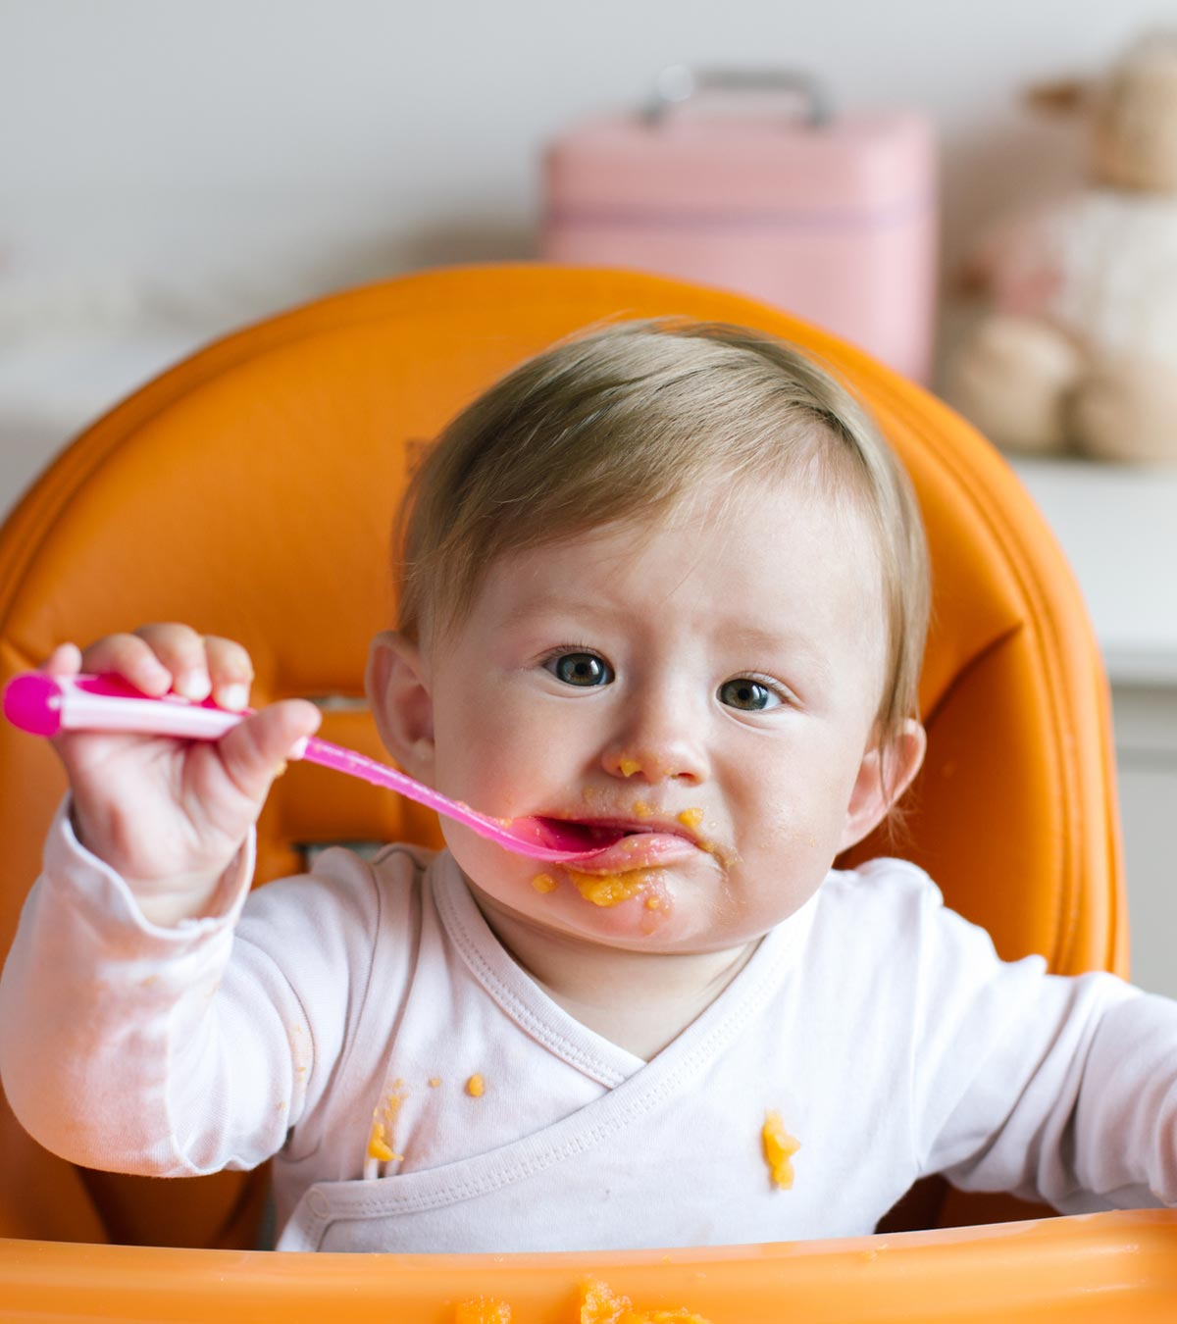
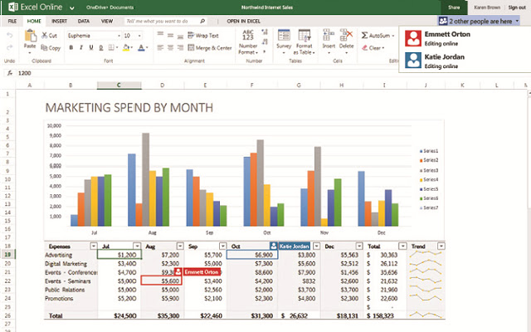
setting up your data in a "tidy" format
(A little disgusting, but oh bless! Move past this as a goal.)
=

Slide 6
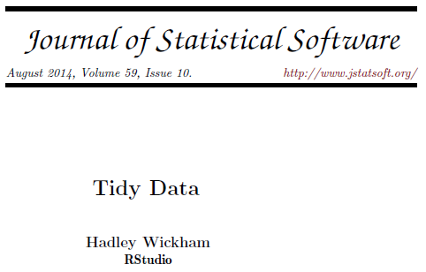
setting up your data in a "tidy" format
(Good manners and fun with friends. Aspire to this as a goal.)
=

Slide 7
setting up your data in a "tidy" format
Tidy ideals
- one case per row
- one column per variable
- short, clear variable names
- define variables in a data dictionary
- just the data thanks
Untidy
- visual formatting
- complicated variable names, symbols, spaces
- embedded fiff faff like graphs or summaries
- redundant tabs or files, excessive versions
- unnecessary spaces

Slide 8
starting a reproducible script
Is there a single best practice way to document your analysis?

Slide 9
starting a reproducible script
Borer, E.T., Seabloom, E.W., Jones, M.B., Schildhauer, M., 2009. Some Simple Guidelines for Effective Data Management. The Bulletin of the Ecological Society of America 90, 205–214. https://doi.org/10.1890/0012-9623-90.2.205
Highlights
For example: R (There are other options like Python & some commercial ones).
Menu-based programs leave no record of the analyses you carried out. You will forget. Menus change.
Script files (commands) become the written record of your analyses.
Surround commands in script files with detailed comments on your choices and actions.

Slide 10
2 "real life" examples
example 1: aphid counts in an orchard, with a spatial component
example 2: an experiment on onions with:
1 treatment + control,
a number of accession groups (each group full-sibs, between groups are half-sibs)
replications of experiment at 3 different time points

